Slide 1
An Investigation of Scales for Consumer Innovativeness* V. 3. 4. 1
2011 33rd INFORMS Marketing Science Conference, Rice University, Houston, TX
June 9-11, 2011.
TC05: Legends Ballroom VI
Cluster : Contributed, Session Information: Thursday Jun 09, 13:30 - 15:00 ,
Title: New Product III: Adoption
Masataka Yamada
Nagoya University of Commerce and Business,4-4 Sagamine, Komenoki-cho, Nissin-shi, Aichi-ken 470-0193, Japan, myamada@nucba.ac.jp
Toshihiko Nagaoka
Team Leader, Nippon Boehringer Ingelheim/Sales Marketing Osaka, 1-1-5, Shinsenri Higasimati, Toyanaka 560-0082, Japan, nagaoka@kaw.boehringer-ingelheim.com
* A part of this study has been supported by Scientific Research (C)
# 23530550 of the Grant-in-Aid for Scientific Research, JSPS
Notes:
1

Slide 2
If I am not better, at least I am different. Jean‐Jacques Rousseau (June 28, 1712 – July 2, 1778)

Slide 3
Problems in Diffusion Theory
With regard to adopter categorization in innovation diffusion theory, there are two major approaches :
(1) Rogers scheme where adopters are classified by their time of adoption assuming a normal distribution, along with diffusion time axis, into five categories (Rogers 1962): innovator, early adopter, early majority, late majority, and laggard.
Although a statistical method to obtain the number of adopter
categories was proposed by Peterson (1973), Rogers scheme
has been generally well accepted by academics and practitioners.
2011/8/23
2011/8/23
2011/8/23
2011/8/23
2011/8/23
2011/8/23
(C) Yamada and Nagaoka
(C) Yamada and Nagaoka
(C) Yamada and Nagaoka
(C) Yamada and Nagaoka
(C) Yamada and Nagaoka
(C) Yamada and Nagaoka

Slide 4
Problems in Diffusion Theory
(2) Bass model and its extensions where adopters are categorized by their traits/behaviors such as innovators / influentials and imitators (Bass 1969; Van den Bulte and Joshi 2004).
It is well known that the innovator coefficient and imitator coefficient, p and q are only mathematical artifacts based on the analytical convenience (assumptions).
Notes:
The preceding analyses illustrate that we must be cautious about the normative policies derived from the diffusion-based dynamic optimization framework because the derived policies could be simply an artifact of the underlying assumptions made for analytical convenience. Despite this observation, the diffusion modeling framework has provided an excellent opportunity to develop a "theory" of life cycle analysis for empirical validation (Mahajan et al 1990, p. 17).

Slide 5
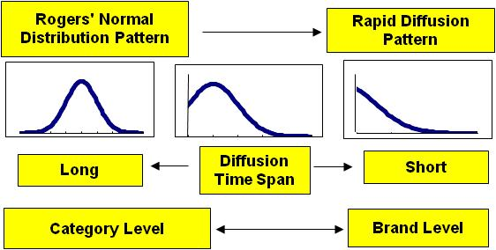
Problems in Diffusion Theory
Recently, however, various non-normal distribution patterns, yet economically important, specifically, rapid diffusion patterns have been found in the diffusions of contents businesses such as music, movies, game software, etc. (Yamada et al 2001; Moe and Fader, 2002).
2011/8/23
2011/8/23
2011/8/23
2011/8/23
2011/8/23
2011/8/23
(C) Yamada and Nagaoka
(C) Yamada and Nagaoka
(C) Yamada and Nagaoka
(C) Yamada and Nagaoka
(C) Yamada and Nagaoka
(C) Yamada and Nagaoka

Slide 6
Problems in Diffusion Theory
As a result, we lost a reasonable basis for adopter categorization of innovation, namely the normal distribution of adoption times.
Therefore, it is time to revisit the concept of consumer innovativeness itself so that we can better understand consumer innovativeness conceptually and behaviorally.
Then, we should also reconsider the framework of innovation diffusion research accordingly.
2011/8/23
2011/8/23
2011/8/23
2011/8/23
2011/8/23
2011/8/23
(C) Yamada and Nagaoka
(C) Yamada and Nagaoka
(C) Yamada and Nagaoka
(C) Yamada and Nagaoka
(C) Yamada and Nagaoka
(C) Yamada and Nagaoka

Slide 7
Contributions from Managerial Point of View
This study may look like a consumer behavior study or a psychological study. But actually this is not.
This study contributes managerially to marketing on the following two points:
This proposes a new adopter categorization scheme based on innovativeness scores instead of adoption times.
2. This finds a way to improve predictability of innovation adoption time and adopter categorization based on scale for an intermediate construct between theoretical construct and disposition concept.

Slide 8
Order of Presentation
1. Objectives
2. Critical Review of Literature
3. Rogers’ definition is a tautology
4. Carnap’s Framework for Construct
5. Reconstruction of Research Framework
6. Summary and Conclusions
2011/8/23
2011/8/23
2011/8/23
2011/8/23
2011/8/23
2011/8/23
(C) Yamada and Nagaoka
(C) Yamada and Nagaoka
(C) Yamada and Nagaoka
(C) Yamada and Nagaoka
(C) Yamada and Nagaoka
(C) Yamada and Nagaoka

Slide 9
1. Objectives
(1) Clarify the construct of innovativeness.
(2) Find a theoretical basis for designing scale for
better prediction of innovative behavior.
(3) Reconstruct the research framework of adoption
and diffusion process of innovation
2011/8/23
2011/8/23
2011/8/23
2011/8/23
2011/8/23
2011/8/23
(C) Yamada and Nagaoka
(C) Yamada and Nagaoka
(C) Yamada and Nagaoka
(C) Yamada and Nagaoka
(C) Yamada and Nagaoka
(C) Yamada and Nagaoka
9
9
9
9
9
9

Slide 10
2. Critical Review of Literature
We only review the studies directly related to our current study for this presentation:
Rogers (2003)
Midgley and Dowling (1978),
Goldsmith and Hofacker (1991),
Im et al (2003),
Im, Mason, and Houston (2007)
Reohrich (2004),
Hoffmann and Soyez (2010),
Bartels and Reinders (2010).
Later in section 5, we will touch upon personality
psychology studies also.
2011/8/23
2011/8/23
2011/8/23
2011/8/23
2011/8/23
(C) Yamada and Nagaoka
(C) Yamada and Nagaoka
(C) Yamada and Nagaoka
(C) Yamada and Nagaoka
(C) Yamada and Nagaoka

Slide 11
2. Critical Review of Literature Rogers (2003)
Definition of Innovativeness: Innovativeness is the degree to which an individual or other unit of adoption is relatively earlier in adopting new ideas than other members of a social system (Rogers 2003, p. 37) .
Rogers adopted adoption time as scale of innovativeness instead of score of innovativeness test, because he considered them equivalent. Here is an evidence: Rogers (2003, pp. 272-274),
“Many human traits are normally distributed, whether the trait is a physical characteristic, such as weight or height, or a behavioral trait, such as intelligence or the learning of new information. Hence a variable such as the degree of innovativeness is also expected to be normally distributed. … .”
However, as we have discussed already, some of innovations diffuse non-normally.
Notes:
If a social system is substituted for the individual in the learning curve, it seems reasonable to expect that experience with the innovation is gained as each successive member in the social system adopts it. We expect a normal adopter distribution for an innovation because of the cumulatively increasing influences upon an individual to adopt or reject an innovation, resulting from the activation of peer networks about the innovation in a system (see Chapter 8).

Slide 12
2. Critical Review of Literature Midgley and Dowling (1978)
Definition of Innovativeness
They defined that innovativeness is a personality trait possessed, to a greater or lesser degree, by all members of a society.
Innovativeness is the degree to which an individual is receptive to new ideas and makes innovation decisions independently of the communicated experience of others.
2011/8/23
2011/8/23
2011/8/23
2011/8/23
2011/8/23
2011/8/23
(C) Yamada and Nagaoka
(C) Yamada and Nagaoka
(C) Yamada and Nagaoka
(C) Yamada and Nagaoka
(C) Yamada and Nagaoka
(C) Yamada and Nagaoka
12
12
Notes:
反証可能性（はんしょうかのうせい、Falsability）とは、検証されようとしている仮説が実験や観察によって反証される可能性があることを意味する。

Slide 13
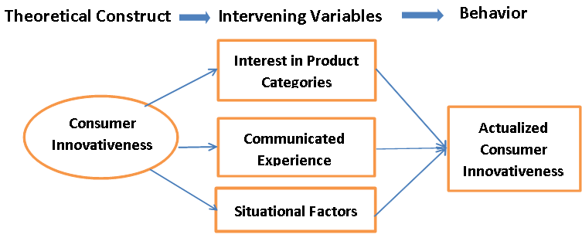
2. Critical Review of Literature: Midgley and Dowling (1978)
Contingency Model
They separated innovativeness into conceptual innovativeness and actualized innovativeness.
Time of adoption is some function of intervening variables: interest in product categories, communicated experience, and situational factors.

Slide 14
2. Critical Review of Literature: Midgley and Dowling (1978)
Measurement of Innovativeness
They investigated 23 studies. 49 percent of them used relative time of adoption, 23 percent of them used ownership of new products or cross-sectional method and the rests used purchase intentions as a measure of innovativeness.
The problem we can see is that they did not cover the problem of non-normal distributions of adoption times because an innovation with a non-normal distribution was considered as a failure at that time.
Even though they did admit that the Rogers’ definition of innovativeness is a tautology, they were bounded by the relative time of adoption methodology.

Slide 15
2. Critical Review of Literature: Midgley and Dowling (1978) Measurement of Innovativeness
Since relative time of adoption and ownership of new products are just time and number, we do not think that such measured numbers can give us some meaningful thing of innovativeness.

Slide 16
2. Critical Review of Literature: Midgley and Dowling (1978)
Another problem is that they categorized consumer innovativeness by its level of abstraction as in the following table. But we believe that their categorization is actually based on the scope of consumer innovativeness. Because some individual consumer may show his/her innovativeness on various product categories (wide), or a product category or a single product (narrow).
Level of Abstraction | Consumer Innovativeness
High | Generalized Trait Innovativeness
Medium | Domain (Product category)-specific Innovativeness
Low | Single Product-specific Innovativeness
Scope
Wide
Narrow

Slide 17
2. Critical Review of Literature: Goldsmith and Hofacker (1991)
Goldsmith and Hofacker aimed at product category-specific innovativeness because they know the inability of predicting behavior by generalized trait innovativeness.
They developed a six-item, self-report scale to measure innovativeness within a specific domain of interest familiar to the consumer.
They found the correlations between the construct and behavior in Rock Music, Fashion, and Cologne.
2011/8/23
2011/8/23
2011/8/23
2011/8/23
2011/8/23
2011/8/23
(C) Yamada and Nagaoka
(C) Yamada and Nagaoka
(C) Yamada and Nagaoka
(C) Yamada and Nagaoka
(C) Yamada and Nagaoka
(C) Yamada and Nagaoka

Slide 18
2. Critical Review of Literature: Goldsmith and Hofacker’s six-item, self-report scale
Negative-direction
Q1: I am the least interested in @@@ among my friends.
Q2: Usually I am the last person who becomes aware of recent @@@ .
Q3: When a new @@@ appeared, often times, I was the last person who
bought the new model among my friends.
Positive-direction
Q4: If I were allowed to buy a new @@@ , then I would buy it immediately.
Q5: I am a kind of a person who buy a new @@@ without testing it by
myself.
Q6: I know the launching date of a new @@@ before other people know it.
@@@ can be Cell phone, PC, etc.
2011/8/23
2011/8/23
2011/8/23
2011/8/23
2011/8/23
2011/8/23
(C) Yamada and Nagaoka
(C) Yamada and Nagaoka
(C) Yamada and Nagaoka
(C) Yamada and Nagaoka
(C) Yamada and Nagaoka
(C) Yamada and Nagaoka

Slide 19
2. Critical Review of Literature: Goldsmith and Hofacker (1991)
For all questions, respondents must choose one of the following answers:
I strongly agree with the statement.
I rather agree with the statement.
I am indifference.
I rather disagree with the statement.
I strongly disagree with the statement.
This scale is aimed to be adaptable across product categories. This only six item yet reliable test is well accepted by other researchers and practitioners.
If you compare their scale to the I-O scale, then you will notice that while the items of former are close to the behavior, the ones of latter are abstract.
2011/8/23
2011/8/23
2011/8/23
2011/8/23
2011/8/23
2011/8/23
(C) Yamada and Nagaoka
(C) Yamada and Nagaoka
(C) Yamada and Nagaoka
(C) Yamada and Nagaoka
(C) Yamada and Nagaoka
(C) Yamada and Nagaoka

Slide 20
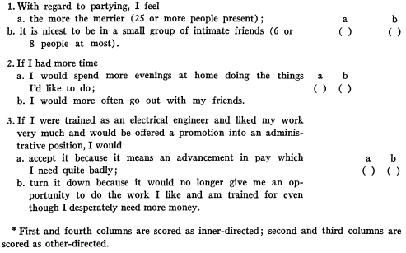
2. Critical Review of Literature:
W. M. Kassarjian’s I-O scale for Generalized Trait Innovativeness

Slide 21
2. Critical Review of Literature:
Im, Bayus and Mason (2003)
Im, Mason, and Houston (2007)
Reohrich (2004)
Hoffmann and Soyez (2010)
Bartels and Reinders (2010)
These studies adopted various approaches to predict innovative behavior and investigated the relative predictability between generalized innovativeness and domain-specific innovativeness.
Although each obtained satisfactory results, none of them investigated the theoretical basis for designing scale for better prediction of innovative behavior and innovation diffusion theory itself.
Notes:
Im, Bayus and Mason (2003)
This article explores the relationships between innate consumer
innovativeness, personal characteristics, and newproduct
adoption behavior. To do this, the authors analyze
cross-sectional data from a household panel using a structural
equation modeling approach. They also test for potential
moderating effects using a two-stage least square
estimation procedure. They find that the personal characteristics
of age and income are stronger predictors of newproduct
ownership in the consumer electronics category
than innate consumer innovativeness as a generalized personality
trait. The authors also find that personal characteristics
neither influence innate consumer innovativeness
nor moderate the relationship between innate consumer
innovativeness and new-product adoption behavior.
Im, Mason, and Houston (2007)
Empirical studies provide an inconsistent picture
of the relationship between an innovative personality
predisposition (i.e., innate consumer innovativeness [ICI])
and innovative behavior (i.e., new product adoption
behavior). Such inconsistencies suggest intervening variables
that may mediate the relationship have not been
considered. Using data from a panel of consumers (n=296
in a cross-sectional phase, n=147 in a matched, two-phase
longitudinal analysis), we find that ICI does not directly
influence adoption behavior but does so indirectly through
two of three components of vicarious innovativeness
(modeling and engagement in word of mouth but not
exposure to advertising). Furthermore, despite the evidence
that consumers’ decision processes differ for service versus
product adoption, extant studies largely ignore the role of
ICI in new service adoption. Our findings suggest that
vicarious innovativeness plays a similar intervening role in
service contexts. Finally, divergent operationalizations of
adoption behavior (ownership, relative time of adoption)
appear to perform equally well.
Reohrich (2004)
Consumer innovativeness, as a force that leads to innovative behavior, has often been cited and studied in research on the diffusion of
innovation. Surprisingly, it appears that there is still room for discussion about this concept. This article attempts to take stock of this issue. In
the first part, the different theoretical definitions of the notion are introduced critically. The second part is devoted to displaying major
measurement scales that have been designed with a view to measuring this construct. This review helps in understanding the diversity of
approaches to innovativeness. It raises two main questions: (1) Are the different theoretical conceptualizations of innovativeness equally valid
and compatible? (2) Do the scales really express each theoretical standpoint? This suggests that the present scales may be imperfect, and
construction of a new one may well be of interest.
Hoffmann and Soyez (2010)
Marketers who launch innovative products need to identify consumers who are willing to learn about, buy,
and use these innovations. To optimize marketing campaigns, practitioners need to know the characteristics
of this key segment in the diffusion process. Previous research, however, provides confounding results about
antecedents of innovativeness because of two limitations: (1) previous studies have conceptualized
innovativeness on different levels of abstraction (2) previous studies have not taken into account the
influence of the product category. The present paper suggests a conceptual framework to overcome these
shortcomings. Based on this framework, the paper suggests a theoretically founded cognitive model of
domain-specific innovativeness for a product category with a utilitarian benefit. This model is empirically
tested in the field of automotive interior. To this end, 521 German car drivers were surveyed. The results of
structural equation modeling show that domain-specific innovativeness for utilitarian products is mainly
influenced by specific need for cognition, special interest media usage and domain-specific opinion
leadership.
Bartels and Reinders (2010)
This article summarizes the results of a systematic review of the literature on consumer innovativeness and
its correlates and provides a propositional inventory for future research. The authors identified seventy-nine
relevant empirical articles from international journals through a search of multiple databases using specific
search terms, a manual search of marketing and consumer behavior journals and a cross-reference search.
The results show that innovativeness consists of different levels of conceptualization and operational
processes. Based on these different conceptualizations, the authors offer propositions for further empirical
exploration on consumer innovativeness.

Slide 22
2. Critical Review of Literature: Summary
(1) We find that the contingency model of Midgley and Dowling (1978) has been and will be a leading model in this field.
(2) Although Midgley and Dowling (1978) proposed three abstraction levels on consumer innovativeness, we consider that their abstraction should be changed to a scope of consumer innovativeness.
(3) Although we understand that the actualized innovativeness is a concept given to time of adoption or number of innovations adopted within a certain period, we do not think that one can claim some meaningful thing based on such simple thing as time or number.

Slide 23
2. Critical Review of Literature: Summary
(4) Hence Midgley and Dowling (1978) pointed out that Rogers’ adopter categorization is a tautology.
(5) It is generally admitted that use of domain-specific innovativeness is the most effective for predicting innovation adoption behavior among the three innovativeness constructs.
(6) No study covered the problem of non-normal distributions of adoption times.
Based on the above six points, we will reconstruct the
overall research framework of innovation adoption and
its diffusion process using Carnap’s framework of
construct.

Slide 24
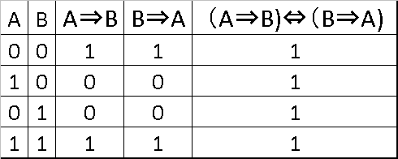
3. Rogers’ definition of innovativeness is a tautology
Midgley and Dowling (1978) pointed out that Rogers’ adopter categorization is a tautology: Innovativeness (A) is what we measure (B) and what we measure (B) is innovativeness (A). Here we analyze this in detail.
This is equivalent to saying that “An innovator (A) is a relatively earlier adopter (B)” is equal to “A relatively earlier adopter (B) is an innovator (A).”
A tautology does not explain the causes of innovativeness at all. It does not have a surplus meaning.
In addition, a tautology is always true and hence it is not equipped with falsability which is necessary for scientific reasoning (Popper 1959).
（A⇒B)⇔（B⇒A)
Truth Table
Notes:
Innovativeness is what we measure in terms of relative time of adoption and what we measure in terms of relative time of adoption is innovativeness. Also they found that domain-specific innovativeness is the most effective predictor among three innovativeness constructs except Im et al.

Slide 25
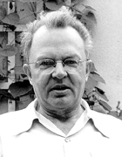
4. Carnap’s Framework for Construct
In psychology, behavioral patterns and regularities are described by construct. Construct can be classified into disposition concept and theoretical construct from logical syntax point of view (Carnap 1956, Watanabe 1995):
Disposition Concept
Construct
Just simple label for
observed behavior
Theoretical Construct
Label that contains thoughts concerning the causes of
observed behavior
(May 18, 1891 – September 14, 1970)
2011/8/23
2011/8/23
2011/8/23
2011/8/23
2011/8/23
(C) Yamada and Nagaoka
(C) Yamada and Nagaoka
(C) Yamada and Nagaoka
(C) Yamada and Nagaoka
(C) Yamada and Nagaoka

Slide 26
5. Reconstruction of Research Framework
We propose this to overcome the six points in the summary of critical review of literature.
(1) Definition of Innovativeness
We adopt Midgley and Dowling’s Definition for our proposal since it has been well accepted by researchers.
(2) Replacing ‘Actualized innovativeness’ to New Disposition Concepts
‘Actualized innovativeness’ of Midgley and Dowling (1978) should be considered as disposition concept which is just a label for convenience to describe observed behavioral pattern. The meaning of the construct is reduced to the observations completely.
In order to avoid confusion, we propose to use simply ‘# of new products adopted’ and ‘time of adoption’ as disposition concepts instead of ‘actualized innovativeness.’
2011/8/23
2011/8/23
2011/8/23
2011/8/23
2011/8/23
2011/8/23
(C) Yamada and Nagaoka
(C) Yamada and Nagaoka
(C) Yamada and Nagaoka
(C) Yamada and Nagaoka
(C) Yamada and Nagaoka
(C) Yamada and Nagaoka

Slide 27
5. Reconstruction of Research Framework
(3) Scope of Innovativeness
As we explained previously,
Abstraction → Scope of innovativeness
Level of Abstraction | Consumer Innovativeness
High | Generalized Trait Innovativeness
Medium | Domain (Product category)-specific Innovativeness
Low | Single Product-specific Innovativeness
Scope
Wide
Narrow
2011/8/23
2011/8/23
2011/8/23
2011/8/23
2011/8/23
2011/8/23
(C) Yamada and Nagaoka
(C) Yamada and Nagaoka
(C) Yamada and Nagaoka
(C) Yamada and Nagaoka
(C) Yamada and Nagaoka

Slide 28
5. Reconstruction of Research Framework
(4) Need an Intermediate Abstract Level of innovativeness (Construct) for Better Prediction of Behavior
Each construct has its own scale to measure itself.
Looking over the past studies, while the scale of theoretical construct consists of abstract items because of its width, the scale of disposition concept consists of items directly related to the innovation adoption behavior.
The effectiveness of the domain-specific innovativeness for predicting innovation adoption behavior can be attributed to the items not directly related to but close to the innovation adoption behavior and intervening variables.

Slide 29
5. Reconstruction of Research Framework
(4) Need an Intermediate Abstract Level of innovativeness (Construct) for
Better Prediction of Behavior (continued)
As we compared Goldsmith and Hofacker’s scale items and Kasserjan’s I-O scale or Kiuchi’s scale items (for all/multiple category innovativeness), the items of the former are close to adoption behavior and the items of the latter consist of indirect contents to adoption behavior.
Hence, with regard to the correlation between adoption behavior and the scale scores, domain-specific innovativeness scale is higher than all/multiple category innovativeness scale.

Slide 30
5. Reconstruction of Research Framework
Supporting evidences:
Hassinger(1959): argued that individuals will seldom expose themselves to messages about an innovation unless they first feel a need for the innovation.
Goldsmith and Hofacker(1991).
Goldsmith et al.(1995).
Reohrich (2004): Goldsmith and Hofacker’s scale is the most effective scale.
Hoffmann and Soyez (2010): they said that consumer innovativeness should be measured in a specific interest category (Gatignon and Robertson, 1985).
2011/8/23
2011/8/23
2011/8/23
2011/8/23
2011/8/23
(C) Yamada and Nagaoka
(C) Yamada and Nagaoka
(C) Yamada and Nagaoka
(C) Yamada and Nagaoka
(C) Yamada and Nagaoka
Notes:
Hassinger 1959 argued that individuals will seldom expose themselves to messages about an innovation unless they first feel a need for the innovation, and that even if such individuals are exposed to these innovation messages, such exposure will have little effect unless the innovation is perceived as relevant to the individuals needs and as consistent with the individuals attitudes and beliefs. — Simon & Schuster, “Diffusion of Innovations” http://www.wordnik.com/words/Hassinger
Hassinger (1959) argues that
even if an individual is exposed to an innovation, it will have little effect unless the innovation is perceived
to be relevant to the needs of that individual.

Slide 31
5. Reconstruction of Research Framework
Supporting evidences (continued):
From personality psychology: The person-situation debate has been hotly contested topic since the late 1960's.
Eysenck (1944) Temperment Mischel (1968) Personality Trait
Mischel (1968): emphasized the importance of situational factors since personality and behavior have less than 0.3 correlation.
Nisbett (1980) revised the personality-behavior correlation upwards to 0.4.
We think that Eysenck and Mischel are looking at the same thing from different angles (see The Cognitive-Affective Processing System, or CAPS (Mischel & Shoda 1995, Shoda & Mischel 1998)).
(born 1930)
Notes:
Nisbett, R. E. (1980). The trait construct in lay and professional psychology. In L. Festinger (Ed.), Retrospections on social psychology (pp. 109-130). New York: Oxford University Press.
Mischel 2004, p. 2 Theodore Newcomb (1929) Newcomb was shocked to find that the average correlation coefficient based on daily behavior records across the situations was about 0.14.
Mischel 2004, p. 3 (e.g., D. Fiske unpublished manuscript; Krahe 1990; Magnusson & Endler 1977; Mischel 1968, 1973; Mischel & Peake 1982; Moskowitz 1982, 1994; Nisbett & Ross 1980; Peterson 1968; Ross & Nisbett 1991; Vernon 1964).
http://shodalab.psych.washington.edu/home.htm

Slide 32
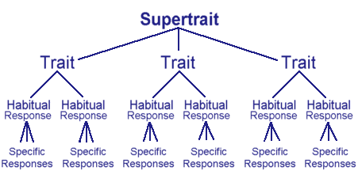
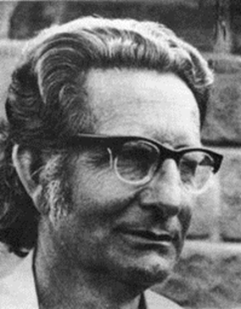
The structure of Eysenck’s hierarchy
Since there are specific responses, we need individual scales for each response (Eysenck) or specific situations need to be implement to the prediction model (Mischel).
Graphic copyright © 1999-2003 Heffner Media Group Inc.
http://www.integratedsociopsychology.net/temperament_dimensions.html
Graphic copyright © 1999-2003 Heffner Media Group Inc.
Notes:
THE CAPS MODEL The Cognitive-Affective Processing System, or CAPS (Mischel & Shoda 1995, Shoda & Mischel 1998), was developed as an exemplar of this kind of framework intended to predict the two types of behavioral consistency discovered in personality research.
Kurt Lewin in his field theory observed that: “[G]eneral laws and individual differences are merely two aspects of one problem; they are mutually dependent on each other and the study of the one cannot proceed without the study of the other (Lewin 1946, p. 794).”
Lewin K. 1946. Behavior and development as a function of the total situation. In Manual of Child Psychology, ed. L Carmichael, pp. 791–802. New York: Wiley.

Slide 33
5. Reconstruction of Research Framework
Supporting evidences (continued):
It is said that higher abstraction (wide scope) constructs are not suitable to measure a specific event in other fields in social sciences. Therefore, less abstraction construct should be used (Buss, 1989; Lastovicka and Joachimsthaler, 1988).
Our conclusion is that if the items of theoretical construct were close to adoption behavior then the predictability should increase.
But most of the scale contents for theoretical construct have been designed to be very abstract because of its width.
That is why the predictability has been generally weak.
Based on these facts, we introduce a new construct in an intermediate level of abstraction between theoretical construct and disposition concept. We name this T-D mixture.
Its scale items must consist of contents close to the innovation adoption behavior. Yet, they should keep some surplus meanings.

Slide 34
5. Reconstruction of Research Framework
The following table summarizes the reconstruction.

Slide 35
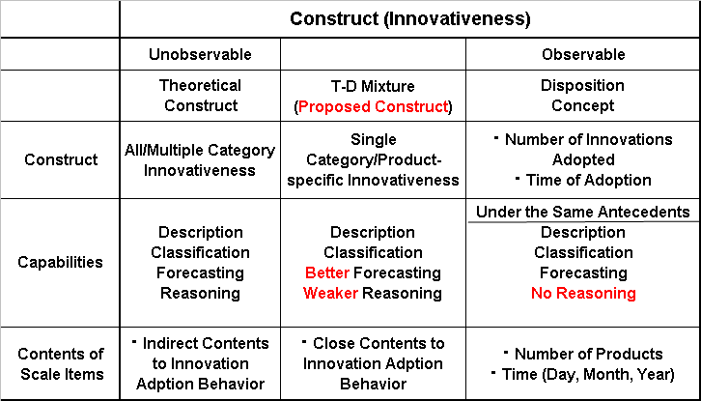
Simplified Version of Research Framework

Slide 36
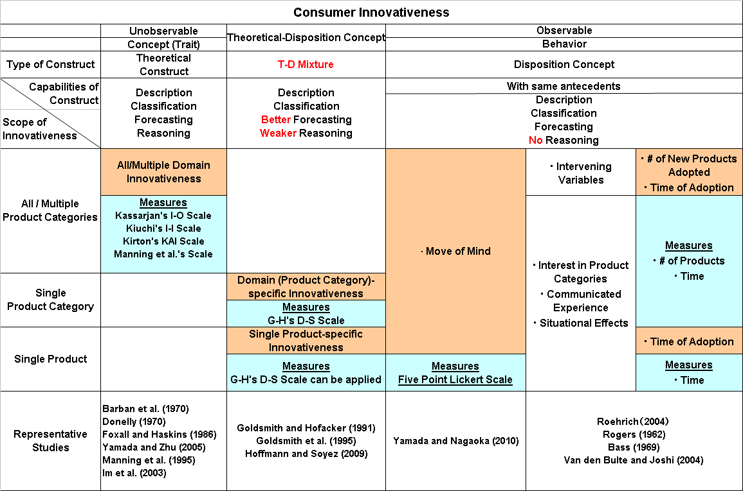
Detailed Version of Research Framework
We reconstructed the framework of innovation diffusion theory based on consumer innovativeness adopting Carnap’s theoretical construct and disposition concept.
The capabilities of theoretical construct include description, classification, forecasting and reasoning. The capabilities of disposition concept include the same except reasoning .
Wide
We replaced Midgley and Dowling’s “actualized innovativeness to “relative time of adoption” and “number of new products adopted” and also abstraction level of innovativeness to scope of innovativeness.
Narrow
Then, in order to improve predictability of behavior, we introduced a new intermediate construct between theoretical construct and disposition concept which can be measured by a scale whose items are close to behavior. We call this T-D mixture. Better Forecasting but Weaker Reasoning

Slide 37
6. Summary and Conclusions
After intensive literature survey of innovation diffusion theory we conclude that Midgley and Dowling contingency model is most suitable with a few modifications.
Innovativeness should be treated as a theoretical construct as one of personality traits. Then we could resolve the (1) the tautology problem of Rogers’ definition on innovativeness.
Taking score of innovativeness scale instead of relative time of adoption, we could handle (2) non-normal distribution of relative time of adoption and resolve (3) the adopter categorization problem.

Slide 38
Through intensive literature survey on innovation diffusion theory, personality psychology and other social sciences, we found that the items of scales for theoretical construct are relatively far from what you want to measure because of its width and that the items of scale for disposition concept are just behavior, at its extreme like time or number with no surplus meaning.
Then, in order to improve our predictability of behavior, we introduced (4) a new intermediate construct between theoretical construct and disposition concept. We call this T-D mixture.
Domain-specific innovativeness happened to be an example of T-D mixture because its scale items include contents closer to the behavior patterns to be predicted but not entirely dispositional.
Finally as a future research, we would like to find the detailed requirements for the scale items of T-D mixture.

Slide 39
Thank you!

Slide 40
References
Barban, Arnold M., C.H. Sandage, Waltraud M. Kassarjian, and Harold
H. Kassarjian, (1970）, “A Study of Riesman’s Inner-Other
Directedness Among Farmers,” Rural Sociology, 35, 232-243.
Bartels, J. and Reinders MJ(2010), “Consumer innovativeness and its
correlates: A propositional inventory for future research,”
Journal of Business Research, doi:10.1016/j.jbusres.2010.05.002.
Bass, F. M. (1969), "A New Product Growth Model for Consumer
Durables," Management Science, 15, 215-227.
Buss, A.H. (1989), “Personality as traits,” American Psychologist, 44
1378-1388.
Carnap, Rudolf (1956), “The Methodological Character of Theoretical
Concepts,” The Foundations of Science and the Concepts of
Psychology and Psychoanalysis, Vol. 1, Minnesota Studies in
The Philosophy of Science Edited by Herbert Feigl and Michael
Scriven, University of Minnesota Press, Minneapolis, Sixth
Printing, 1968, 38-76.
2011/8/23
2011/8/23
2011/8/23
2011/8/23
2011/8/23
2011/8/23
(C) Yamada and Nagaoka
(C) Yamada and Nagaoka
(C) Yamada and Nagaoka
(C) Yamada and Nagaoka
(C) Yamada and Nagaoka
(C) Yamada and Nagaoka

Slide 41
References
Eysenck, H. J. (1967), The biological basis of personality, Springfield,
IL: Charles C. Thomas.
Goldsmith, R. E. and C. F. Hofacker (1991), “Measuring Consumer
Innovativeness,“ Journal of the Academy of Marketing Science,
19(3), 209-22.
Hoffmann S. and K. Soyez (2010), “A cognitive model to predict
domain-specific consumer innovativeness,” Journal of
Business Research, Vol. 63, 7, July. 778-785.
Im, S., B. J. Bayus and C. H. Mason (2003), “An Empirical Study of
Innate Consumer Innovativeness, Personal Characteristics, and
New-Product Adoption Behavior,” Journal of the Academy of
Marketing Science, 31, 1, 61-73.
Im, S., C.H. Mason, and M.B. Houston (2007), “Does innate consumer
innovativeness relate to new product/service adoption behavior?
The intervening role of social learning via vicarious innovativeness.
Journal of the Academy of Marketing Science 35 (1), 63–75.
2011/8/23
2011/8/23
2011/8/23
2011/8/23
2011/8/23
2011/8/23
(C) Yamada and Nagaoka
(C) Yamada and Nagaoka
(C) Yamada and Nagaoka
(C) Yamada and Nagaoka
(C) Yamada and Nagaoka
(C) Yamada and Nagaoka
41
41
41
41
41
41
Notes:
Kenrick, D. T., & Funder, D. C. (1991). The person-situation debate: Do personality traits really exist? In V. J. Derlega, B. A. Winstead, & W. H. Jones (Eds.) Personality, Contemporary theory and research. Chicago: Nelso-Hall.

Slide 42
References
Kenrick, D. T., & Funder, D. C. (1991). The person-situation debate: Do
personality traits really exist? In V. J. Derlega, B. A. Winstead, &
W. H. Jones (Eds.), Personality: Contemporary theory and
research (pp.149-173). Chicago: Nelson-Hall.
Kirton, M. (1976), “Adaptors and innovators: A description and
measure,” Journal of Applied Psychology, Vol. 61, No. 5, 622-629.
Kiuchi, Aki (1996), “Independent-Interdependent Self Construal,
Relationship of Cultural Influence and Personality Trait,”
Research in Psychology, 67, 308-313 (translated by the authors).
J.k. Lastovicka and E.A. Joachimsthaler (1988). “Improving the
detection of personality-behavior relationships in consumer
research,” Journal of Consumer Research, 14 (March) 583-587.

Slide 43
References
MaCorquadale, K. and Meehl, P. E. (1948), “On a Distinction between
Hypothetical Constructs and Intervening Variables,”
Psychological Review, 55, 95-107.
Manning, Kenneth C., William O. Bearden, and Thomas J. Madden
(1995), “Consumer Innovativeness and the Adoption Process,”
Journal of Consumer Psychology, 4(4), 329-345.
Markus, H. R., & Kitayama, S. 1991 Culture and the self : Implication
for cognition, emotion, and motivation. Psychological Review,
Vol. 98, 224-253.
Midgley, David F. and Grahame R. Dowling (1978), “Innovativeness:
The concept and its measurement,” Journal of Consumer
Research, 4 (March) 229-242.
Mischel, W (1968), Personality and Assessment, New York: John
Wiley & Sons, Inc.
2011/8/23
2011/8/23
2011/8/23
2011/8/23
2011/8/23
(C) Yamada and Nagaoka
(C) Yamada and Nagaoka
(C) Yamada and Nagaoka
(C) Yamada and Nagaoka
(C) Yamada and Nagaoka

Slide 44
References
Mischel W, Shoda Y. (1995), “A cognitive-affective system theory of
personality: reconceptualizing situations, dispositions,
dynamics, and invariance in personality structure,” Psychol.
Rev. 102:246–68.
Mischel W, and Shoda Y. (1998), “Reconciling processing dynamics
and personality dispositions,” Annu. Rev. Psychol. 49:229–58.
Mischel, W. (2004), "Toward an integrative science of the person,”
Annual Review of Psychology, 55, 1-22.
Mudd, Samuel (1990), “The place of innovativeness in models of the
adoption process: an integrative review,” Technovation 10 (2),
119-134.
Nisbett, R. E. (1980). The trait construct in lay and professional
psychology. In L. Festinger (Ed.), Retrospections on social
psychology (pp. 109-130). New York: Oxford University Press.
Peterson, Robert A. (1973), "A Note on Optimal Adopter Category
Determination," Journal of Marketing Research, 10 (August),
325-9.

Slide 45
References
Popper, Karl R. (1959) The Logic of Scientific Discovery. Hutchson.
Roehrich, Gilles (2004), “Consumer innovativeness Concepts
and measurements,” Journal of Business Research, 57,
671– 677.
Rogers, Everett M. (1962), Diffusion of Innovations, The Free Press.
New York.
Rogers, Everett M. (2003), Diffusion of Innovations, 5th ed., The Free
Press, New York.
Watanabe, Yoshiyuki (1995), “CONSTRUCTS AND CAUSAL
EXPLANATIONS IN PSYCHOLOGY,” Bulletin of School of
Nursing & Social Services, Health Sciences University of
Hokkaido, 2, 1-7.
Yamada, Masataka and Xiaoying Zhu (2005), “A basic model for
identifying adopter’s category (adoption time) with personality
score,” Marketing Science Conference 2005. Emory University,
Atlanta Georgia, INFORMS, Society for Marketing Science.

