Slide 1
An Investigation of Domain-specific Innovativeness*: Reconstruction of Innovation Diffusion Research Framework V. 1.6
2012 34rd INFORMS Marketing Science Conference, Boston University, Boston, MA
June 7-10, 2012.
TD10: St. George D
Cluster : Contributed, Session Information: Thursday Jun 07, 15:30 - 17:00,
Title: New Products Adoption III
Masataka Yamada
Nagoya University of Commerce and Business,4-4 Sagamine, Komenoki-cho, Nissin-shi, Aichi-ken 470-0193, Japan, myamada@nucba.ac.jp
Toshihiko Nagaoka
Ph.D. candidate, Graduate School of Business Administration,Kyoto Sangyo University,
Motoyama, Kita-ku, Kyoto, 603-8555, Japan, nagaoka@cc.kyoto-su.ac.jp
* A part of this study has been supported by Scientific Research (C)
# 23530550 of the Grant-in-Aid for Scientific Research, JSPS
Notes:
1我々は消費者革新性についての新しい研究枠組みを提案してきた。サンディエゴ、ケルン、ヒューストン
しかしながら、理論のみであり実地データを紹介出来ていなかった。
今回、日本人を対象にしたデータが出ましたので発表させて頂きます。
宜しくお願い致します。
We have proposed the new research framework about consumer innovation.
San Diego, Cologne, Houston
?
However, it is only theory and was not able to introduce actual data.
?
Since the data for Japanese people came out this time, I will announce.
?
I would appreciate your favor.

Slide 2
Introduction
Consumer innovativeness has been continuously studied till now since 1950s.
One of the important topics is predictive superiority of innovative behavior between domain-general consumer innovativeness (DGI) and domain-specific innovativeness (DSI).
We believe that in the latest two decades, people have started to support the superiority of DSI.
Unfortunately however, it seems that there is no theory why DSI is superior to DGI.
Notes:
Consumer innovativeness has been continuously studied till now since 1950s.One of the important topics is predictive superiority of innovative behavior between domain-general consumer innovativeness (DGI) and domain-specific innovativeness (DSI).We believe that in the latest two decades, people have started to support the superiority of DSI.Unfortunately however, it seems that there is no theory why DSI is superior to DGI.
消費者革新性は、1950年代以来連続的に今まで研究されました。重要なトピックのうちの1つは、領域一般的な消費者革新性(DGI)と領域特化型の革新性(DSI)の間の革新的な振る舞いの予言的な優勢です。私たちは、20年間の終わりでは、人々がDSIの優勢を支援し始めたと信じます。不運にも、しかしながら、理論はないように見えます、DSIは、DGIよりなぜ優れていますか。

Slide 3
Order of Presentation
1. Objectives
2. Theory
Carnap’s Framework for Construct
Theoretical Developments in Personality Psychology
Reconstruction of Innovation Diffusion Framework
Midgeley and Dowling’s Contingency Model
Our Model with T-D Mixture Concept
3. Hypotheses
4. Data
5. Results
6. Summary and Future Study Directions
2012/6/7
2012/6/7
2012/6/7
2012/6/7
2012/6/7
2012/6/7
(C) Yamada and Nagaoka
(C) Yamada and Nagaoka
(C) Yamada and Nagaoka
(C) Yamada and Nagaoka
(C) Yamada and Nagaoka
(C) Yamada and Nagaoka

Slide 4
Objectives
To theorize why DSI predicts consumer innovative behavior better than DGI.
To reconstruct Innovation Diffusion Research Framework
Empirical Research to Confirm Our Framework
Notes:
To theorize why DSI predicts consumer innovative behavior better than DGI.
To reconstruct Innovation Diffusion Research Framework
Empirical Research to Confirm Our Framework
理論を立てるために、なぜDSIは消費者を予言するか、DGIよりよい革新的な振る舞い。イノベーション普及度調査フレームワークの改造実証的研究は私たちのフレームワークを確認します

Slide 5
Carnap’s Framework for Construct
In psychology, behavioral patterns and regularities are described by construct. Construct can be classified into theoretical construct and disposition concept with its implications, reductability into observations of behavioral patterns, or existence of surplus meanings from logical syntax point of view (Carnap 1956, Watanabe 1995):
CONSTRUCT
Personality Trait
Behavior
Theoretical Construct
Label that contains thoughts (surplus meaning) concerning the causes of
observed behavior
Disposition Concept
Just simple label for observed behavior
The capabilities: description, classification, forecasting under the same antecedents but no reasoning
The capabilities: description, classification, forecasting and reasoning
Notes:
In psychology, behavioral patterns and regularities are described by construct. Construct can be classified into theoretical construct and disposition concept from logical syntax point of view (Carnap 1956, Watanabe 1995):
心理学では、行動パターンと規則性は構成物によって記述されます。構成物は論理的シンタックスの視点(カルナップ1956およびワタナベ1995)から見て理論的な構成物および配置概念に分類することができます:

Slide 6
Any psychological construct can be classified into disposition-concept and theoretical construct with its implications, reductability into observations of behavioral patterns, or existence of surplus meanings.
In describing behavioral patterns and classifying individuals, disposition concepts and theoretical constructs are equally usable, but cross-situational predictions and causal explanations of behavior are permitted only in theoretical constructs.

Slide 7
No Reasoning from Disposition Concept
Since Disposition Concept is
Just a simple label for observed behavior, there is no way to derive reasoning from it.
Theoretical Reasoning
Ex 1: The Rogers' Definition of Innovativeness is a tautology (Midgley and Dowling 1978) :
Innovativeness is the degree to which an individual or other unit of adoption is relatively earlier in adopting new ideas than other members of a society (p. 37, Rogers 2003).
Ex 2: The Rogers‘ Adopter Categorization based on the normal distribution of adoption times is also derived from disposition concept and is no longer viable because of the appearances of non- normal distributions such as digital contents.

Slide 8
Typically behavior is predicted from personality trait in psychology.
Personality Trait
Behavior
Theoretical Construct
Disposition Concept
Example
Extraversion and Introversion
Extravert and Introvert
Scale
Questionnaire
Scale
Observation
Dependent/Independent
Sociable/Unsociable
Measured Value
Score Points
Measured Value
Observed Patterns
Notes:
Extravert and Introvert
外向的な人と内向的な人

Slide 9
Also consumer innovativeness behavior should be predicted from the theoretical construct.
Personality Trait
Behavior
Theoretical Construct
Generalized Innovativeness
Domain-specific Innovativeness
Single Product Innovativeness
Scale
Time, Day, Month, Year
Count
Scale
I-O Scale, Hurt et al Scale
Goldsmith & Hofacker Scale
Measured Value
Examples: 5 hours, 3 days, 2 months,
1 years
One, Two, Ten, …
Measured Value
Score Points

Slide 10
Theoretical Developments in Personality Psychology
Since there are specific responses, we need individual scales for each response (Eysenck).
Mischel (1968): emphasized the importance of situational factors since personality and behavior have less than 0.3 correlation.
We think that Eysenck and Mischel are looking at the same thing from different angles (see The Cognitive-Affective Processing System, or CAPS (Mischel & Shoda 1995, Shoda & Mischel 1998)).
Since Midgeley and Dowling’s model is well accepted by marketing community with the above supporting evidences in Personal Psychology, we conclude to adopt Midgeley and Dowling’s model as prediction model for adoption behavior.
Notes:
Since there are specific responses, we need individual scales for each response (Eysenck).
Mischel (1968): emphasized the importance of situational factors since personality and behavior have less than 0.3 correlation.
We think that Eysenck and Mischel are looking at the same thing from different angles (see The Cognitive-Affective Processing System, or CAPS (Mischel & Shoda 1995, Shoda & Mischel 1998)).
Since Midgeley and Dowling’s model is well accepted by marketing community with the above supporting evidences in Personal Psychology, we conclude to adopt Midgeley and Dowling’s model as prediction model for adoption behavior.
特異反応があるので、私たちは各レスポンス(アイゼンク)の個々の規模を必要とします。ミッセル(1968):個性と振る舞いに0.3未満の相関性があるので、状況的要因の重要性を強調しました。私たちは、異なる角度(コグニティブな感情の処理システム、あるいはCAPS(ミッセル& Shoda 1995年、Shoda &ミッセル1998)を参照)からの同じものをアイゼンクとミッセルは見ていると思います。MidgeleyおよびDowlingのモデルがパーソナルな心理学の上記の根拠となる証拠を持ったコミュニティーを売ることによりよく受理されるので、私たちは採用行動用予測モデルとしてMidgeleyおよびDowlingのモデルを採用することを決定します。

Slide 11
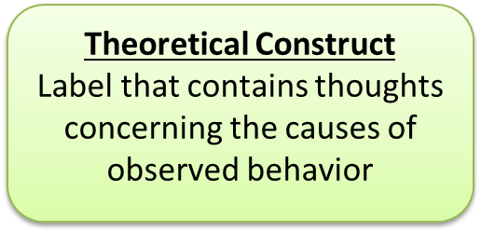
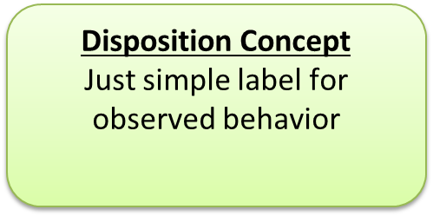
Theoretical Developments in Personality Psychology From “Trait-Behavior” to “Trait-intervening variables-Behavior”
Personality Trait
Behavior
specific responses (Eysenck 1944)
specific situations (Mischel 1968)

Slide 12
Reconstruction of Innovation Diffusion Research Framework:
Midgeley and Dowling’s Contingency Model is well accepted in marketing and consumer behavior area. So we start with this model.
Theoretical Construct:
Consumer Innovativeness
Disposition Concept:
Adoption Behavior
Intervening Variables:
Interest in Product Categories
Communicated Experience
Situational Factors

Slide 13
Reconstruction of Research Framework
Most of the scale items for domain-general innovativeness (dgi), namely, theoretical construct have been designed to be very abstract because of its generality. That is why the predictability has been generally weak.
Also single product innovativeness needs past similar products which are based on subjective judgments.
Based on these facts, we introduce a new construct in an intermediate level of abstraction between theoretical construct and disposition concept. We name this T-D mixture.
Its scale items must consist of contents close to the innovation adoption behavior and yet, they should keep some surplus meanings.
We consider that this intermediate construct, T-D mixture happened to be the domain-specific innovativeness (dsi) developed by Goldsmith and Hofacker (1991) .
Notes:
Most of the scale items for domain-general innovativeness (dgi), namely, theoretical construct have been designed to be very abstract because of its generality. That is why the predictability has been generally weak.Also single product innovativeness needs past similar products which are based on subjective judgments.Based on these facts, we introduce a new construct in an intermediate level of abstraction between theoretical construct and disposition concept. We name this T-D mixture. Its scale items must consist of contents close to the innovation adoption behavior and yet, they should keep some surplus meanings.We consider that this intermediate construct, T-D mixture happened to be the domain-specific innovativeness (dsi) developed by Goldsmith and Hofacker (1991) .
領域一般的な革新性(dgi)用のほとんどの規模アイテム、理論的で、すなわち、構築する、その一般法則のために非常に抽象的になるように設計されました。そのため、予言は一般に弱かった。さらに単一の製品革新性は、主観的判断に基づく過去の類似品を必要とします。これらの事実に基づいて、私たちは、理論的な構成物および配置概念の間の抽象の中間レベルに新しい構成物を導入します。私たちはこのT-D混合を指定します。その規模アイテムは革新採用行動に近い内容から成るに違いありません。また、しかし、それらはいくつかの余分の意味を維持するべきです。私たちはそれをこれと考えます、中間、構築する、T-D混合は、偶然ゴールドスミスおよびホーファッカー(1991)によって開発された領域特化型の革新性(dsi)でした。

Slide 14
Reconstruction of Innovation Diffusion Framework: Our model
T-D Mixture Construct:
Domain-specific Innovativeness
Disposition Concept:
Adoption Behavior
Intervening Variables:
Interest in Product Categories
Communicated Experience
Situational Factors

Slide 15
 | Unobservable | Observable
Type of Construct | Theoretical Construct | T-D Mixture | Disposition Concept
Construct | Domain-general Innovativeness | Domain-specific Innovativeness | · # of New Products Adopted · Time of Adoption
Contents of Scale Items | · Indirect Contents to Adoption Behavior such as Traits | · Indirect Contents to Adoption Behavior such as Traits · Direct Contents to Adoption Behavior such as Intervening Variables | · # of Products · Time
Scales Developed | Kassarjan's I-O Scale Kiuchi's I-I Scale Hurt et al's scale Kirton's KAI Scale Manning et al.'s Scale | Goldsmith-Hofacker's Scale | · Unit of Products · day, week, month, year
Function | Description Classification Forecasting Reasoning | Description Classification Better Forecasting Weaker Reasoning | Under same antecedents Description Classification Forecasting No Reasoning

Slide 16
Hypotheses
In order to prove why the domain-specific innovativeness (DSI) predicts consumer innovative behavior better than the domain-general innovativeness (DGI), we would like to test the following hypotheses. However, before we proceed, we would like to take this opportunity to show the variability of DSI within a same subject so that we can justify the domain specificity.
Since DSI is assumed that each person has his/her own preferred product categories, so each person has different DSI score on different innovation:
H1: H₀: DSI₁=DSI₂….=DSI_{k} (k = # of innovations)
H₁: at least one pair is different.
Note: Here “predicts better” means strictly in theoretical sense. Of course, we can make better operational prediction models using disposition concepts.
Notes:
In order to prove why the domain-specific innovativeness (DSI) predicts consumer innovative behavior better than the domain-general innovativeness (DGI), we would like to test the following hypotheses. However, before we proceed, we would like to take this opportunity to show the variability of DSI within a same subject so that we can justify the domain specificity.
Since DSI is assumed that each person has his/her own preferred product categories, so each person has different DSI score on different innovation:
なぜ領域特化型の革新性(DSI)が消費者を予言するか証明するために、領域一般的な革新性(DGI)よりよい革新的な振る舞い、私たちは次の仮説をテストしたい。しかしながら、進む前に、領域固有性を正当化することができるように、私たちはこの機会をとらえて同じ主題内のDSIの変わりやすさを示したい。DSIが仮定されるので、人がそれぞれその人の自分自身のものを持っていることは製品分野を好みました。したがって、人はそれぞれ異なる革新の上に異なるDSIスコアを持っています:
Here “predicts better” means strictly in theoretical sense. Of course, we can make better operational prediction models using disposition concepts.
ここに「よりよく予言する」手段、理論的な感覚の中で厳密に。もちろん、私たちは配置概念を使用して、よりよい運用上の予測モデルを作ることができます。

Slide 17
Hypotheses
H2: DSI predicts innovative behavior better than DGI. This will be divided into three operational hypotheses:
H2_{a1}: There is no significant correlation between DGI and innovative behavior (adoption time).
H2_{a2}: There is a significant correlation between DSI and innovative behavior (adoption time).
H2_{b}: There is no significant correlation between DSI and DGI.
Notes:
H2: DSI predicts innovative behavior better than DGI. This will be divided into three operational hypotheses:
H2a1: There is no significant correlation between DGI and innovative behavior (adoption time).
H2a2: There is a significant correlation between DSI and innovative behavior (adoption time).
H2b: There is no significant correlation between DSI and DGI.
H2: DSIはDGIよりよい革新的な振る舞いを予言します。これは3つの運用上の仮説に分割されるでしょう:H2a1:DGIおよび革新的な振る舞い(採用時間)の間に重要な相関性はありません。H2a2:DSIおよび革新的な振る舞い(採用時間)の間に重要な相関性があります。H2b:DSIとDGIの間に重要な相関性はありません。

Slide 18
Hypotheses
Using Cox regression function, we estimate the parameters. Dependent variable is adoption time and the explanatory variables are DSI and intervening variables (Sex, Age, and Part time job).
Survival rate = f (DSI, Sex, Age, Part time job)
Notes:
Using Cox regression function, we estimate the parameters. Dependent variable is adoption time and the explanatory variables are DSI and intervening variables
コックス回帰関数を使用して、私たちはパラメーターを評価します。従属変数は採用時間です。また、説明変数はDSIと仲介変数です。

Slide 19
Sample
Data were collected by web uploaded self-administered questionnaire from 896 business undergraduates at our (private) university in Kyoto, Japan during June 10th – July 29th 2009. Removal of 207 subjects owing to missing data, non-response, and random response resulted in a total usable sample of 688 subjects.
The final sample was comprised of 455 men (66.1 %) and 233 women (33.9%). Ages of the subjects ranged from 18 to 27 years, with a mean of 20.3 (SD=1.188).
Mobile phone, SNS and e-money are chosen as the innovative products.
Notes:
The MEANS Procedure
Analysis Variable : age N Mean Std Dev Minimum Maximum 688 20.3284884 1.1881031 19.0000000 27.0000000
The MEANS Procedure
Analysis Variable : age N Mean Std Dev Minimum Maximum 688 20.3284884 1.1881031 19.0000000 27.0000000
Data were collected by web uploaded self-administered questionnaire from 896 business undergraduates at our (private) university in Kyoto, Japan during June 10th – July 29th 2009. Removal of 207 subjects owing to missing data, non-response, and random response resulted in a total usable sample of 688 subjects.
The final sample was comprised of 455 men (66.1 %) and 233 women (33.9%). Ages of the subjects ranged from 18 to 27 years, with a mean of 20.3 (SD=1.188).
Mobile phone, SNS and e-money are chosen as the innovative products.
データは6月10日に京都(日本)の私たちの(個人)大学で896人のビジネス大学生からウェブにアップロードされた自己記入質問書によって集められました?2009年7月29日。欠測値、無回答および任意のレスポンスに起因する207の主題の除去は、688の主題の完全な使用可能なサンプルに帰着しました。最終サンプルは455人の男性(66.1%)および233人の女性(33.9%)で構成されました。主題の時代は20.3(SD=1.188)の中間と共に18から27年まで及びました。携帯電話、SNSおよび電子マネーは革新的な製品に選ばれます。

Slide 20
Questionnaire
Total number of items: 155
①Demographics: Q1-Q4, Q70～Q77, Q92～Q155
②Kiuti score: Q5～Q20 (Self construal scale similar to I-O scale) We use this scale as DGI scale.
③DSI Scale (Goldsmith & Hofacker’s scale)
Mobile phone: Q30～Q35
SNS: Q53～Q58
e-money: Q64～Q69
Manning et al. (1995)
④CNS Score: Q84～Q91 (Consumer Novelty Seeking)
⑤CIJM Score: Q78～Q83 (Consumer Independent Judgement Making)
⑥Wakuwaku Score
Mobile phone: Q28
SNS: Q45
e-money: Q63
⑦Other questions
Mobile phone: Q21～Q27, Q29
SNS: Q36～Q51
e-money: Q59～Q62
For separate study

Slide 21
Results

Slide 22
Cronbach's alpha
Kiuti’s scale: 0.820669 （Standardized 0.823837）
DSI scale for Mobilephone: 0.711561 （Standardized 0.716864）
DSI scale for SNS: 0.779302 （Standardized 0.780617）
DSI scale for e-money: 0.787977 （Standardized 0.791207）
They seem to be reasonably one dimensional.

Slide 23
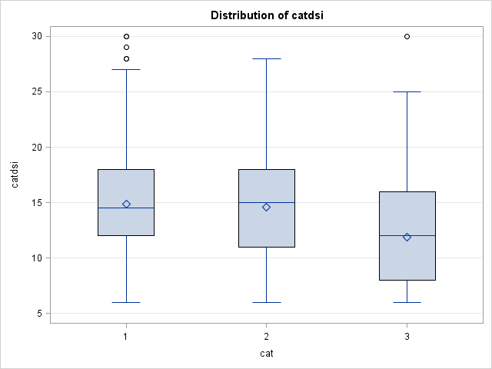
H1: H₀: DSI₁=DSI₂=DSI₃
H₁: at least one pair is different.
Distribution of DSI
Mobilephone
SNS
e-money

Slide 24
Note: | This test controls the Type I experimentwise error for comparisons of all treatments against a control.
The GLM Procedure
Dunnett's t Tests for catdsi
Alpha | 0.05
Error Degrees of Freedom | 2061
Error Mean Square | 22.23536
Critical Value of Dunnett's t | 2.21364
Minimum Significant Difference | 0.5628
Comparisons significant at the 0.05 level are indicated by ***.
cat Comparison | Difference Between Means | Simultaneous 95% Confidence Limits
1 - 3 | 2.9767 | 2.4139 | 3.5395 | ***
2 - 3 | 2.6730 | 2.1102 | 3.2358 | ***
Hence DSIs of different innovations are different within a subject.
Different from DGI

Slide 25
Mobile phone
H2_{a1}: There is no significant correlation between DGI and innovative behavior (adoption time).
H2_{a2}: There is a significant correlation between DSI and innovative behavior (adoption time).

Slide 26
SNS
H2_{a1}: There is no significant correlation between DGI and innovative behavior (adoption time).
H2_{a2}: There is a significant correlation between DSI and innovative behavior (adoption time).

Slide 27
e-money
H2_{a1}: There is no significant correlation between DGI and innovative behavior (adoption time).
H2_{a2}: There is a significant correlation between DSI and innovative behavior (adoption time).

Slide 28
H2_{b}: There is no significant correlation between DSI and DGI.

Slide 29
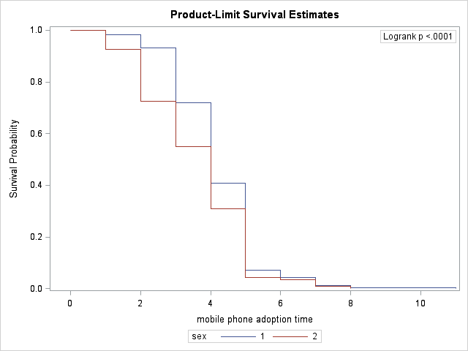
Mobile phone
Summary of the Number of Censored and Uncensored Values
Stratum | sex | Total | Failed | Censored | Percent Censored
1 | M | 455 | 455 | 0 | 0.00
2 | F | 233 | 233 | 0 | 0.00
Total |  | 688 | 688 | 0 | 0.00

Slide 30
Mobile phone Parameter Estimates of Cox regression
DGI is excluded from the model based on the result of H2_{a1}.
Testing Global Null Hypothesis: BETA=0
Test | Chi-Square | DF | Pr > ChiSq
Likelihood Ratio | 33.2890 | 4 | <.0001
Score | 32.7299 | 4 | <.0001
Wald | 32.6376 | 4 | <.0001
Model Fit Statistics
Criterion | Without Covariates | With Covariates
-2 LOG L | 8072.434 | 8039.145
AIC | 8072.434 | 8047.145
SBC | 8072.434 | 8065.280
Analysis of Maximum Likelihood Estimates
Parameter | DF | Parameter Estimate | Standard Error | Chi-Square | Pr > ChiSq | Hazard Ratio
sex | 1 | 0.19147 | 0.08150 | 5.5191 | 0.0188 | 1.211
age | 1 | -0.12119 | 0.03133 | 14.9596 | 0.0001 | 0.886
part time job | 1 | 0.05861 | 0.02391 | 6.0103 | 0.0142 | 1.060
kdsi | 1 | 0.01693 | 0.00818 | 4.2851 | 0.0384 | 1.017

Slide 31
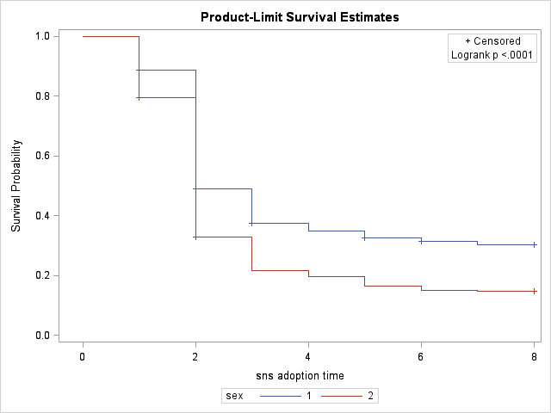
SNS
Summary of the Number of Censored and Uncensored Values
Stratum | sex | Total | Failed | Censored | Percent Censored
1 | M | 455 | 316 | 139 | 30.55
2 | F | 233 | 197 | 36 | 15.45
Total |  | 688 | 513 | 175 | 25.44

Slide 32
SNS Parameter Estimates of Cox regression
DGI is excluded from the model based on the result of H2_{a1}.
Testing Global Null Hypothesis: BETA=0
Test | Chi-Square | DF | Pr > ChiSq
Likelihood Ratio | 106.6036 | 4 | <.0001
Score | 108.2835 | 4 | <.0001
Wald | 106.8269 | 4 | <.0001
Model Fit Statistics
Criterion | Without Covariates | With Covariates
-2 LOG L | 6359.941 | 6253.337
AIC | 6359.941 | 6261.337
SBC | 6359.941 | 6278.298
Analysis of Maximum Likelihood Estimates
Parameter | DF | Parameter Estimate | Standard Error | Chi-Square | Pr > ChiSq | Hazard Ratio
sex | 1 | 0.29098 | 0.09353 | 9.6783 | 0.0019 | 1.338
age | 1 | -0.00763 | 0.03514 | 0.0471 | 0.8281 | 0.992
part time job | 1 | -0.00228 | 0.02787 | 0.0067 | 0.9349 | 0.998
mdsi | 1 | 0.08866 | 0.00942 | 88.5823 | <.0001 | 1.093

Slide 33
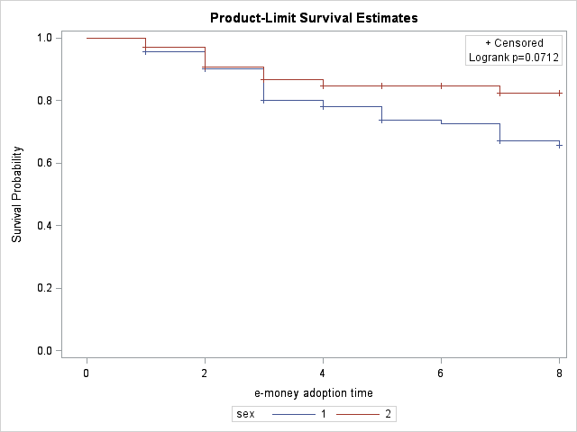
e-money
Summary of the Number of Censored and Uncensored Values
Stratum | sex | Total | Failed | Censored | Percent Censored
1 | M | 455 | 74 | 381 | 83.74
2 | F | 233 | 26 | 207 | 88.84
Total |  | 688 | 100 | 588 | 85.47

Slide 34
e-money Parameter Estimates of Cox regression
DGI is excluded from the model based on the result of H2_{a1}.
Testing Global Null Hypothesis: BETA=0
Test | Chi-Square | DF | Pr > ChiSq
Likelihood Ratio | 108.1922 | 4 | <.0001
Score | 123.8775 | 4 | <.0001
Wald | 107.1305 | 4 | <.0001
Model Fit Statistics
Criterion | Without Covariates | With Covariates
-2 LOG L | 1193.215 | 1085.023
AIC | 1193.215 | 1093.023
SBC | 1193.215 | 1103.444
Analysis of Maximum Likelihood Estimates
Parameter | DF | Parameter Estimate | Standard Error | Chi-Square | Pr > ChiSq | Hazard Ratio
sex | 1 | 0.02678 | 0.23605 | 0.0129 | 0.9097 | 1.027
age | 1 | 0.17001 | 0.06667 | 6.5023 | 0.0108 | 1.185
part time job | 1 | -0.10084 | 0.05961 | 2.8617 | 0.0907 | 0.904
ddsi | 1 | 0.18764 | 0.02091 | 80.5342 | <.0001 | 1.206

Slide 35
Considerations on Time dependency of T-D mixture (DSI)
In general, a scale must be time invariant.
The way you choose a domain defines the degree of the time invariability of the scale scores.
If you take a domain as wide as possible, you may be able to avoid its time dependency.
For example, if you take electronics gadgets as a domain for iPad, then the scale scores must remain constant for a certain period. Because people’s interest toward electronics gadgets stays same.
On the other hand, if you take iPad as a domain for its next generation as a narrow case, then the scale scores will be different at separate times. Because the consumers’ iPad awareness will increase and change their attitudes as time goes by.
Notes:
In general, a scale must be time invariant.
The way you choose a domain defines the degree of the time invariability of the scale scores.
If you take a domain as wide as possible, you may be able to avoid its time dependency.
For example, if you take electronics gadgets as a domain for iPad, then the scale scores must remain constant for a certain period. It is because people’s interest toward electronics gadgets stays the same.
On the other hand, if you take iPad as a domain for its next generation as a narrow case, then the scale scores will be different at separate times. Because the consumers’ iPad awareness will increase and change their attitudes as time goes by.
一般に、規模は時間不変式であるに違いありません。あなたが領域を選ぶ方法は、規模スコアの時間不変性の程度を定義します。できるだけ広い領域をとれば、その時間依存性を回避することができるかもしれません。例えば、あなたがiPadに対してエレクトロニクス装置を領域と考えれば、規模スコアは一定の期間の間一定のままであるに違いありません。それは人々のエレクトロニクス装置への興味が同じことを止めるからです。他方では、あなたが狭い場合としてのその次世代の間iPadを領域と考えれば、規模スコアは個別の時に異なるでしょう。消費者のiPad意識が増加し、時間が経過するとともに、それらの態度を変えるので。

Slide 36
Managerial Implications of T-D mixture
For example, if you need to collect info from innovative consumers with regard to non-existing category within electronics gadget category, then you should choose electronics gadget as your domain.
If you would like to predict consumers’ adoption behavior about the next generation of smartphone, you may choose mobile phone or smartphone as your domain. In this case, you have to take the time dependency of scale scores into your considerations.
In this study, because e-money is the latest innovation among three, the diffusion rate is the lowest and accordingly the mean of the scale scores is the lowest.
If multiple innovations were launched around the same time, then regardless of category, the means of DSI scores will positively correlate with the diffusion rates, namely the attractiveness of innovation.
Notes:
For example, if you need to collect info from innovative consumers with regard to non-existing category within electronics gadget category, then you should choose electronics gadget as your domain.
If you would like to predict consumers’ adoption behavior about the next generation of smartphone, you may choose mobile phone or smartphone as your domain. In this case, you have to take the time dependency of scale scores into your considerations.
In this study, because e-money is the latest innovation among three, the diffusion rate is the lowest and accordingly the mean of the scale scores is the lowest.
If multiple innovations were launched around the same time, then regardless of category, the means of DSI scores will positively correlate with the diffusion rates, namely the attractiveness of innovation.
例えば、エレクトロニクス装置カテゴリー内に非既存のカテゴリーに関して革新的な消費者から情報を集める必要があれば、エレクトロニクス装置を領域に選ぶべきです。消費者のスマートフォンの次世代に関する採用行動を予言したければ、携帯電話またはスマートフォンを領域に選んでもよい。この場合、考察の中への規模スコアの時間依存性を連れて行かなければなりません。この研究で、電子マネーが3の中の最新の革新であるので、普及率は最低です。また、従って、規模スコアの中間は最低です。カテゴリーにかかわらず、もし多数の革新が同時のまわりで始められれば、DSIスコアの手段は確かに普及率(すなわち革新の魅力)と関連するでしょう

Slide 37
Summary and Future research direction
Starting with logical syntax point of view (Carnap 1956, Watanabe 1995), we classified consumer innovativeness into theoretical construct and disposition concept.
In describing behavioral patterns and classifying individuals, disposition concepts and theoretical constructs are equally usable, but cross-situational predictions and causal explanations of behavior are permitted only in theoretical constructs.
We explained that Rogers’ definition of consumer innovativeness is a tautology and his adopter categorization is also illogical because they are derived from the disposition concept which does not contain surplus meaning at all.
Notes:
Starting with logical syntax point of view (Carnap 1956, Watanabe 1995), we classified consumer innovativeness into theoretical construct and disposition concept.
We explained that Rogers’ definition of consumer innovativeness is a tautology and his adopter categorization is also illogical because they are derived from the disposition concept which does not contain surplus meaning at all.
論理的シンタックス視点(カルナップ1956およびワタナベ1995)から始めて、私たちは理論的な構成物および配置概念に消費者革新性を分類しました。私たちは、ロジャーズの消費者革新性の定義が類語反復で、さらに、それらが余分の意味を全く含んでいない配置概念に由来するので彼の採用者分類が非論理的であることを説明しました。

Slide 38
Most of the scale items for DGI, namely, theoretical construct have been designed to be very abstract because of its generality. That is why the predictability has been generally weak.
Also when you use single product innovativeness, you need past similar products based on your subjective judgments.
Based on these facts, we introduce a new construct in an intermediate level of abstraction between theoretical construct and disposition concept. We name it T-D mixture.
Its scale items must consist of contents close to the innovation adoption behavior in a product/category and yet, they should keep some surplus meanings.
We consider that this intermediate construct, T-D mixture happened to be the Goldsmith and Hofacker’s scale (DSI）.
Notes:
Most of the scale items for DGI, namely, theoretical construct have been designed to be very abstract because of its generality. That is why the predictability has been generally weak.
Also when you use single product innovativeness, you need past similar products based on your subjective judgments.
Based on these facts, we introduce a new construct in an intermediate level of abstraction between theoretical construct and disposition concept. We name it T-D mixture.
Its scale items must consist of contents close to the innovation adoption behavior in a product/category and yet, they should keep some surplus meanings.
We consider that this intermediate construct, T-D mixture happened to be the DSI.
DGIのためのほとんどの規模アイテム、理論的で、すなわち、構築する、その一般法則のために非常に抽象的になるように設計されました。そのため、予言は一般に弱かった。さらに単一の製品革新性を使用する場合、過去の類似品はあなたの主観的判断に基づく必要があります。これらの事実に基づいて、私たちは、理論的な構成物および配置概念の間の抽象の中間レベルに新しい構成物を導入します。私たちはそれをT-D混合と命名します。その規模アイテムは、製品/カテゴリー中の革新採用行動に近い内容から成るに違いありません、しかし、それらはいくつかの余分の意味を維持するべきです。私たちはそれをこれと考えます、中間、構築する、T-D混合は偶然DSIでした。

Slide 39
Then we tested our model validity by correlational hypotheses.
Also we confirmed the validity of our innovation diffusion framework by Cox regression analysis.
As a future research direction, we would like to develop a new scale for T-D mixture since Cronbach’s alpha of DSI is less than 80 percent.
Also, we would like to investigate attractiveness of innovation to consumers based on DSI scores.
Notes:
Then we tested our model validity by correlational hypotheses.
Also we confirmed the validity of our innovation diffusion framework by Cox regression analysis.
As a future research direction, we would like to develop a new scale for T-D mixture since Cronbach’s alpha of DSI is less than 80 percent.
Also, we would like to investigate attractiveness of innovation to consumers based on DSI scores.
その後、私たちは相互関係の仮説によってモデル有効性をテストしました。さらに、私たちは、コックス回帰分析によって革新拡散フレームワークの有効性を確認しました。将来研究方向として、CronbachのDSIのアルファが80パーセント未満であるので、私たちは、T-D混合のための新しい規模を開発したい。さらに、私たちは、DSIスコアに基づいた消費者への革新の魅力を調査したい。

Slide 40
Thank you for your attention!

Slide 41
References
Carnap, Rudolf (1956), “The Methodological Character of Theoretical Concepts,”
The Foundations of Science and the Concepts of Psychology and
Psychoanalysis, Vol. 1, Minnesota Studies in The Philosophy of Science Edited
by Herbert Feigl and Michael Scriven, University of Minnesota Press,
Minneapolis, Sixth Printing, 1968, 38-76.
Hurt, H Thomas, Katherine Joseph and Chester D. Cook (1977), “Scales for The
Measurement of Innovativeness,” Human Communication Research, Vol. 4,
No. 1, Fall.
Kirton, M. (1976), “Adaptors and innovators: A description and measure,” Journal
of Applied Psychology, Vol. 61, No. 5, 622-629.
Kiuchi, Aki (1996), “Independent-Interdependent Self Construal, Relationship of
Cultural Influence and Personality Trait,” Research in Psychology, 67, 308-313
(translated by the authors).

Slide 42
Supporting Evidences
Buss, 1989; Lastovicka and Joachimsthaler, 1988: It is said that higher abstraction constructs are not suitable to measure a specific event in other fields in social sciences. Therefore, less abstraction construct should be used.
Hassinger(1959): argued that individuals will seldom expose themselves to messages about an innovation unless they first feel a need for the innovation.
Goldsmith and Hofacker (1991).
Goldsmith et al. (1995).
Reohrich (2004): Goldsmith and Hofacker’s scale is the most effective scale.
Hoffmann and Soyez (2010): they said that consumer innovativeness should be measured in a specific interest category (Gatignon and Robertson, 1985).
Bartels, J. and Reinders MJ (2010), “Consumer innovativeness and its correlates: A propositional inventory for future research,” Journal of Business Research,
doi: 10.1016/j.jbusres.2010.05.002 return

Slide 43
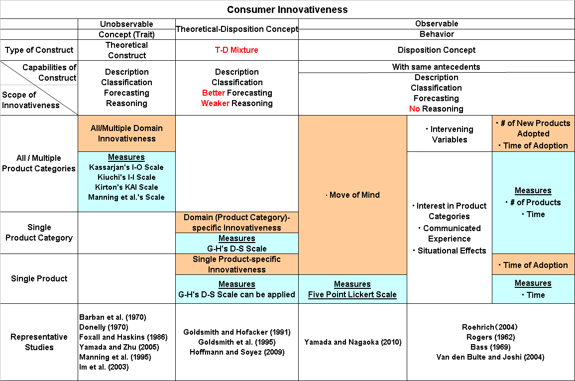
Detailed Version of Research Framework
We reconstructed the framework of innovation diffusion theory based on consumer innovativeness adopting Carnap’s theoretical construct and disposition concept.
The capabilities of theoretical construct include description, classification, forecasting and reasoning. The capabilities of disposition concept include the same except reasoning .
Wide
We replaced Midgley and Dowling’s “actualized innovativeness to “relative time of adoption” and “number of new products adopted” and also abstraction level of innovativeness to scope of innovativeness.
Narrow
Then, in order to improve predictability of behavior, we introduced a new intermediate construct between theoretical construct and disposition concept which can be measured by a scale whose items are close to behavior. We call this T-D mixture. Better Forecasting but Weaker Reasoning

Slide 44
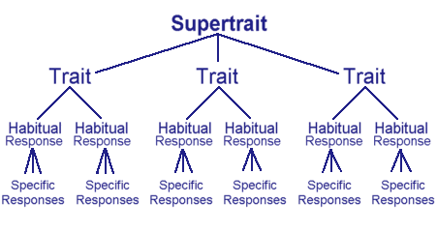
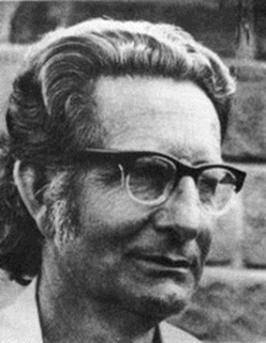
The structure of Eysenck’s hierarchy
Since there are specific responses, we need individual scales for each response (Eysenck) or specific situations need to be implement to the prediction model (Mischel).
Graphic copyright © 1999-2003 Heffner Media Group Inc.
http://www.integratedsociopsychology.net/temperament_dimensions.html
Graphic copyright © 1999-2003 Heffner Media Group Inc.
Notes:
THE CAPS MODEL The Cognitive-Affective Processing System, or CAPS (Mischel & Shoda 1995, Shoda & Mischel 1998), was developed as an exemplar of this kind of framework intended to predict the two types of behavioral consistency discovered in personality research.
Kurt Lewin in his field theory observed that: “[G]eneral laws and individual differences are merely two aspects of one problem; they are mutually dependent on each other and the study of the one cannot proceed without the study of the other (Lewin 1946, p. 794).”
Lewin K. 1946. Behavior and development as a function of the total situation. In Manual of Child Psychology, ed. L Carmichael, pp. 791–802. New York: Wiley.

Slide 45
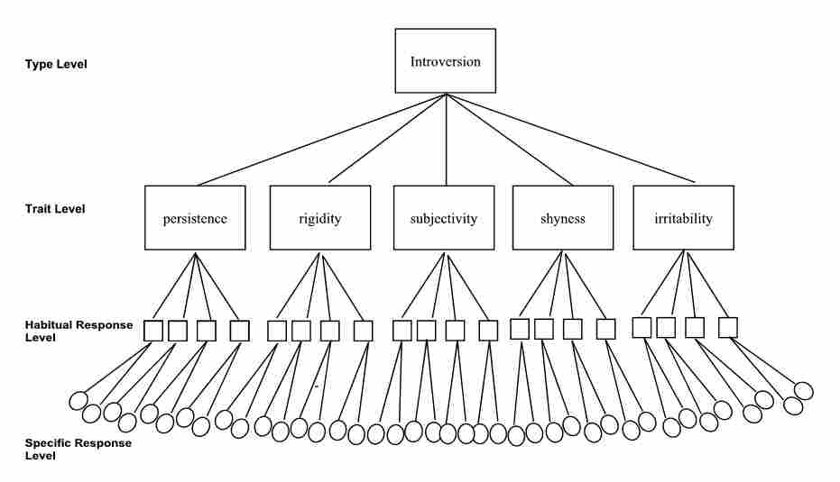
http://www.integratedsociopsychology.net/temperament_dimensions.html

Slide 46
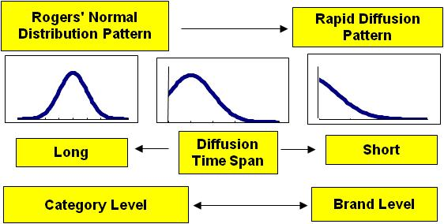
Problems in Diffusion Theory
Recently, however, various non-normal distribution patterns, yet economically important, specifically, rapid diffusion patterns have been found in the diffusions of contents businesses such as music, movies, game software, etc. (Yamada et al 2001; Moe and Fader, 2002).
2012/6/7
2012/6/7
2012/6/7
2012/6/7
2012/6/7
2012/6/7
(C) Yamada and Nagaoka
(C) Yamada and Nagaoka
(C) Yamada and Nagaoka
(C) Yamada and Nagaoka
(C) Yamada and Nagaoka
(C) Yamada and Nagaoka

Slide 47
2. Critical Review of Literature: Goldsmith and Hofacker’s six-item, self-report scale
Negative-direction
Q1: I am the least interested in @@@ among my friends.
Q2: Usually I am the last person who becomes aware of recent @@@ .
Q3: When a new @@@ appeared, often times, I was the last person who
bought the new model among my friends.
Positive-direction
Q4: If I were allowed to buy a new @@@ , then I would buy it immediately.
Q5: I am a kind of a person who buy a new @@@ without testing it by
myself.
Q6: I know the launching date of a new @@@ before other people know it.
@@@ can be Cell phone, PC, etc.
2012/6/7
2012/6/7
2012/6/7
2012/6/7
2012/6/7
2012/6/7
(C) Yamada and Nagaoka
(C) Yamada and Nagaoka
(C) Yamada and Nagaoka
(C) Yamada and Nagaoka
(C) Yamada and Nagaoka
(C) Yamada and Nagaoka

Slide 48
2. Critical Review of Literature: Goldsmith and Hofacker (1991)
For all questions, respondents must choose one of the following answers:
I strongly agree with the statement.
I rather agree with the statement.
I am indifference.
I rather disagree with the statement.
I strongly disagree with the statement.
This scale is aimed to be adaptable across product categories. This only six item yet reliable test is well accepted by other researchers and practitioners.
If you compare their scale to the I-O scale, then you will notice that while the items of former are close to the behavior, the ones of latter are abstract.
2012/6/7
2012/6/7
2012/6/7
2012/6/7
2012/6/7
2012/6/7
(C) Yamada and Nagaoka
(C) Yamada and Nagaoka
(C) Yamada and Nagaoka
(C) Yamada and Nagaoka
(C) Yamada and Nagaoka
(C) Yamada and Nagaoka

Slide 49
Kiuchi’s 16-item Test continued
For all questions, respondents must choose one
of the following answers:
I strongly agree with A.
I agree with A if I have to choose from A or B.
I agree with B if I have to choose from A or B.
I strongly agree with B.
2012/6/7
2012/6/7
2012/6/7
2012/6/7
2012/6/7
2012/6/7
(C) Yamada and Nagaoka
(C) Yamada and Nagaoka
(C) Yamada and Nagaoka
(C) Yamada and Nagaoka
(C) Yamada and Nagaoka
(C) Yamada and Nagaoka

Slide 50
Appendix: Kiuchi’s 16-item Independent-Interdependent Self Construal Test
Q1 A: I generally agree with the opinions of other people. B: I always express my own opinion.
Q2 A: I show my individuality. B: I cooperate with other people.
Q3 A: In order to meet the expectations of other people,
I usually conform to their ways of thinking. B: Despite receiving criticism from other people,
I rarely change my way of thinking.
Q4 A: I usually express my feelings honestly. B: I usually try to conform to others.
Q5 A: When I have to do something, I usually think first
about how other people expect me to act. B: When I have to do something, I usually think first
about how I can make the best use of my abilities.
2012/6/7
2012/6/7
2012/6/7
2012/6/7
2012/6/7
2012/6/7
(C) Yamada and Nagaoka
(C) Yamada and Nagaoka
(C) Yamada and Nagaoka
(C) Yamada and Nagaoka
(C) Yamada and Nagaoka
(C) Yamada and Nagaoka

Slide 51
Kiuchi’s 16-item Test continued
Q6 A: I usually do what I want to do despite opposition
from other people. B: I usually give up doing what I want to do, if other
people do not want to do it.
Q7 A: I usually accomplish my goals despite opposition
from other people. B: I usually give up trying to accomplish my goals, if I
meet with opposition from other people.
Q8 A: I express my individuality rather than behaving the
way other people want me to behave. B: I behave the way other people want me to behave.
Q9 A: I behave the way other people want me to behave
rather than making the most of my abilities. B: I make the most of my abilities.
2012/6/7
2012/6/7
2012/6/7
2012/6/7
2012/6/7
2012/6/7
(C) Yamada and Nagaoka
(C) Yamada and Nagaoka
(C) Yamada and Nagaoka
(C) Yamada and Nagaoka
(C) Yamada and Nagaoka
(C) Yamada and Nagaoka

Slide 52
Kiuchi’s 16-item Test continued
Q10 A: When I have to do something, I usually think first
about how to please other people. B: When I have to do something, I usually think first
about how I can make the best of my abilities.
Q11 A: I usually avoid conflicts of interest. B: I usually make my interests and desires
clear to other people.
Q12 A: In expressing my opinion, I usually consider
how other people think. B: I usually have confidence in my opinion, and
therefore, I express it frankly.
Q13 A: In acting, I usually consider the values of
other people. B: I usually act according to my own values.
2012/6/7
2012/6/7
2012/6/7
2012/6/7
2012/6/7
2012/6/7
(C) Yamada and Nagaoka
(C) Yamada and Nagaoka
(C) Yamada and Nagaoka
(C) Yamada and Nagaoka
(C) Yamada and Nagaoka
(C) Yamada and Nagaoka

Slide 53
Kiuchi’s 16-item Test continued
Q14 A: Whenever I do something, I usually make
concessions to other people. B: Whenever I do something, I rarely make
concessions to other people.
Q15 A: I usually make a decision based on my own
judgment, and I take responsibility for the decision. B: I usually make a decision after consulting other
people.
Q16 A: At a meeting with other people, I usually speak
without reservation. B: At a meeting with other people, I am usually
reserved.
2012/6/7
2012/6/7
2012/6/7
2012/6/7
2012/6/7
2012/6/7
(C) Yamada and Nagaoka
(C) Yamada and Nagaoka
(C) Yamada and Nagaoka
(C) Yamada and Nagaoka
(C) Yamada and Nagaoka
(C) Yamada and Nagaoka

