Slide 1
The following slides are a preliminary version of my talk at the Kyoto Conference on “How and Why Economists and Philosophers Do Experiments”.
Please do not quote or circulate without permission.
Stephen Stich

Slide 2

Experimental Philosophy and Experimental Economics:
Challenging Entrenched
Assumptions
Stephen Stich
Dept. of Philosophy & Center for Cognitive Science
sstich@ruccs.rutgers.edu

Slide 3
Introduction
Though Experimental Economics (X-ECON) & Experimental Philosophy (X-PHIL) differ in many ways, my goal in this talk is to underscore one crucial feature that they share
They both challenge fundamental and long entrenched assumptions in their discipline

Slide 4
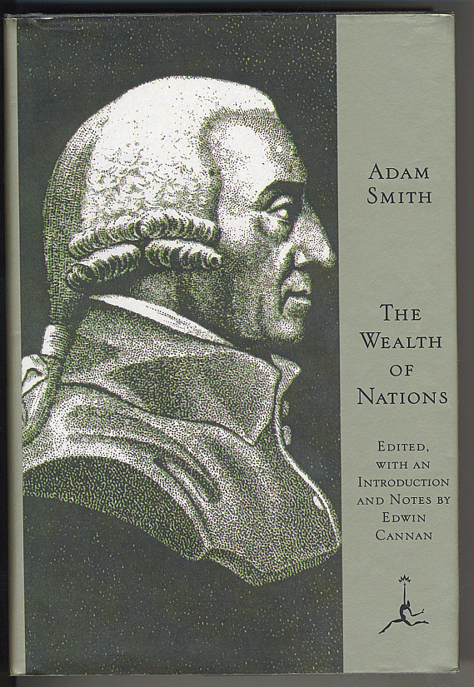
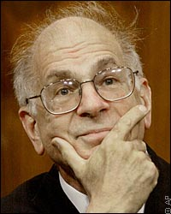
Introduction
          Economics
From Adam Smith until the 1970s economists assumed that Homo Economicus (a rational utility maximizer) is a plausible model for Homo Sapiens
The work of Kahneman, Tversky & others posed a fundamental challenge to this assumption

Slide 5
Introduction
          Philosophy
In philosophy the challenge is aimed at a METHOD that has been widely used by philosophers since antiquity
The method uses the spontaneous judgments about thought experiments as EVIDENCE in philosophical arguments
    These judgments are often called
    “(philosophical) intuitions”

Slide 6
Introduction
In a typical episode, a philosopher will describe a real or (more commonly) an imaginary situation and ask whether some of the people or objects or events in the situation described exhibit some philosophically interesting property or relation:
  Is the action described morally wrong?
  Does the person described know that some proposition is true?
  Does the protagonist in the story have free will?
  Does the “Chinese Room” (a weird sort of computer) really understand the story?

Slide 7
Introduction
When things go well, both the philosopher and his audience will agree that the answer is intuitively obvious…
…and that will be taken to be evidence for or against some philosophical thesis.

Slide 8
Introduction
An example from Plato’s Republic
Well said, Cephalus, I replied: but as concerning justice, what is it? – to speak the truth and to pay your debts – no more than this? And even to this are there not exceptions? Suppose a friend when in his right mind has deposited arms with me and he asks for them when he is not in his right mind, ought I to given them back to him? No one would say that I ought or that I should be right in doing so, any more than they would say that I ought always to speak the truth to one who is in his condition.
You are quite right, he replied.
But then, I said, speaking the truth and paying your debts is not a correct definition of justice.
Quite correct, Socrates.

Slide 9
Introduction
the thought experiment
An example from Plato’s Republic
Well said, Cephalus, I replied: but as concerning justice, what is it? – to speak the truth and to pay your debts – no more than this? And even to this are there not exceptions? Suppose a friend when in his right mind has deposited arms with me and he asks for them when he is not in his right mind, ought I to given them back to him? No one would say that I ought or that I should be right in doing so, any more than they would say that I ought always to speak the truth to one who is in his condition.
You are quite right, he replied.
But then, I said, speaking the truth and paying your debts is not a correct definition of justice.
Quite correct, Socrates.

Slide 10
Introduction
An example from Plato’s Republic
Well said, Cephalus, I replied: but as concerning justice, what is it? – to speak the truth and to pay your debts – no more than this? And even to this are there not exceptions? Suppose a friend when in his right mind has deposited arms with me and he asks for them when he is not in his right mind, ought I to given them back to him? No one would say that I ought or that I should be right in doing so, any more than they would say that I ought always to speak the truth to one who is in his condition.
You are quite right, he replied.
But then, I said, speaking the truth and paying your debts is not a correct definition of justice.
Quite correct, Socrates.
the intuitions

Slide 11
Introduction
An example from Plato’s Republic
Well said, Cephalus, I replied: but as concerning justice, what is it? – to speak the truth and to pay your debts – no more than this? And even to this are there not exceptions? Suppose a friend when in his right mind has deposited arms with me and he asks for them when he is not in his right mind, ought I to given them back to him? No one would say that I ought or that I should be right in doing so, any more than they would say that I ought always to speak the truth to one who is in his condition.
You are quite right, he replied.
But then, I said, speaking the truth and paying your debts is not a correct definition of justice.
Quite correct, Socrates.
the conclusion

Slide 12
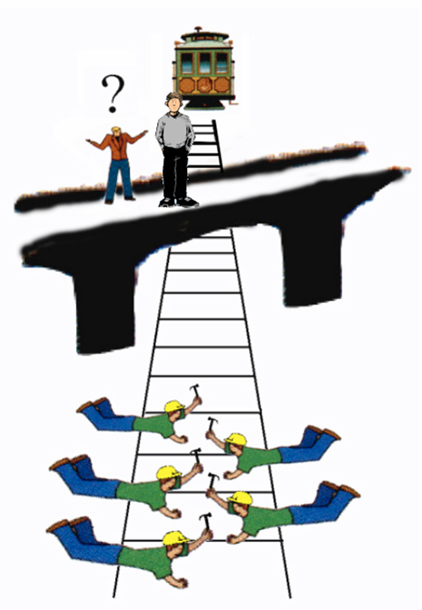
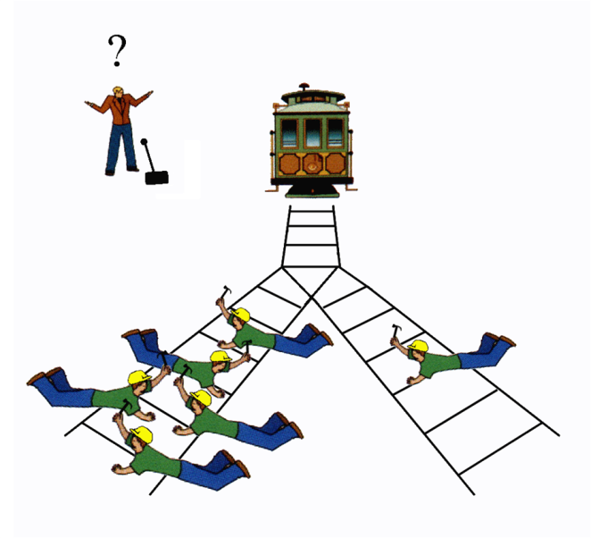
Introduction
Appeal to intuitions continues to play a central role in contemporary moral philosophy
“Trolley Problems” have been widely discussed in debates about Utilitarianism and the doctrine of double effect

Slide 13
Introduction
An example from epistemology
From Plato until the middle of the 20th century, the most widely accepted account of knowledge was that
    knowledge
    is
          justified
          true
          belief

Slide 14
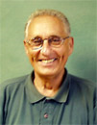
Introduction
But in 1963, Edmund Gettier constructed a collection of thought experiments which have been widely interpreted as showing that Plato’s “JTB” account of knowledge is mistaken

Slide 15
Introduction
Bob has a friend, Jill, who has driven a Buick for many years. Bob therefore thinks that Jill drives an American car. He is not aware, however, that her Buick has recently been stolen, and he is also not aware that Jill has replaced it with a Pontiac, which is a different kind of American car.
Does Bob really know that Jill drives an American car,
or
does he only believe it?

Slide 16
Introduction
Bob has a friend, Jill, who has driven a Buick for many years. Bob therefore thinks that Jill drives an American car. He is not aware, however, that her Buick has recently been stolen, and he is also not aware that Jill has replaced it with a Pontiac, which is a different kind of American car.
Does Bob really know that Jill drives an American car,
or
does he only believe it?
The intuition of most philosophers

Slide 17
Introduction
Evidence that the justified-true-belief account of knowledge is mistaken
Bob has a friend, Jill, who has driven a Buick for many years. Bob therefore thinks that Jill drives an American car. He is not aware, however, that her Buick has recently been stolen, and he is also not aware that Jill has replaced it with a Pontiac, which is a different kind of American car.
Does Bob really know that Jill drives an American car,
or
does he only believe it?
The intuition of most philosophers

Slide 18

Introduction
An example from philosophy of language
  Philosophy of Language 101
    Descriptivism, championed by Frege and others maintains that
      competent speakers associate a description with every proper name; this description specifies a set of properties
      an object is the referent of a proper name if and only if it uniquely or best satisfies the description associated with this proper name

Slide 19
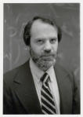
Introduction
    The Causal / Historical theory, championed by Kripke and others maintains that
    a name is introduced into a linguistic community for the purpose of referring to an individual; it continues to refer to that individual as long as its uses are linked to the individual via a causal chain of successive users
    speakers may associate descriptions with names; but after a name is introduced, the associated description does not play any role in the fixation of the referent; the referent may entirely fail to satisfy the description.

Slide 20
Introduction
    It is widely agreed that in deciding between these two theories, appeal to intuition is crucial. The correct theory is the one which best comports with our intuitions in actual and hypothetical cases.
    Kripke’s masterstroke was to propose cases that elicited widely shared intuitions that were inconsistent with traditional descriptivist theories.
    Since almost all philosophers share the intuitions elicited by Kripke's fictional cases, it was widely conceded that the description theory was in trouble and (at least) would need a sophisticated patch.

Slide 21
Introduction
Suppose that John has learned in college that Gödel is the man who proved an important mathematical theorem, called the incompleteness of arithmetic. John is quite good at mathematics and he can give an accurate statement of the incompleteness theorem, which he attributes to Gödel as the discoverer. But this is the only thing that he has heard about Gödel. Now suppose that Gödel was not the author of this theorem. A man called “Schmidt” whose body was found in Vienna under mysterious circumstances many years ago, actually did the work in question. His friend Gödel somehow got hold of the manuscript and claimed credit for the work, which was thereafter attributed to Gödel. Thus he has been known as the man who proved the incompleteness of arithmetic. Most people who have heard the name “Gödel” are like John; the claim that Gödel discovered the incompleteness theorem is the only thing they have ever heard about Gödel. When John uses the name “Gödel,” is he talking about:
    (A) the person who really discovered the incompleteness of arithmetic?
    or
    (B) the person who got hold of the manuscript and claimed credit for the work?

Slide 22
Introduction
Suppose that John has learned in college that Gödel is the man who proved an important mathematical theorem, called the incompleteness of arithmetic. John is quite good at mathematics and he can give an accurate statement of the incompleteness theorem, which he attributes to Gödel as the discoverer. But this is the only thing that he has heard about Gödel. Now suppose that Gödel was not the author of this theorem. A man called “Schmidt” whose body was found in Vienna under mysterious circumstances many years ago, actually did the work in question. His friend Gödel somehow got hold of the manuscript and claimed credit for the work, which was thereafter attributed to Gödel. Thus he has been known as the man who proved the incompleteness of arithmetic. Most people who have heard the name “Gödel” are like John; the claim that Gödel discovered the incompleteness theorem is the only thing they have ever heard about Gödel. When John uses the name “Gödel,” is he talking about:
    (A) the person who really discovered the incompleteness of arithmetic?
    or
    (B) the person who got hold of the manuscript and claimed credit for the work?
the description theory answer

Slide 23
Introduction
Evidence that the causal-historical theory is correct
Suppose that John has learned in college that Gödel is the man who proved an important mathematical theorem, called the incompleteness of arithmetic. John is quite good at mathematics and he can give an accurate statement of the incompleteness theorem, which he attributes to Gödel as the discoverer. But this is the only thing that he has heard about Gödel. Now suppose that Gödel was not the author of this theorem. A man called “Schmidt” whose body was found in Vienna under mysterious circumstances many years ago, actually did the work in question. His friend Gödel somehow got hold of the manuscript and claimed credit for the work, which was thereafter attributed to Gödel. Thus he has been known as the man who proved the incompleteness of arithmetic. Most people who have heard the name “Gödel” are like John; the claim that Gödel discovered the incompleteness theorem is the only thing they have ever heard about Gödel. When John uses the name “Gödel,” is he talking about:
    (A) the person who really discovered the incompleteness of arithmetic?
    or
    (B) the person who got hold of the manuscript and claimed credit for the work?
the causal-historical theory answer
The intuition of most philosophers

Slide 24
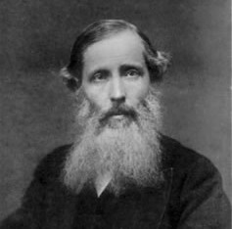
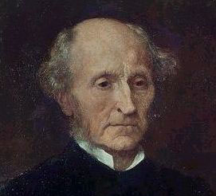
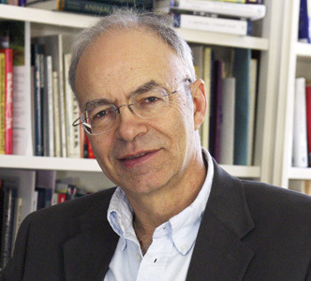
Introduction
Though this method is familiar and widely used, it has been subjected to a fair amount of criticism from both historical and contemporary philosophers
Sidgwick
Mill
Singer

Slide 25
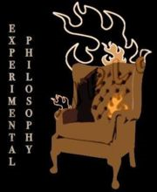
Introduction
X-PHIL has opened a new and powerful line of criticism of the entrenched philosophical practice of using intuitions as evidence by conducting experiments designed to explore the factors that influence intuitive judgments
What these experiments have shown is that, in many cases, intuitions are influenced by factors that undermine their use as evidence for philo- sophical theories

Slide 26
An Overview of the Rest of the Talk
What is Experimental Philosophy?
Three Families of Philosophical Projects
The Empirical Study of Philosophical Intuitions: Four Sorts of Findings that Challenge the Use of Intuitions as Evidence
What Can We Conclude from these Findings?

Slide 27
What Is a Experimental Philosophy?
As I use the term, it has a broad extension and very fuzzy boundaries
  Experimental philosophy is empirical work undertaken with the goal of contributing to a philosophical debate
    though that may not be the only goal
  Sometimes experimental philosophers do experiments, sometimes they don’t
    Brandt’s Hopi ethnography is leading example of X-Φ
  Some X-Φ is done by philosophers, some is done by psychologists, anthropologists, economists, etc.

Slide 28
An Overview of the Rest of the Talk
What is Experimental Philosophy?
Three Families of Philosophical Projects
The Empirical Study of Philosophical Intuitions: Four Sorts of Findings that Challenge the Use of Intuitions as Evidence
What Can We Conclude from these Findings?

Slide 29
Three Families of Philosophical Projects
1. Conceptual Analysis: Projects in the first family aim to analyze or characterize some philosophically important concept, like
  the concept of knowledge, or the concept of rationality (in epistemology)
  the concept of causation or the concept of free will (in metaphysics)
  the concept of belief or the concept of emotion (in the philosophy of mind)
  the concept of moral responsibility or the concept of justice (in ethics)

Slide 30
Three Families of Philosophical Projects
  The term ‘concept’ can be understood quite differently by different philosophers.
  The prototypical examples of the sort of conceptual analysis that I have in mind try to characterize what Goldman usefully labels personal psychological concepts.
    A concept, in this sense, “is literally something in the head, for example, a mental representation of a category”

Slide 31
Three Families of Philosophical Projects
2. The goal of projects in the second family is to characterize some philosophically important phenomenon, property, state or relationship. For example,
  in epistemology, projects in this family try to characterize knowledge, not some person or group’s concept of knowledge
  in metaphysics, projects in this family try to characterize causation, not some person or group’s concept of causation
  in ethics, projects in this family try to characterize justice, not some person or group’s concept of justice

Slide 32
Three Families of Philosophical Projects
3. Projects in the third family have as their goal articulating and defending claims that are explicitly normative. For example,
  in epistemology, projects in this family try to say what people ought to believe or how people ought to revise their beliefs when confronted with new evidence
  in ethics, projects in this family try to say how we should act, or what sorts of people we should be

Slide 33
Three Families of Philosophical Projects
1.
Conceptual Analysis
the concept of knowledge
the concept of justice
the concept of causation
2.
Characterizing a philosophically important phenomenon
knowledge
justice
causation
3.
Defend claims that are explicitly normative
how people should revise their beliefs
what sort of people we should be

Slide 34
Three Families of Philosophical Projects
1.
Conceptual Analysis
the concept of knowledge
the concept of justice
the concept of causation
2.
Characterizing a philosophically important phenomenon
knowledge
justice
causation
3.
Defend claims that are explicitly normative
how people should revise their beliefs
what sort of people we should be
I have no in principle objection to using intuitions as evidence for projects of this sort.

Slide 35
Three Families of Philosophical Projects
1.
Conceptual Analysis
the concept of knowledge
the concept of justice
the concept of causation
2.
Characterizing a philosophically important phenomenon
knowledge
justice
causation
3.
Defend claims that are explicitly normative
how people should revise their beliefs
what sort of people we should be
I do have serious qualms about the way philosophers have gathered evidence about intuitions. But that’s a topic for another talk.

Slide 36
Three Families of Philosophical Projects
1.
Conceptual Analysis
the concept of knowledge
the concept of justice
the concept of causation
2.
Characterizing a philosophically important phenomenon
knowledge
justice
causation
3.
Defend claims that are explicitly normative
how people should revise their beliefs
what sort of people we should be
I do have serious qualms about the way philosophers have gathered evidence about intuitions. But that’s a topic for another talk.

Slide 37
Three Families of Philosophical Projects
1.
Conceptual Analysis
the concept of knowledge
the concept of justice
the concept of causation
2.
Characterizing a philosophically important phenomenon
knowledge
justice
causation
3.
Defend claims that are explicitly normative
how people should revise their beliefs
what sort of people we should be
I do have serious qualms about the way philosophers have gathered evidence about intuitions. But that’s a topic for another talk.

Slide 38
Three Families of Philosophical Projects
2.
Characterizing a philosophically important phenomenon
knowledge
justice
causation
3.
Defend claims that are explicitly normative
how people should revise their beliefs
what sort of people we should be
I maintain that there are EMPIRICAL reasons to worry about the use of intuitions as evidence in projects like these

Slide 39
An Overview of the Rest of the Talk
What is Experimental Philosophy?
Three Families of Philosophical Projects
The Empirical Study of Philosophical Intuitions: Four Sorts of Findings that Challenge the Use of Intuitions as Evidence
What Can We Conclude from these Findings?

Slide 40
Some Empirical Reasons to Worry About the Use of Intuitions as Evidence
The empirical studies I’ll focus on falls into four categories
  1. Studies that find demographic differences in intuitions
  2. Studies that find order effects in intuitions
  3. Studies that find framing effects in intuitions
  4. Studies that find intuitions are covertly influenced by environmental factors which are irrelevant to the subject matter of the intuition

Slide 41
Some Empirical Reasons to Worry About the Use of Intuitions as Evidence
1. Demographic Differences
  i. Differences in epistemic intuitions elicited from
  a. Americans students of European ancestry & American students of East Asian ancestry
  b. high SES Americans & low SES Americans
  c. students who have had one or more philosophy course & students who have had no philosophy courses (Weinberg et al. 2001: Nichols et al. 2003)

Slide 42
Some Empirical Reasons to Worry About the Use of Intuitions as Evidence
Gettier Cases
Bob has a friend, Jill, who has driven a Buick for many years. Bob therefore thinks that Jill drives an American car. He is not aware, however, that her Buick has recently been stolen, and he is also not aware that Jill has replaced it with a Pontiac, which is a different kind of American car.
Does Bob really know that Jill drives an American car,
or
does he only believe it?

Slide 43
Some Empirical Reasons to Worry About the Use of Intuitions as Evidence
Gettier Case
Western & East Asian

Slide 44
Some Empirical Reasons to Worry About the Use of Intuitions as Evidence
Gettier Case
Western & South Asian

Slide 45
Some Empirical Reasons to Worry About the Use of Intuitions as Evidence
1. Demographic Differences
  i. Differences in epistemic intuitions elicited from
  a. Americans students of European ancestry & American students of East Asian ancestry
  b. high SES Americans & low SES Americans
  c. students who have had one or more philosophy course & students who have had no philosophy courses (Weinberg et al. 2001: Nichols et al. 2003)
What about gender?

Slide 46
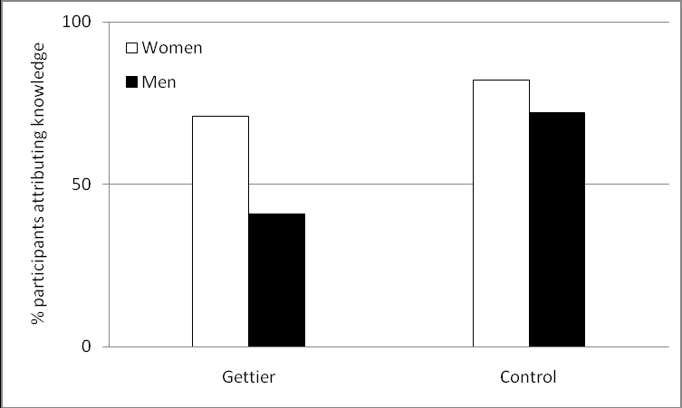
Some Empirical Reasons to Worry About the Use of Intuitions as Evidence
Starmans & Friedman (forthcoming)
1. Demographic Differences
  i. Differences in epistemic intuitions elicited from
  a. Americans students of European ancestry & American students of East Asian ancestry
  b. high SES Americans & low SES Americans
  c. students who have had one or more philosophy course & students who have had no philosophy courses (Weinberg et al. 2001: Nichols et al. 2003)
What about gender?

Slide 47
Some Empirical Reasons to Worry About the Use of Intuitions as Evidence
1. Demographic Differences
  ii. Differences in intuitions about reference elicited from American students and English speaking Chinese students in Hong King (Machery et al. 2004)

Slide 48
Some Empirical Reasons to Worry About the Use of Intuitions as Evidence
Kripke’s Gödel Case
Suppose that John has learned in college that Gödel is the man who proved an important mathematical theorem, called the incompleteness of arithmetic. John is quite good at mathematics and he can give an accurate statement of the incompleteness theorem, which he attributes to Gödel as the discoverer. But this is the only thing that he has heard about Gödel. Now suppose that Gödel was not the author of this theorem. A man called “Schmidt” whose body was found in Vienna under mysterious circumstances many years ago, actually did the work in question. His friend Gödel somehow got hold of the manuscript and claimed credit for the work, which was thereafter attributed to Gödel. Thus he has been known as the man who proved the incompleteness of arithmetic. Most people who have heard the name “Gödel” are like John; the claim that Gödel discovered the incompleteness theorem is the only thing they have ever heard about Gödel. When John uses the name “Gödel,” is he talking about:
(A) the person who really discovered the incompleteness of arithmetic?
or
(B) the person who got hold of the manuscript and claimed credit for the work?

Slide 49
70
Percentage of participants
giving causal-historical responses
60
50
40
Westerners
30
Chinese
20
10
0
Gödel case #1
χ 2 (1, N=72) = 6.023, p < .05

Slide 50
Machery, Olivola & DeBlanc, 2009

Slide 51
Some Empirical Reasons to Worry About the Use of Intuitions as Evidence
1. Demographic Differences
  iii. Differences in moral judgments
    about the treatment of animals (Brandt)
    “the Magistrate and the Mob” (Peng, Doris, et al.)
    the Ultimatum Game (Henrich et al.)
    the Public Goods Game (Gächter et al.)

Slide 52
Some Empirical Reasons to Worry About the Use of Intuitions as Evidence
Epistemology
Reference
Ethics
Demographic Differences | TrueTemp (W/EA) Gettier (W/EA/SA; SES, HiΦ /Lo-Φ, Gender) | Gödel (US/HK in English) Gödel (US/Fr/India/ Mongolia - trans.) | Animals (Brandt – Hopi) Magistrate & Mob (Peng et al.) UG (Henrich et al. 16 small scale) PGG (Gächter et al.)
Order Effects | TrueTemp (Weinberg et al.) |  | Various (Petrinovich & O’Neill, Haidt & Baron, Fessler et al.)
Framing Effects |  |  | Various (Tversky & Kahneman, Petrinovich & O’Neill, etc.)
Environmental Factors |  |  | Dirty Office & Lady Macbeth (Schnall) Saturday Night Live (Valdesolo & DeSteno)

Slide 53
Some Empirical Reasons to Worry About the Use of Intuitions as Evidence
Epistemology
Reference
Ethics
Demographic Differences | TrueTemp (W/EA) Gettier (W/EA/SA; SES, HiΦ /Lo-Φ, Gender) | Gödel (US/HK in English) Gödel (US/Fr/India/ Mongolia - trans.) | Animals (Brandt – Hopi) Magistrate & Mob (Peng et al.) UG (Henrich et al. 16 small scale) PGG (Gächter et al.)
Order Effects | TrueTemp (Weinberg et al.) |  | Various (Petrinovich & O’Neill, Haidt & Baron, Fessler et al.)
Framing Effects |  |  | Various (Tversky & Kahneman, Petrinovich & O’Neill, etc.)
Environmental Factors |  |  | Dirty Office & Lady Macbeth (Schnall) Saturday Night Live (Valdesolo & DeSteno)

Slide 54
Some Empirical Reasons to Worry About the Use of Intuitions as Evidence
1. Demographic Differences
  If these findings are reliable & robust, the consequences for those who would use intuitions as evidence in Projects 2 & 3 are unsettling.

Slide 55
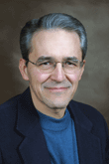
Some Empirical Reasons to Worry About the Use of Intuitions as Evidence
1. Demographic Differences
  As Sosa, a leading advocate of the use of intuitions in Projects 2 & 3 has noted, if we are going to take our intuitions (i.e. the intuitions of mostly upper middle class, mostly white, mostly western, mostly male and all highly educated professional philosophers) as evidence, we will need some “theory of error that will explain why so many are going wrong when we are getting it right”
  And plausible, empirically supported theories of that sort are not exactly thick on the ground

Slide 56
Some Empirical Reasons to Worry About the Use of Intuitions as Evidence
The empirical studies I’ll focus on falls into four categories
  1. Studies that find demographic differences in intuitions
  2. Studies that find order effects in intuitions
  3. Studies that find framing effects in intuitions
  4. Studies that find intuitions are covertly influenced by environmental factors which are irrelevant to the subject matter of the intuition

Slide 57
Some Empirical Reasons to Worry About the Use of Intuitions as Evidence
2. Order Effects
  In a typical demonstration of order effects, participants are asked to make judgments about a number of cases, and their judgments vary as a function of the order in which the cases are presented

Slide 58
Some Empirical Reasons to Worry About the Use of Intuitions as Evidence
2. Order Effects
  Significant order effects have been found in participants judgments about trolley problems & a variety of other moral issues (Petrinovich & O’Neill (1996); Haidt & Baron (1996))
E
T
H
I
C
S

Slide 59
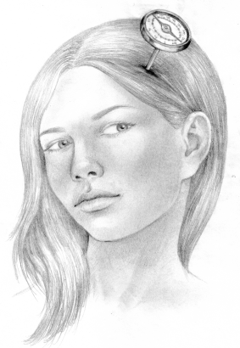
Some Empirical Reasons to Worry About the Use of Intuitions as Evidence
2. Order Effects
  Swain, Alexander & Weinberg (2008) report some important order effects in intuitions about “Truetemp”
  “Intuitions about the Truetemp Case reverse direction depending on whether the case is presented after a case of clear non-knowledge.”
EPISTEMOLOGY

Slide 60
Some Empirical Reasons to Worry About the Use of Intuitions as Evidence
2. Order Effects
  Swain, Alexander & Weinberg (2008) report some important order effects in intuitions about “Truetemp”
  “Intuitions about the Truetemp Case reverse direction depending on whether the case is presented after a case of clear non-knowledge.”
EPISTEMOLOGY

Slide 61
Some Empirical Reasons to Worry About the Use of Intuitions as Evidence
2. Order Effects
  As Swain and colleagues note: “The fact that people’s intuitions about particular thought-experiments vary based on what other things they have been thinking about recently is troubling. Philosophers who rely on thought-experiments should be especially concerned about findings that indicate that, at least in some cases, subjects’ intuitions are easily influenced.
EPISTEMOLOGY

Slide 62
Some Empirical Reasons to Worry About the Use of Intuitions as Evidence
  Of course, it is not merely the ease with which intuitions or judgments are influenced that is disquieting
    it is the fact that they are being influenced by factors that appear to be irrelevant to the subject matter of the judgment.
  As Sinnott-Armstrong notes, in a discussion of order effects in moral judgment studies
    “the truth about what is morally right or wrong in the cases did not vary with order. Hence moral [intuitions] fail to track the truth and are unreliable insofar as they are subject to such order effects.” (Sinnott-Armstrong 2008, 67)

Slide 63
Some Empirical Reasons to Worry About the Use of Intuitions as Evidence
  Of course, it is not merely the ease with which intuitions or judgments are influenced that is disquieting
    it is the fact that they are being influenced by factors that appear to be irrelevant to the subject matter of the judgment.
  As Sinnott-Armstrong notes, in a discussion of order effects in moral judgment studies
    “the truth about what is morally right or wrong in the cases did not vary with order.
    Hence moral [intuitions] fail to track the truth and are unreliable insofar as they are subject to such order effects.” (Sinnott-Armstrong 2008, 67)

Slide 64
Some Empirical Reasons to Worry About the Use of Intuitions as Evidence
Epistemology
Reference
Ethics
Demographic Differences | TrueTemp (W/EA) Gettier (W/EA/SA; SES, HiΦ /Lo-Φ, Gender) | Gödel (US/HK in English) Gödel (US/Fr/India/ Mongolia - trans.) | Animals (Brandt – Hopi) Magistrate & Mob (Peng et al.) UG (Henrich et al. 16 small scale) PGG (Gächter et al.)
Order Effects | TrueTemp (Weinberg et al.) |  | Various (Petrinovich & O’Neill, Haidt & Baron, Fessler et al.)
Framing Effects |  |  | Various (Tversky & Kahneman, Petrinovich & O’Neill, etc.)
Environmental Factors |  |  | Dirty Office & Lady Macbeth (Schnall) Saturday Night Live (Valdesolo & DeSteno)

Slide 65
Some Empirical Reasons to Worry About the Use of Intuitions as Evidence
Epistemology
Reference
Ethics
Demographic Differences | TrueTemp (W/EA) Gettier (W/EA/SA; SES, HiΦ /Lo-Φ, Gender) | Gödel (US/HK in English) Gödel (US/Fr/India/ Mongolia - trans.) | Animals (Brandt – Hopi) Magistrate & Mob (Peng et al.) UG (Henrich et al. 16 small scale) PGG (Gächter et al.)
Order Effects | TrueTemp (Weinberg et al.) |  | Various (Petrinovich & O’Neill, Haidt & Baron, Fessler et al.)
Framing Effects |  |  | Various (Tversky & Kahneman, Petrinovich & O’Neill, etc.)
Environmental Factors |  |  | Dirty Office & Lady Macbeth (Schnall) Saturday Night Live (Valdesolo & DeSteno)

Slide 66
Some Empirical Reasons to Worry About the Use of Intuitions as Evidence
The empirical studies I’ll focus on falls into four categories
  1. Studies that find demographic differences in intuitions
  2. Studies that find order effects in intuitions
  3. Studies that find framing effects in intuitions
  4. Studies that find intuitions are covertly influenced by environmental factors which are irrelevant to the subject matter of the intuition

Slide 67
Some Empirical Reasons to Worry About the Use of Intuitions as Evidence
3. Framing Effects
  A “framing effect” is a change in intuition that is correlated with a small (and apparently inconsequential) change in the vignette used to elicit the intuition
  The most famous of these is Tversky and Kahneman’s case of the impending Asian disease

Slide 68
Some Empirical Reasons to Worry About the Use of Intuitions as Evidence
Imagine the U.S. is preparing for the outbreak of an unusual Asian disease which is expected to kill 600 people. Two alternative programs to combat the disease have been proposed. Assume that the exact scientific estimates of the consequences of the program are as follows:

Slide 69
Some Empirical Reasons to Worry About the Use of Intuitions as Evidence
If program A is adopted , 200 people will be saved.
If program B is adopted, there is a 1/3 probability that 600 people will be saved and a 2/3 probability that no people will be saved.

Slide 70
Some Empirical Reasons to Worry About the Use of Intuitions as Evidence
If program A is adopted , 200 people will be saved.
If program B is adopted, there is a 1/3 probability that 600 people will be saved and a 2/3 probability that no people will be saved.

Slide 71
Some Empirical Reasons to Worry About the Use of Intuitions as Evidence
If program A is adopted , 200 people will be saved.
If program B is adopted, there is a 1/3 probability that 600 people will be saved and a 2/3 probability that no people will be saved.
If program C is adopted, 400 people will die.
If program D is adopted, there is a 1/3 probability that nobody will die and a 2/3 probability that 600 people will die.

Slide 72
Some Empirical Reasons to Worry About the Use of Intuitions as Evidence
If program A is adopted , 200 people will be saved.
If program B is adopted, there is a 1/3 probability that 600 people will be saved and a 2/3 probability that no people will be saved.
If program C is adopted, 400 people will die.
If program D is adopted, there is a 1/3 probability that nobody will die and a 2/3 probability that 600 people will die.

Slide 73
Some Empirical Reasons to Worry About the Use of Intuitions as Evidence
If program A is adopted , 200 people will be saved.
If program B is adopted, there is a 1/3 probability that 600 people will be saved and a 2/3 probability that no people will be saved.
If program C is adopted, 400 people will die.
If program D is adopted, there is a 1/3 probability that nobody will die and a 2/3 probability that 600 people will die.

Slide 74
Some Empirical Reasons to Worry About the Use of Intuitions as Evidence
  Similar framing effects have been found in trolley problems and in a wide range of decision tasks

Slide 75
Some Empirical Reasons to Worry About the Use of Intuitions as Evidence
  What is disquieting about these findings is that people’s moral intuitions are being profoundly, though covertly, influenced by factors that just about everyone takes to be morally irrelevant.
  In cases where this sort of influence is a serious possibility, the status of moral intuitions as evidence for moral conclusions is called into question.
  But the only way to know when framing is likely is to undertake systematic empirical studies.

Slide 76
Some Empirical Reasons to Worry About the Use of Intuitions as Evidence
  Philosophers who continue to rely on intuitions as evidence without undertaking these sorts of studies are, I submit, simply being intellectually irresponsible.

Slide 77
Some Empirical Reasons to Worry About the Use of Intuitions as Evidence
Epistemology
Reference
Ethics
Demographic Differences | TrueTemp (W/EA) Gettier (W/EA/SA; SES, HiΦ /Lo-Φ, Gender) | Gödel (US/HK in English) Gödel (US/Fr/India/ Mongolia - trans.) | Animals (Brandt – Hopi) Magistrate & Mob (Peng et al.) UG (Henrich et al. 16 small scale) PGG (Gächter et al.)
Order Effects | TrueTemp (Weinberg et al.) |  | Various (Petrinovich & O’Neill, Haidt & Baron, Fessler et al.)
Framing Effects |  |  | Various (Tversky & Kahneman, Petrinovich & O’Neill, etc.)
Environmental Factors |  |  | Dirty Office & Lady Macbeth (Schnall) Saturday Night Live (Valdesolo & DeSteno)

Slide 78
Some Empirical Reasons to Worry About the Use of Intuitions as Evidence
Epistemology
Reference
Ethics
Demographic Differences | TrueTemp (W/EA) Gettier (W/EA/SA; SES, HiΦ /Lo-Φ, Gender) | Gödel (US/HK in English) Gödel (US/Fr/India/ Mongolia - trans.) | Animals (Brandt – Hopi) Magistrate & Mob (Peng et al.) UG (Henrich et al. 16 small scale) PGG (Gächter et al.)
Order Effects | TrueTemp (Weinberg et al.) |  | Various (Petrinovich & O’Neill, Haidt & Baron, Fessler et al.)
Framing Effects |  |  | Various (Tversky & Kahneman, Petrinovich & O’Neill, etc.)
Environmental Factors |  |  | Dirty Office & Lady Macbeth (Schnall) Saturday Night Live (Valdesolo & DeSteno)

Slide 79
Some Empirical Reasons to Worry About the Use of Intuitions as Evidence
The empirical studies I’ll focus on falls into four categories
  1. Studies that find demographic differences in intuitions
  2. Studies that find order effects in intuitions
  3. Studies that find framing effects in intuitions
  4. Studies that find intuitions are covertly influenced by environmental factors which are irrelevant to the subject matter of the intuition

Slide 80
Some Empirical Reasons to Worry About the Use of Intuitions as Evidence
4. Covert Influence by Irrelevant Environmental Factors
  Studies of framing show that intuitions or judgments are covertly influenced by features of the question that are irrelevant to the issue at hand.
  There is also a large body of work showing that, in many cases, people’s judgments, choices and behavior are influenced by features of the physical or social situation in which the judgment is elicited – features which are utterly irrelevant to the substance of the judgment.

Slide 81
Some Empirical Reasons to Worry About the Use of Intuitions as Evidence
Schnall & colleagues asked subjects to make judgments about whether the characters described in 24 brief vignettes were doing something wrong, and to rate the wrongness on a 7 point Likert scale.
Some of the subjects performed the task at a clean and tidy desk.
Others did it at a desk arranged to evoke mild feelings of disgust

Slide 82
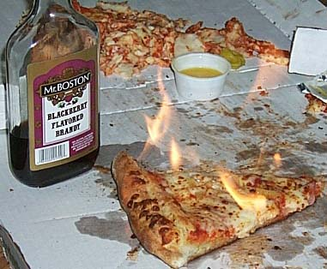
Some Empirical Reasons to Worry About the Use of Intuitions as Evidence
greasy pizza boxes
sticky chair
a dried up smoothie
a chewed up pen

Slide 83
Some Empirical Reasons to Worry About the Use of Intuitions as Evidence
Judgments of the subjects in the disgust evoking environment were significantly more severe!

Slide 84
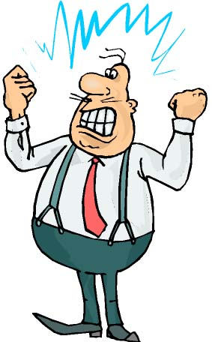
Some Empirical Reasons to Worry About the Use of Intuitions as Evidence
Schnall & Prinz have recently shown that anger induction leads participants make more severe moral judgments in some cases but not in others

Slide 85
Some Empirical Reasons to Worry About the Use of Intuitions as Evidence
The Lady Macbeth Effect
  Zhong & Liljenquist have shown that recalling an unethical deed increased the desire for products related to cleansing, like antiseptic wipes
  And that cleaning one’s hands after describing a past unethical deed reduced moral emotions like guilt & shame
    and also reduced the likelihood that participants would volunteer to help a desperate graduate student!

Slide 86

Some Empirical Reasons to Worry About the Use of Intuitions as Evidence
In another experiment, illustrating the Lady Macbeth Effect, Schnall & colleagues found that the moral judgments of subjects who had just used an alcohol based cleaning gel were significantly less severe than the judgments of subjects who had used an ordinary non-cleansing hand cream

Slide 87
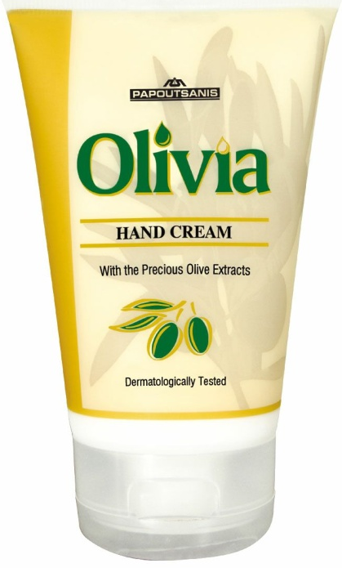
Some Empirical Reasons to Worry About the Use of Intuitions as Evidence
In another experiment, illustrating the Lady Macbeth Effect, Schnall & colleagues found that the moral judgments of subjects who had just used an alcohol based cleaning gel were significantly less severe than the judgments of subjects who had used an ordinary non-cleansing hand cream

Slide 88

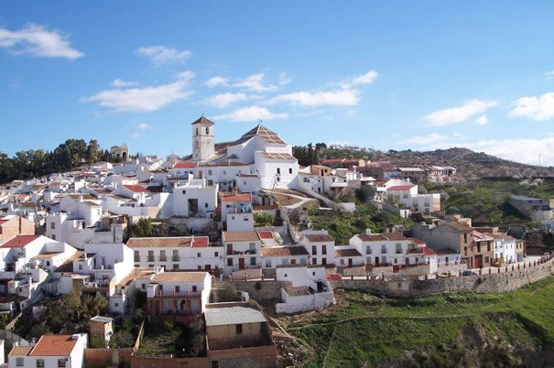
Some Empirical Reasons to Worry About the Use of Intuitions as Evidence
Valdesolo & DeSteno
32%
8%

Slide 89
Some Empirical Reasons to Worry About the Use of Intuitions as Evidence
Epistemology
Reference
Ethics
Demographic Differences | TrueTemp (W/EA) Gettier (W/EA/SA; SES, HiΦ /Lo-Φ, Gender) | Gödel (US/HK in English) Gödel (US/Fr/India/ Mongolia - trans.) | Animals (Brandt – Hopi) Magistrate & Mob (Peng et al.) UG (Henrich et al. 16 small scale) PGG (Gächter et al.)
Order Effects | TrueTemp (Weinberg et al.) |  | Various (Petrinovich & O’Neill, Haidt & Baron, Fessler et al.)
Framing Effects |  |  | Various (Tversky & Kahneman, Petrinovich & O’Neill, etc.)
Environmental Factors |  |  | Dirty Office & Lady Macbeth (Schnall) Saturday Night Live (Valdesolo & DeSteno)

Slide 90
Some Empirical Reasons to Worry About the Use of Intuitions as Evidence
Epistemology
Reference
Ethics
Demographic Differences | TrueTemp (W/EA) Gettier (W/EA/SA; SES, HiΦ /Lo-Φ, Gender) | Gödel (US/HK in English) Gödel (US/Fr/India/ Mongolia - trans.) | Animals (Brandt – Hopi) Magistrate & Mob (Peng et al.) UG (Henrich et al. 16 small scale) PGG (Gächter et al.)
Order Effects | TrueTemp (Weinberg et al.) |  | Various (Petrinovich & O’Neill, Haidt & Baron, Fessler et al.)
Framing Effects |  |  | Various (Tversky & Kahneman, Petrinovich & O’Neill, etc.)
Environmental Factors |  |  | Dirty Office & Lady Macbeth (Schnall) Saturday Night Live (Valdesolo & DeSteno)

Slide 91
An Overview of the Rest of the Talk
What is Experimental Philosophy?
What Is a Philosophical Intuition?
A Taxonomy of Philosophical Projects
The Empirical Study of Philosophical Intuitions: Four Sorts of Findings that Challenge the Use of Intuitions as Evidence
What Can We Conclude from these Findings?

Slide 92
What Conclusions Can We Draw From This Evidence?
To the extent that a class of intuitions or judgments are subject to one or more of the four phenomena I’ve discussed, their status as evidence in Projects 2 & 3 is severely compromised.
3.
Defend claims that are explicitly normative
how people should revise their beliefs
what sort of people we should be
2.
Characterizing a philosophically important phenomenon
knowledge
justice
causation

Slide 93
What Conclusions Can We Draw From This Evidence?
  If a class of judgments vary with the demographic group that makes them, or with the order in which they are made, then many judgments in that class cannot be true.
  Judgments which vary with irrelevant features of the wording of the question, or with irrelevant features of the situation in which the question is asked are not to be trusted.

Slide 94
What Conclusions Can We Draw From This Evidence?
Without careful experimental work, it is typically not possible to know whether one’s own judgments, or those of others, are influenced by the phenomena we’ve discussed
  Introspection is of no help!
  The advice, offered by Williamson, Sosa & others, that one should “be careful” in using one’s intuitions – is quite useless…
    unless being careful means: Engage in a wide ranging empirical inquiry into the many ways in which the evidential status of our intuitions might be undermined

Slide 95
How Pervasive Is the Problem?
Which judgments or philosophical intuitions are likely to be undermined by phenomena like those on our list?
At this point we just don’t know.
  I certainly do not claim that all of the judgments or intuitions that have played a role in philosophical discussions are influenced by demography, order, framing or context.

Slide 96
How Pervasive Is the Problem?
But I don’t envy the situation of the philosopher who is betting these effects will be limited to just a few philosophical intuitions
It is a striking fact that when psychologists or empirically minded philosophers go looking for trouble with the sorts of intuitions that philosophers invoke, far more often than not, they find it.
  Indeed, some of the results I’ve discussed were found by investigators who weren’t looking for them.

Slide 97
How Pervasive Is the Problem?
As I see it, the philosopher who uses intuitions as evidence in projects of type 2 & type 3 is a bit like a pilot with alarm bells going off all over the cockpit.
  Perhaps most of them are false alarms; perhaps the problems are restricted to just a few non-essential components of his plane.

Slide 98
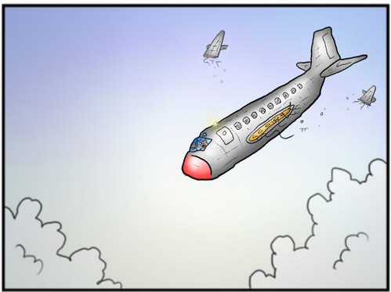
How Pervasive Is the Problem?
As I see it, the philosopher who uses intuitions as evidence in projects of type 2 & type 3 is a bit like a pilot with alarm bells going off all over the cockpit.
  Perhaps most of them are false alarms; perhaps the problems are restricted to just a few non-essential components of his plane.
  But if I were that pilot – or if I were a practitioner of intuition based philosophy – we would be getting very worried
M

Slide 99
How Pervasive Is the Problem?
The value of much of what has been done on Projects 2 & 3, from antiquity to the present, is contingent on a rarely acknowledged empirical bet that most philosophical intuitions are not significantly influenced by irrelevant factors like those that I’ve sketched in the previous section.

Slide 100


How Pervasive Is the Problem?
If that bet is lost, then a great deal of what goes on in contemporary philosophy, and a great deal of what has gone on in the past, belongs in the rubbish bin.

Slide 101

How Pervasive Is the Problem?
The End
If that bet is lost, then a great deal of what goes on in contemporary philosophy, and a great deal of what has gone on in the past, belongs in the rubbish bin.

