Slide 1
Random volumes from matrices
Naoya Umeda (Kyoto Univ.)
2016.2.15 @京都産業大学 益川塾
Based on the work with
Masafumi Fukuma and Sotaro Sugishita (Kyoto Univ.)
[arXiv:1503.08812][JHEP 1507 (2015) 088] “Random volumes from matrices”
[arXiv:1504.03532] “Putting matters on the triangle-hinge models”
M. Fukuma, S. Sugishita and N.U. (in preparation / work in progress)

Slide 2
Introduction
String theory : strong candidate for unified theory including QG
M theory : one of the aspects of the string theory
supermembrane theory in 11D spacetime
the random walk of a membrane (random volumes)
Random volume theory : 3D QG theory coupled to scalar fields
In this talk, we discuss the discretized approach to random volume theory.

Slide 3
Introduction
Discretized approach (random surfaces)
Random surface theory : 2D QG theory coupled to scalar fields
We approximate 2D surfaces as triangular decompositions:
2D closed surface
triangular decomposition
Then is defined as the sum of
all distinct connected triangular decompositions.
We now consider the model such that
the free energy can be realized as the sum of triangular decompositions.

Slide 4
Introduction
Discretized approach (random surfaces)
This form of free energy can be obtained by the matrix models.
: Hermitian matrix
Feynman rules
Feynman diagram
This model dynamically generates
triangular decompositions.

Slide 5
Introduction
Discretized approach (random surfaces)
: Hermitian matrix
This model can be solved analytically:
diagonalization :
effective action :
Large analysis can be performed by the saddle point method.

Slide 6
Introduction
Discretized approach of 3D random volumes
The discretized approach to 3D random volume theory
can be obtained in the similar way as that of 2D random surface theory.
We approximate 3D volumes as tetrahedral decompositions:
closed 3D volume
tetrahedral decomposition
Then is defined as the sum of
all distinct connected tetrahedral decompositions
of 3D manifolds.

Slide 7
One approach (tensor models)
[Ambjorn et al.-Sasakura 1991]
Matrix models
Tensor models
: Hermitian matrix
: tensor
Feynman diagrams
triangular decompositions
tetrahedral decompositions

Slide 8
One approach (tensor models)
Matrix models
Tensor models
Analytic property
Analytic property
diagonalization
effective action
no such analogues
large analysis can be performed
by the saddle point method
We propose a new class of “matrix models”
which generate 3D random volumes.

Slide 9
Plan of talk
Introduction
The models (triangle-hinge models)
- Model definition
- Algebraic construction
General forms of the free energy
Matrix ring
Restricting to manifolds
Assigning matter degrees of freedom

Slide 10
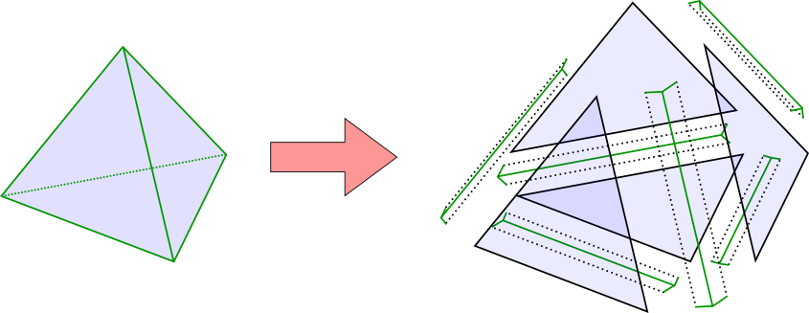
The models (triangle-hinge models)
Main idea
Using triangles (instead of tetrahedra) as building blocks.
That is, we decompose a tetrahedral decomposition to
a collection of triangles glued together along multiple hinges.
[cf: Chung-Fukuma-Shapere 1993]
hinge
triangle
tetrahedral decomposition
triangle
hinge (蝶番)

Slide 11
The models (triangle-hinge models)
Strategy
We construct tetrahedral decompositions in the following steps:
(1) Decompose a tetrahedral decomposition
to a collection of triangles and hinges
decompose
(2) Assign real numbers and :
triangles
- hinges

Slide 12
Here, and have two symmetries:
The properties of and
(1) rotation: these are cyclically symmetric.
(2) flip: these are invariant under flipping.
Here, is the “direction revering tensor”, which satisfies .

Slide 13
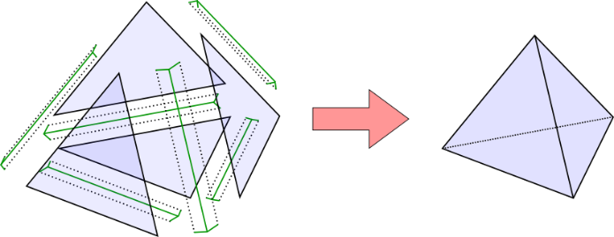
The models (triangle-hinge models)
Strategy
(3) Reconstruct the original tetrahedral decomposition
by gluing triangles and hinges along edges
with the tensors and
reconstruct
same direction
opposite direction
(4) Assign Boltzmann weight to diagram
The indices are contracted when two edges are identified
( to be inserted when necessary )

Slide 14
The models (triangle-hinge models)
Model definition (strategy)
dynamical variables
with
action
Feynman rules
glued:
: projection matrix
: invariant under

Slide 15
The models (triangle-hinge models)
Triangles and hinges have orientations.
In order to represent the orientations,
we set the index to be double index ; .
: single index
: double index

Slide 16
The models (triangle-hinge models)
Algebraic construction
The building blocks and can be obtained
from a semisimple associative algebra .
linear space with product
satisfying associativity :
In the following, we take a basis .
The product is expressed as
( : structure constants)
have two important properties.
(1) associativity
cyclically symmetric

Slide 17
The models (triangle-hinge models)
(2) metric
is semisimple
has
[Fukuma-Hosono-Kawai 1994]
can be defined as
And we can choose as
rotation :
These have the symmetries
flip :

Slide 18
The models (triangle-hinge models)
Model definition (summary)
This model is characterized by an associative algebra .
dynamical variables
: real symmetric matrices
action
Here, and is the inverse of .
algebraic properties
(1) associativity
(2) metric

Slide 19
Plan of talk
Introduction
The models (triangle-hinge models)
General forms of the free energy
Matrix ring
Restricting to manifolds
Assigning matter degrees of freedom

Slide 20
General forms of the free energy
Index function and index networks
action
The free energy of this model has the following form:
: connected diagram
: symmetry factor
: # of triangles
: # of -hinges
: a function of and (thus a function of )
“index function of diagram ”
We claim :
is given as the product of 2D topological invariants,
which are defined around the vertices of the diagram .

Slide 21
General forms of the free energy
This fact can be shown in two steps:
(1) is given as the product of the contributions from vertices :
The index lines on two different hinges
are connected (through an intermediate triangle)
if and only if the hinges share the same vertex of .
The connected components of the index lines (index network)
have a one-to-one correspondence to the vertices of .
index lines
Each connected component of the index networks
can be regarded as a closed 2D surface enclosing a vertex.
(not necessarily a sphere)
index network

Slide 22
General forms of the free energy
This fact can be shown in two steps:
(2) Each contribution is a 2D topological invariant
of the 2D closed surface enclosing the vertex :
( : genus of the 2D surface)
The contribution for the index network around
is invariant under the following deformations:
(associativity)
(definition of metric)
These deformations generate 2D topology-preserving local moves.
[Fukuma-Hosono-Kawai 1994]
is the 2D topological invariant of associated with .
( : genus of )

Slide 23
Plan of talk
Introduction
The models (triangle-hinge models)
General forms of the free energy
Matrix ring
Restricting to manifolds
Assigning matter degrees of freedom

Slide 24
Matrix ring
Matrix ring
In this section, we discuss a simple (and important) example of associative algebra .
Set to be a matrix ring:
the set of real matrices
the usual matrix product
Then the variables in the model can be illustrated as the thickened diagrams.
interaction terms
interaction terms

Slide 25
Matrix ring
Model definition (matrix ring)
dynamical variables
action
Feynman rules
glued:

Slide 26
Matrix ring
In this case, we can calculate exactly.
action
The dependence appears in three ways (from index loops, triangles and hinges).
Each index network becomes a collection of index loops,
and each index loop gives the factor
polygon
segment (1/3 of a triangle)
junction (1/2 of a hinge)
Each triangle gives the factor
and each triangle gives three segments
Each hinge has the factor
and each hinge gives two junctions

Slide 27
Plan of talk
Introduction
The models (triangle-hinge models)
General forms of the free energy
Matrix ring
Restricting to manifolds
Assigning matter degrees of freedom

Slide 28
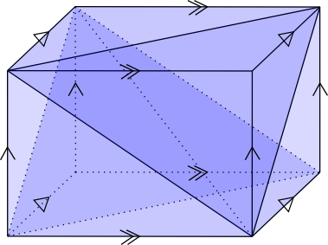
Restricting to manifolds
Feynman diagrams
The set of connected diagrams
3D manifolds
Not 3D manifolds
Some diagrams represent 3D manifolds:
But some do not.
boundary of :
(Two tetrahedra glued at four faces)

Slide 29
Restricting to manifolds
Feynman diagrams
The set of connected diagrams
3D manifolds
tetrahedral
decompositions
Not tetrahedral decompositions
There are diagrams which do not represent tetrahedral decompositions.
The free energy of 3D gravity:
of 3D manifold
We restrict diagrams to “tetrahedral decompositions of 3D manifold”.

Slide 30
Restricting to manifolds
How to restrict diagrams
Again we set to be a matrix ring:
and change the form of :
This changes the triangle term:
Every index loop becomes the trace of .

Slide 31
Restricting to manifolds
is the shift matrix.
If we take the limit
The dominant contributions : the diagrams with for every index loop
(to be proved in the next slide)
Each index loop represents a corner of a tetrahedron.
These diagrams represent tetrahedral decompositions.

Slide 32
Restricting to manifolds
Proof of
We recall and define the following numbers.
: # of triangles
: # of - hinges
: # of vertices
: # of - gons
: # of segments
: # of - junctions
These satisfy
The Boltzmann weight is expressed as
polygon
segment
(1/3 of a triangle)
Here,
If we take the limit
junction
(1/2 of a hinge)
The dominant contributions : the diagrams with
the diagrams with for every index loop

Slide 33
Restricting to manifolds
Triangle-hinge models generates 3D oriented tetrahedral decompositions.
Two triangles (upper and lower side of a thickened triangle)
always have opposite orientations.
If we define local orientation to each tetrahedron,
two tetrahedra glued at their faces
always have the same orientation.

Slide 34
Restricting to manifolds
The Boltzmann weight of the diagram is expressed as
If we further take the limit ,
the dominant contributions: the diagrams with
The genus of
Each vertex of these diagrams has a neighborhood of .
This neighborhood is homeomorphic to .
These diagrams represent 3D manifolds.
We can single out tetrahedral decompositions of orientable 3D manifolds
by taking the large limit of the parameters.

Slide 35
Plan of talk
Introduction
The models (triangle-hinge models)
General forms of the free energy
Matrix ring
Restricting to manifolds
Assigning matter degrees of freedom

Slide 36
Assigning matter degrees of freedom
Assigning matter degrees of freedom
We have discussed 3D “pure gravity”.
In order to assign matter degres of freedom,
we set to be a tensor product of algebras :
(factorized)
The index function also factorizes :
restricts the diagrams to tetrahedral decompositions of 3D manifold
can represent matter degrees of freedom
In the following, we only discuss (and omit the index of )

Slide 37
Assigning matter degrees of freedom
Set also to be a matrix ring :
and choose to have the form :
: projection matrix
This changes the triangle term:
The four index loops in each tetrahedron gives the factor
Each tetrahedron has a single color.

Slide 38
Assigning matter degrees of freedom
Interaction term ( part) :
Feynman rules
(1) Assign a color to each tetrahedron
(2) If two adjacent tetrahedra have colors and , multiply
( part)
(3) Sum over all distinct tetrahedral decompositions of 3D manifold
( part)
This is the -state spin system on 3D random volumes.
Example : The Ising model coupled to 3D QG
Comment
In the similar way, we can put local spin systems
on simplices of arbitrary dimensions.
(tetrahedra, triangles, edges and vertices)

Slide 39
Summary
We proposed a new class of matrix models which generate 3D random volumes.
The models are characterized by semisimple associative algebras .
Although most of the Feynman diagrams do not represent manifolds,
we can reduce the possible diagrams
to those representing tetrahedral decompositions of 3D manifolds.
We can assign matter degrees of freedom on simplices of any dimensions.
Future directions
Further developing the analytic treatment
Inventing a machinery to restrict the diagrams to a particular topology
Assigning matter degrees of freedom corresponding to
the target space coordinates and investigating the critical behaviors

