Slide 1

Inflation through hidden Yukawa couplings in the extra dimension
Tetsutaro Higaki
(Keio University)
Based on work (in progress ) with Y. Tatsuta (Waseda).

Slide 2
An inflation model ↔ Symmetries
What we want to focus on

Slide 3
Planck unit in this talk

Slide 4
Contents
Introduction: Review of inflation
Flat inflaton potential & symmetry
A UV completion in the string theory
Conclusion & discussion

Slide 5
1. Introduction: Review of inflation

Slide 6
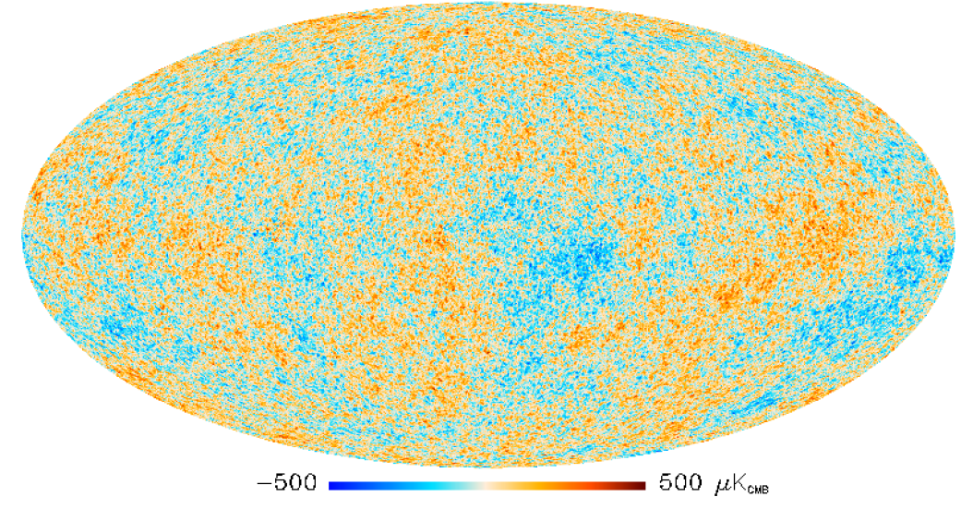
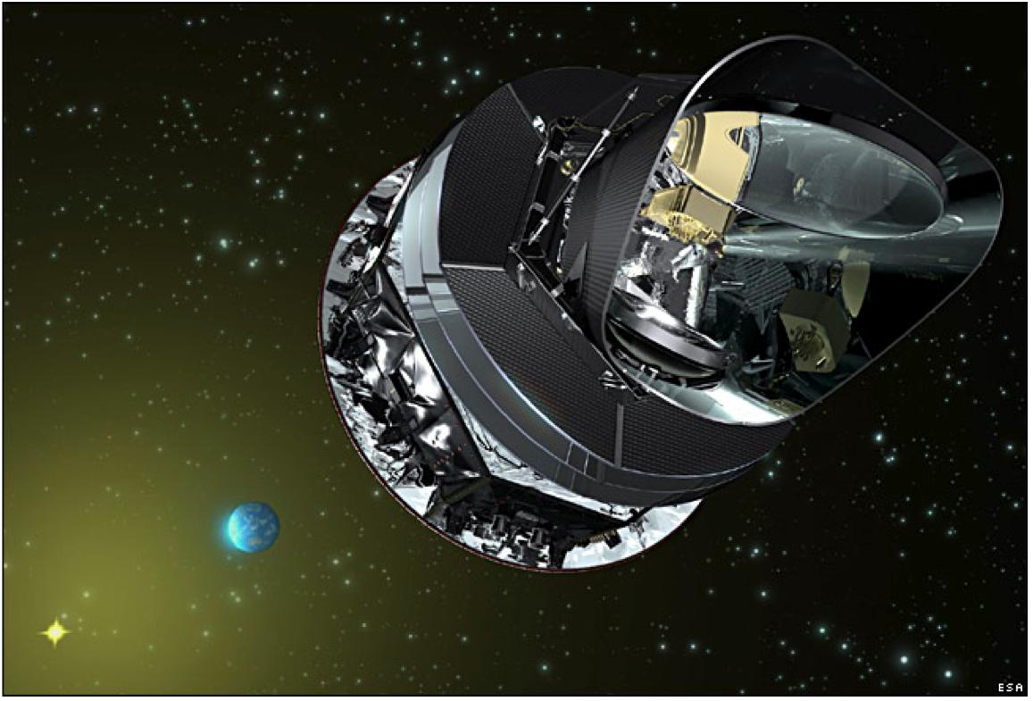
Cosmic Microwave Background (CMB)
[Planck collaborations]
CMB fluctuation: ΔT/T ～ 10⁻⁵
where T ～2.7 K.
Planck satellite

Slide 7
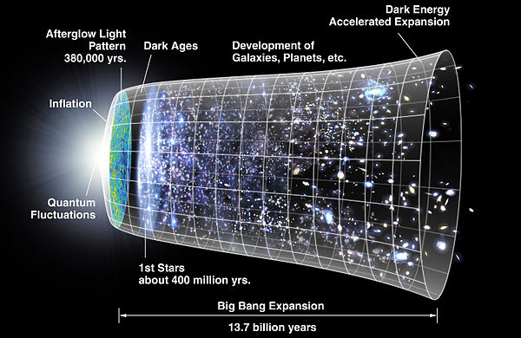
Inflation: origin of CMB
Accelerating expansion of the universe
Planck satellite

Slide 8
Why inflation?
Generating density fluctuations : ΔT/T ~ 10⁻⁵
= seeds of galaxies (= those of us)
Solutions for fine-tuning problems by the expansion
  Flatness problem: Ω_{curvature} << 1
  Horizon problem : T ～2.7K in CMB all over the sky
Inflation

Slide 9
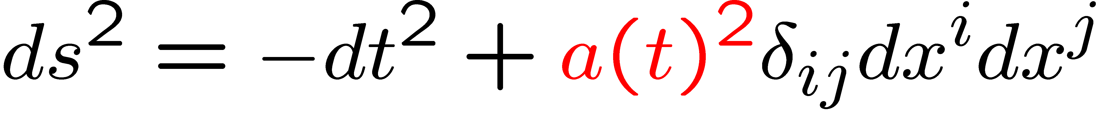
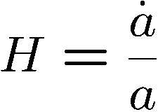
(Flat) Freedman-Robertson-Walker metric
a(t): Scale factor
: Hubble parameter

Slide 10
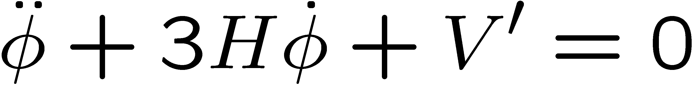
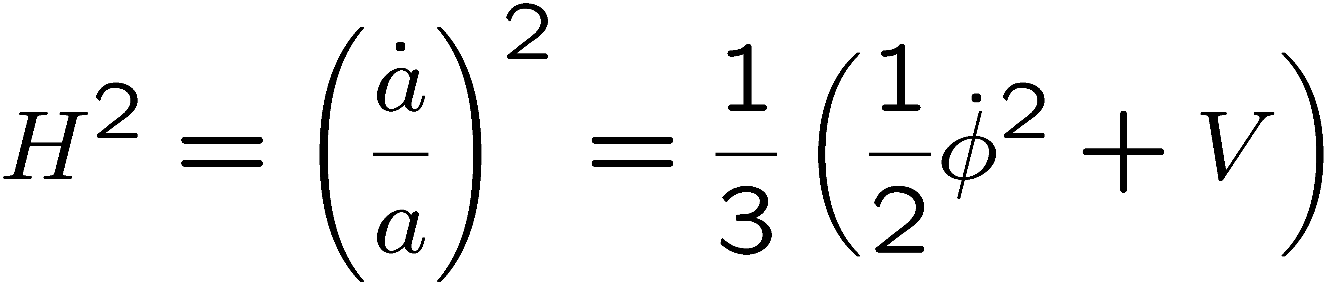


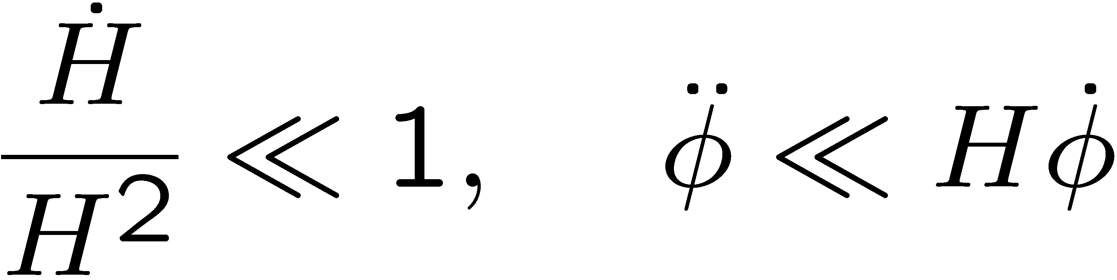
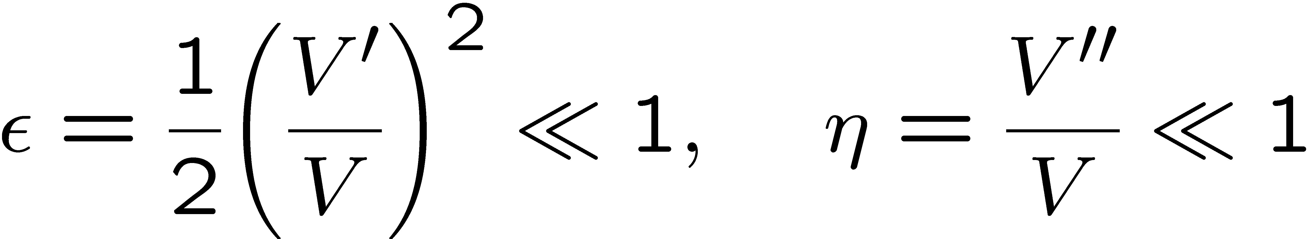
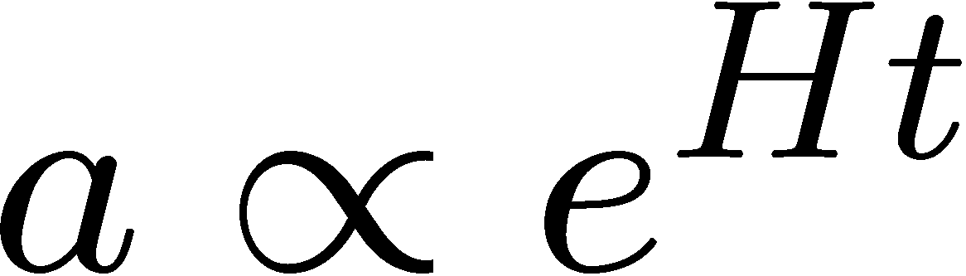
Inflation driven by an inflaton φ
EOM
Friedman Eq.
Slow-roll conditions
Inflation!!
V(φ)
Slow roll
φ

Slide 11
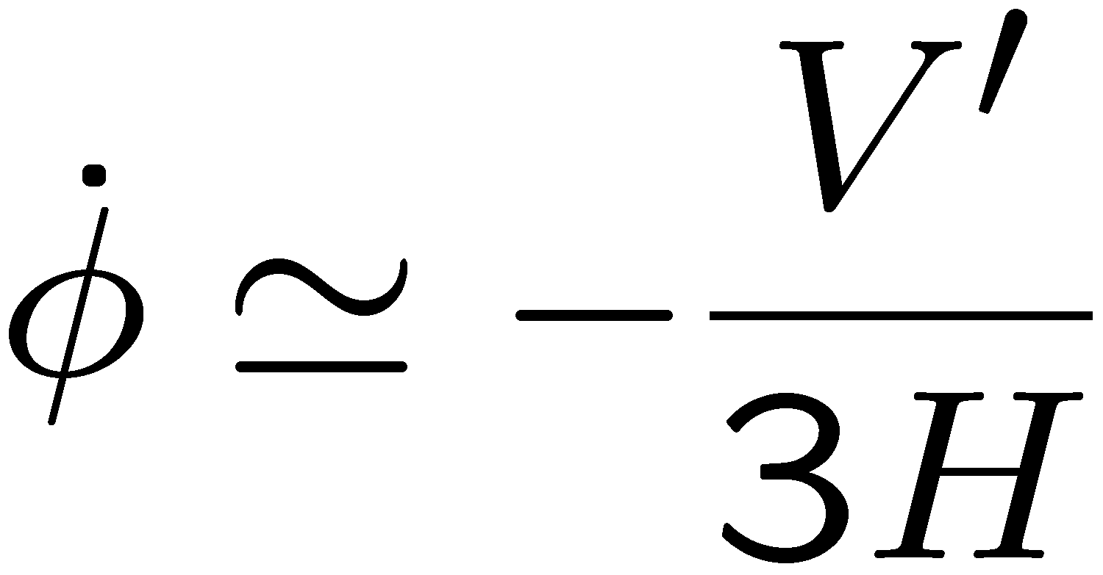
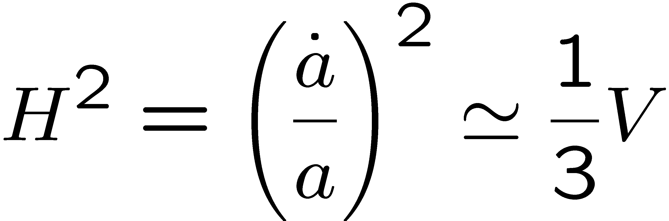
Inflation driven by an inflaton φ
EOM
Friedman Eq.
Slow-roll conditions
Inflation!!
V(φ)
Slow roll
φ

Slide 12
Metric perturbation
Perturbations to FRW metric:
ζ： Scalar perturbation from inflaton
h: Tensor perturbation
(gravitational wave itself from inflation energy V_{inf})
→ B-mode polarization in CMB photon

Slide 13
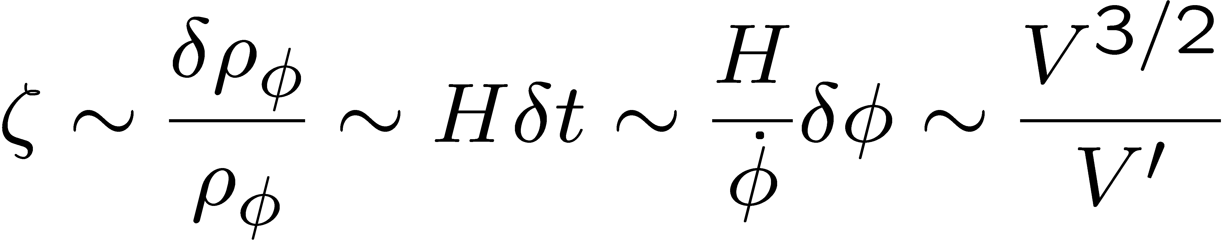
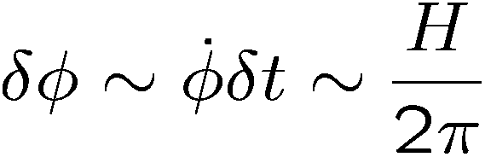



ζ = Inflaton’s quantum fluctuation δφ
Amplitude expanded by
Universe expansion
Slow roll
(Inflaton)

Slide 14
CMB fluctuation generated by inflaton
φ decay ⇒ T ～ 2.7K
δφ ⇒ ζ ⇒ ΔT/T ～10⁻⁵
h
⇒

Slide 15
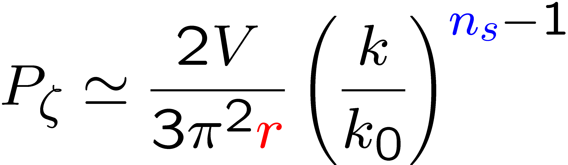
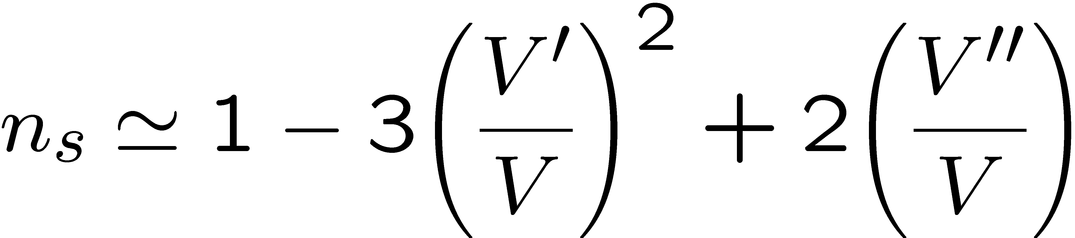
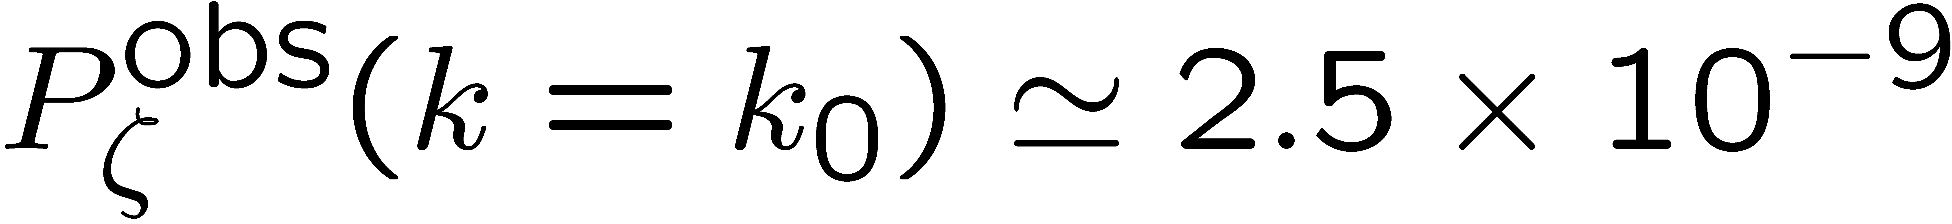
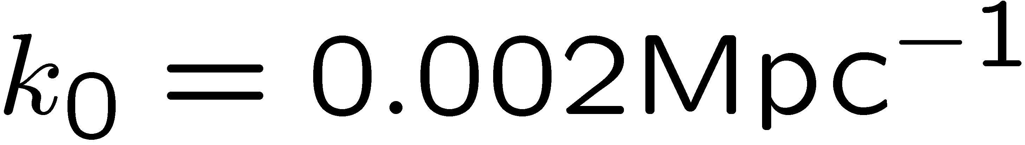
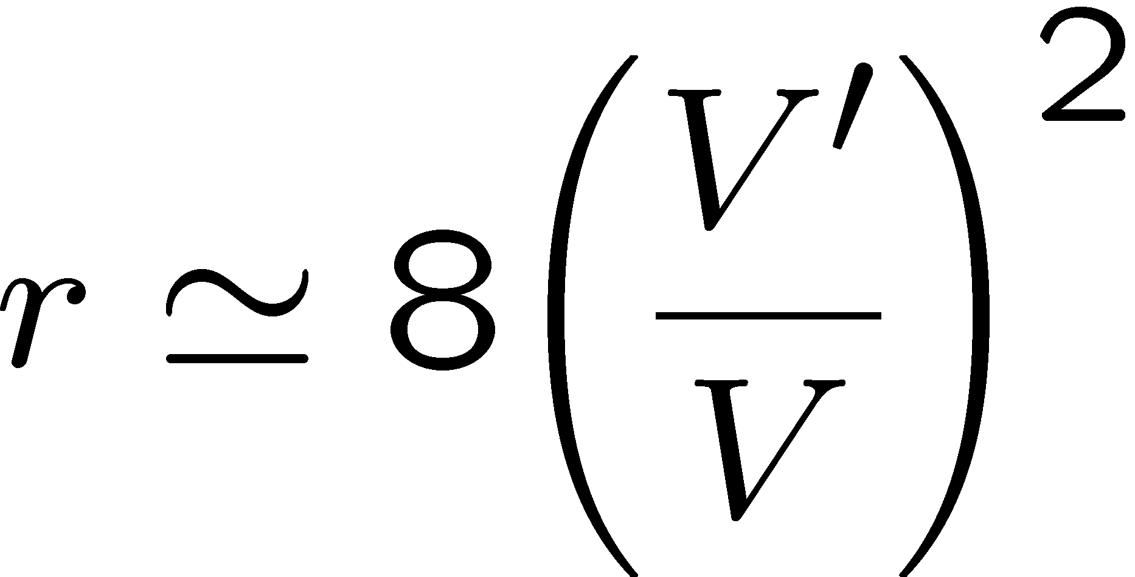
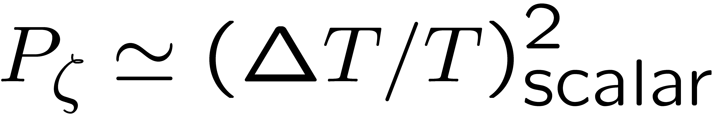
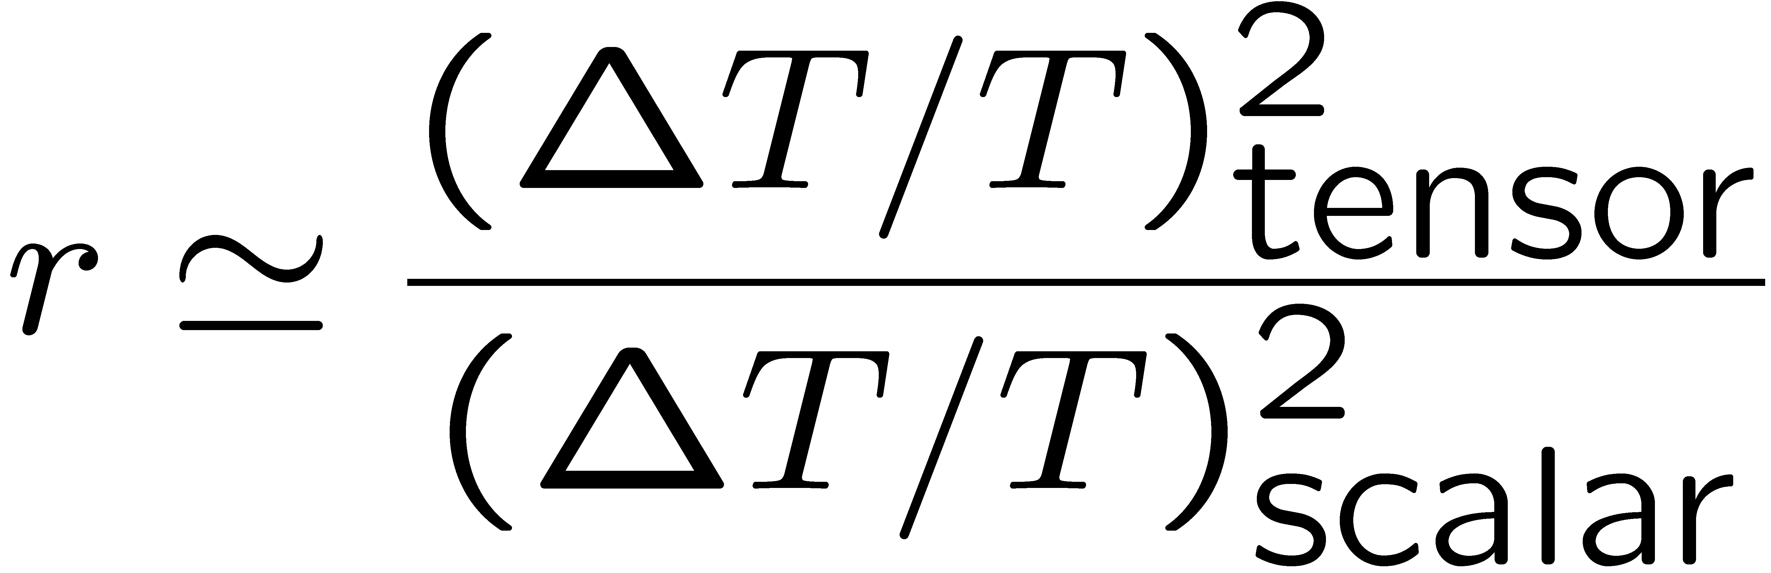
Theory and observations
[Planck collaboration]
P_{ζ} : Power spectrum = (ΔT/T)² from scalar,
n_{s}: Spectral index = scale dependence of P_{ζ}
r: Tensor to scalar ratio = (ΔT/T)² ratio of gravitational wave to scalar,

Slide 16

(n_{s}, r)-contour: focus on small r
[Planck 2015 collaborations]

Slide 17
(n_{s}, r)-contour: focus on small r
[Planck 2015 collaborations]
Small r can be favored.

Slide 18
2. Flat inflaton potential & symmetry

Slide 19
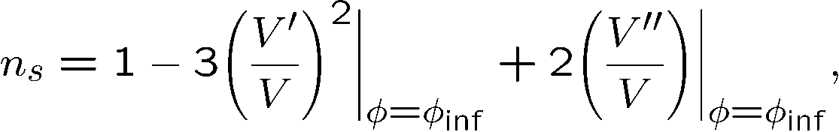
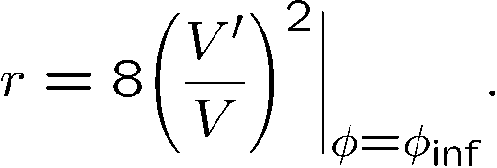
Inflaton potential: very small slope and curvature
r = Slope of potential
Slow roll
(Inflaton)
<<
<<
<<
Observations:
1 1 1

Slide 20

Control of potential flatness by shift symmetry
Shift symmetry for a flat inflaton potential:

Slide 21

Control of potential flatness by shift symmetry
Shift symmetry for a flat inflaton potential:
  Chaotic (monodromy) inflation: softly-broken only by a single scale μ
  [Linde]; [Silverstein, Westphal]; [McAllister, Silverstein, Westphal]

Slide 22
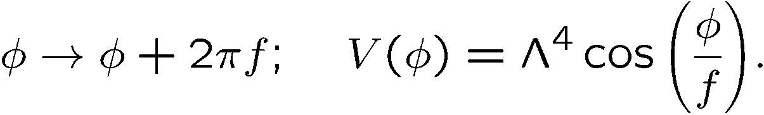
Control of potential flatness by shift symmetry
Shift symmetry for a flat inflaton potential:
  Chaotic (monodromy) inflation: softly-broken only by a single scale μ
  [Linde]; [Silverstein, Westphal]; [McAllister, Silverstein, Westphal]
  Natural inflation: broken but a discrete shift symmetry below Λ [Freese, Frieman, Olinto]

Slide 23
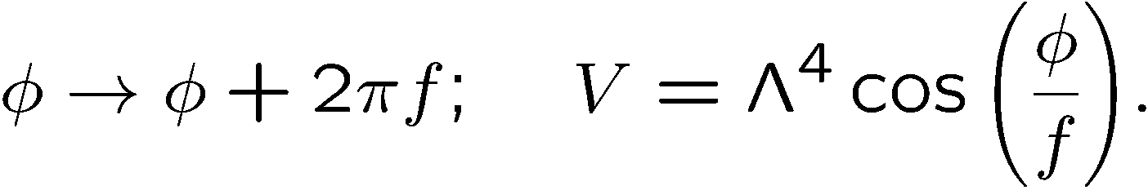
Natural inflation & discrete shift symmetry
Natural inflation: well-controlled by a discrete shift symmetry

Slide 24
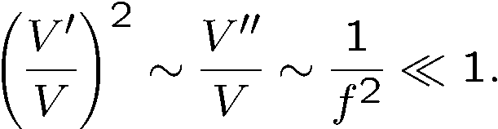
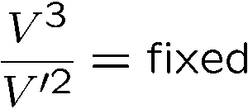
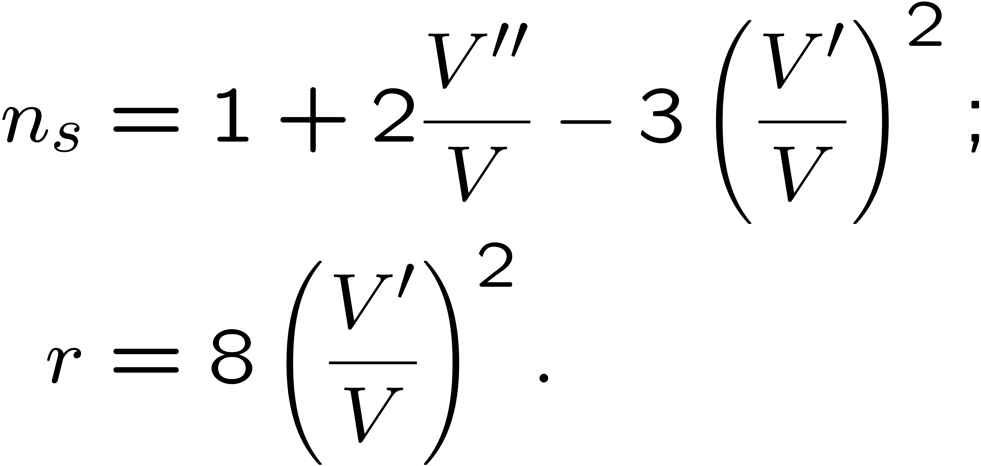
Natural inflation & discrete shift symmetry
Natural inflation: well-controlled by a discrete shift symmetry
Large f (V=φ²)
Remark:
Small f

Slide 25
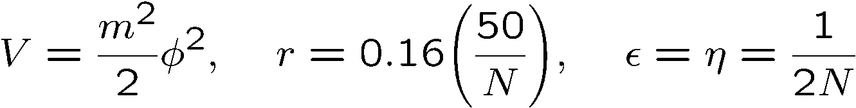
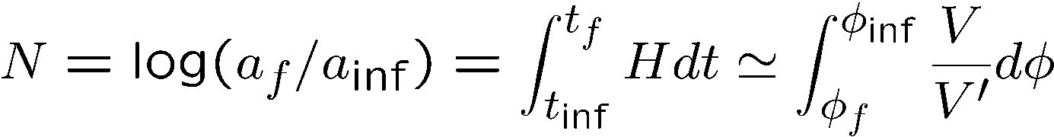
Natural inflation and f-dependence
f→small: φ_{inf} is near hilltop for a long slow-roll:
f → large: Chaotic inflation
: e-folding

Slide 26
Natural inflation & discrete shift symmetry
Natural inflation: well-controlled by a discrete shift symmetry
But, want a smaller r.
f > 5 M_{Pl} :
Weak gravity conjecture?
Large f (V=φ²)
Small f

Slide 27


Natural inflation for a small r?
An idea: a cancellation against a big cosine function in potential
Flatter & low potential

Slide 28
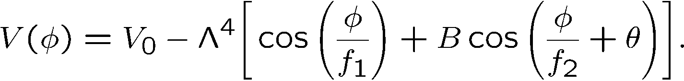
Multi-natural inflation: a bottom-up approach
[Czerny, Takahashi]; [Czerny, TH, Takahashi]; [TH, Takahashi]; [Kobayashi, Takahashi];[Czerny, Kobayashi, Takahashi]
Modification for it: Adding cosine function(s) to natural inflation

Slide 29

Multi-natural inflation: a bottom-up approach
[Czerny, Takahashi]; [Czerny, TH, Takahashi]; [TH, Takahashi]; [Kobayashi, Takahashi];[Czerny, Kobayashi, Takahashi]
Modification for it: Adding cosine function(s) to natural inflation
r < 0.11
f₁, f₂ < M_{Pl} via a tuning:
→ Good against weak gravity conjecture.
Cf. Possible to have a modulation for f₁ >> f₂ & B << 1 (Running n_{s}).

Slide 30

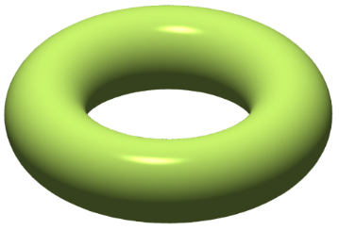
A UV completion and compactification
Q. How is this model controlled? :
  What are discrete symmetries for control?
  What are their origins?
A. Discrete symmetry from compactification of extra dimension
∵ Discreteness ＝ Compactness
φ-space
on a circle
Compactification of extra dim.
relevant to φ-periodicity
f

Slide 31
3. A UV completion in the string theory

Slide 32
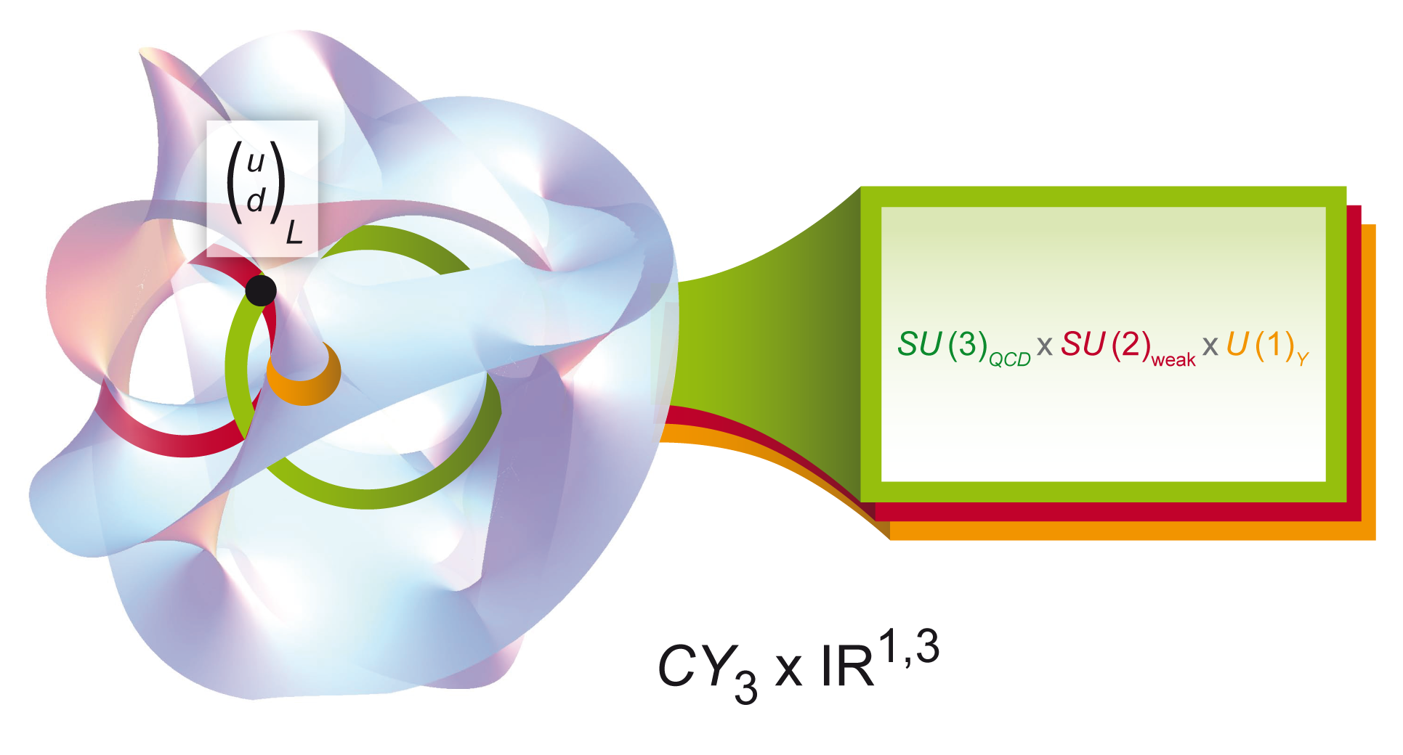
String theory as the origin of forces & matter
S
～ 10⁻³³ cm(?)
～ 10⁻³² cm (?)
～ 10⁻¹⁶ cm
Matter
Gauge
Matter
Gravity
D-brane
(Membrane upon which open strings end)
Extra 6 dim.
Gauge bosons
(Gluon, photon, W/Z)
Gravity

Slide 33

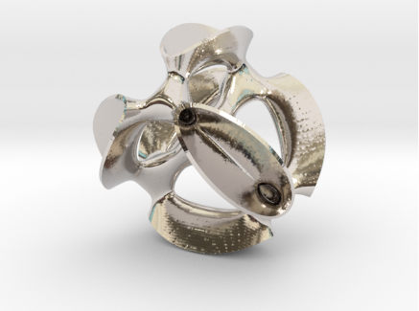
String theory compactification on torus
Let 10D = 4D spacetime + 2d torus (T²) + X₄ (something)
+
+

Slide 34
String theory compactification on torus
Let 10D = 4D spacetime + 2d torus (T²) + X₄ (something)
+
+
Consider intersecting D6-branes in IIA model; just one direction of D6 on T²
(Similarly, possible to consider magnetized D-branes in IIB model)

Slide 35
String theory compactification on torus
Let 10D = 4D spacetime + 2d torus (T²) + X₄ (something)
+
+
Consider intersecting D6-branes in IIA model; just one direction of D6 on T²
(Similarly, possible to consider magnetized D-branes in IIB model)
Inflation energy: SUSY-breaking by Izawa-Yanagida-Intriligator-Thomas (IYIT)

Slide 36
An example of D6-brane configuration
Spacetime 0 1 2 3 4 5 6 7 8 9
D6_{a} ○ ○ ○ ○ ○ × ○ × ○ ×
D6_{b} ○ ○ ○ ○ × ○ × ○ ○ ×
T²
5
D6_{b}
D6_{a}
4

Slide 37
An example of D6-branes on T²
[Cremades-Ibanez-Marhesano]
Branes (gauge theories) = lines
Matter = Intersection points
Yukawa coupling = Sum of triangles
(Winding modes)
#(a・b) = 2 (i = 0,1)
#(c・a) = 3 (j= 0,1,2)
#(b・c) = 5 (k =0,1,2,3,4)

Slide 38
Example: Parts of D6-branes on T²
[Cremades-Ibanez-Marhesano]
Branes (gauge theories) = lines
Matter = Intersection points
Yukawa coupling = Sum of triangles
(Winding modes)
#(a・b) = 2 (i = 0,1)
#(c・a) = 3 (j= 0,1,2)
#(b・c) = 5 (k =0,1,2,3,4)

Slide 39
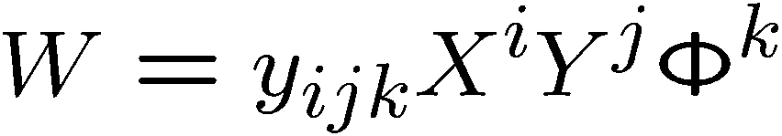





Intersecting D-branes on 2D torus
Discrete symmetries from “Torus property × D-brane configuration”:
SU(2) gauge theory
relevant to control .
(preliminary result)
Focus

Slide 40


Intersecting D-branes on 2D torus
Torus property × D-brane configuration ～ SL(2,Z) ×periodicity×(Z₂)²
SU(2) gauge theory
B: NS B-field axion, A: torus area
ν + b: brane position moduli
a: brane intersection #-dependent number
Focus

Slide 41
Intersecting D-branes on 2D torus
Torus property × D-brane configuration ～ SL(2,Z) ×periodicity×(Z₂)²
SU(2) gauge theory
Focus
(T-dual of complex structure on T²)

Slide 42
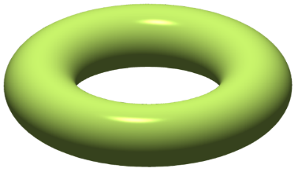
Intersecting D-branes on 2D torus
Torus property × D-brane configuration ～ SL(2,Z) ×periodicity×(Z₂)²
SU(2) gauge theory
=
+
+ ・・・
Focus
1×wrapping string
2×wrapping string

Slide 43


Intersecting D-branes on 2D torus
Torus property × D-brane configuration ～ SL(2,Z) ×periodicity×(Z₂)²
invariant Yukawa coupling :
SU(2) gauge theory
1.
2.
Focus

Slide 44
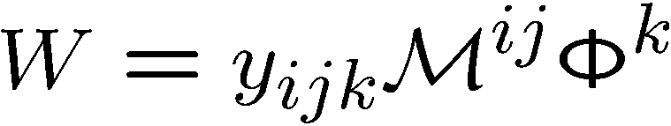

Low energy W & explicit form of Yukawas
Low energy W in IYIT model:
with taking

Slide 45
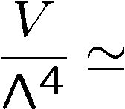


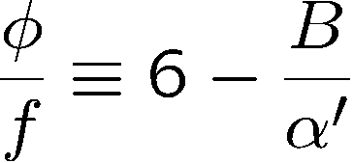
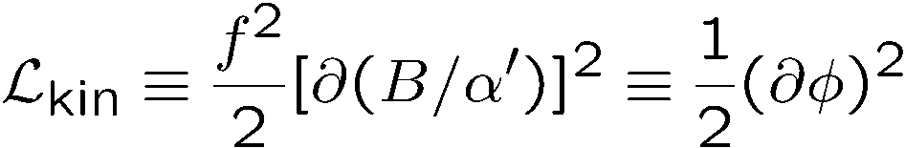
Scalar potential
A/α’=1.0
Inflaton φ:
Decay constant f:
A/α’=1.5
A/α’=2.0

Slide 46
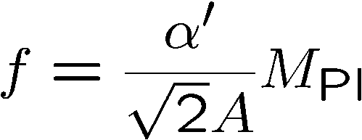
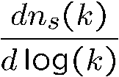
Results for string inspired case of
N=50
N=60
1σ
2σ
2σ

Slide 47
4. Review of other attempts for natural inflation

Slide 48
Natural inflation & discrete shift symmetry
Natural inflation: well-controlled by a discrete shift symmetry
f > 5 M_{Pl} :
Weak gravity conjecture?
Large f (V=φ²)
Small f

Slide 49

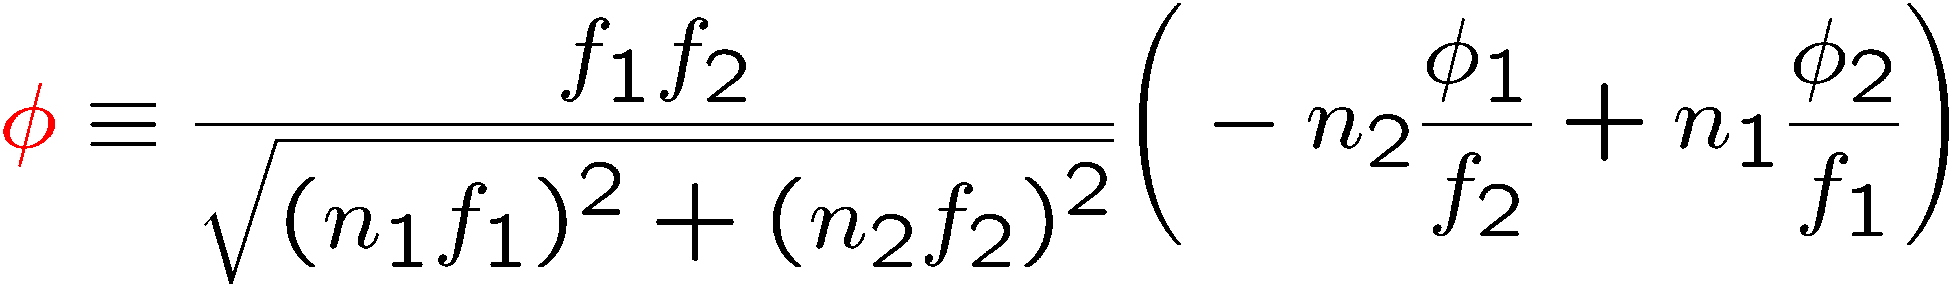
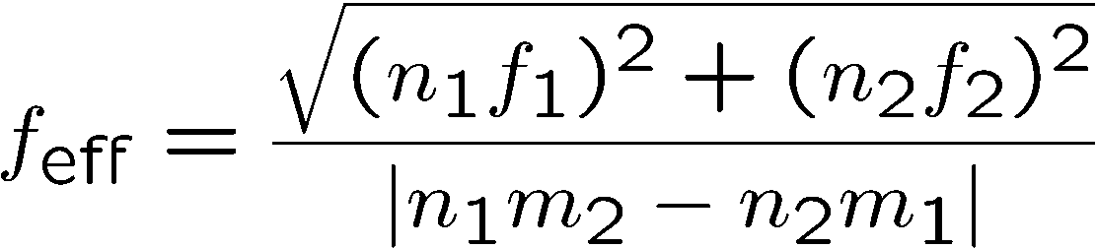
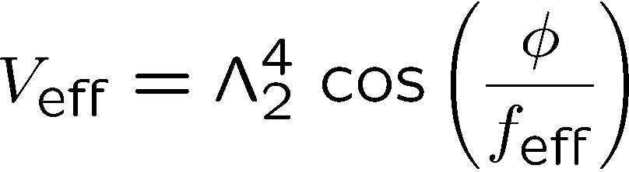
Aligned natural inflation for f > M_{Pl}
Two axions: φ₁ → φ₁ + 2πf₁, φ₂ → φ₂ + 2πf₂
For Λ₁ >> Λ₂, becomes inflaton:
[Kim, Nilles, Peloso]

Slide 50
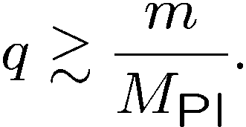
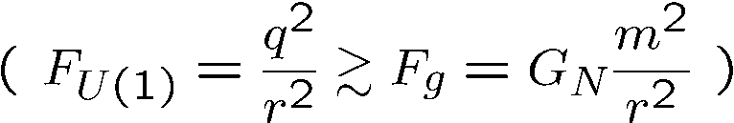
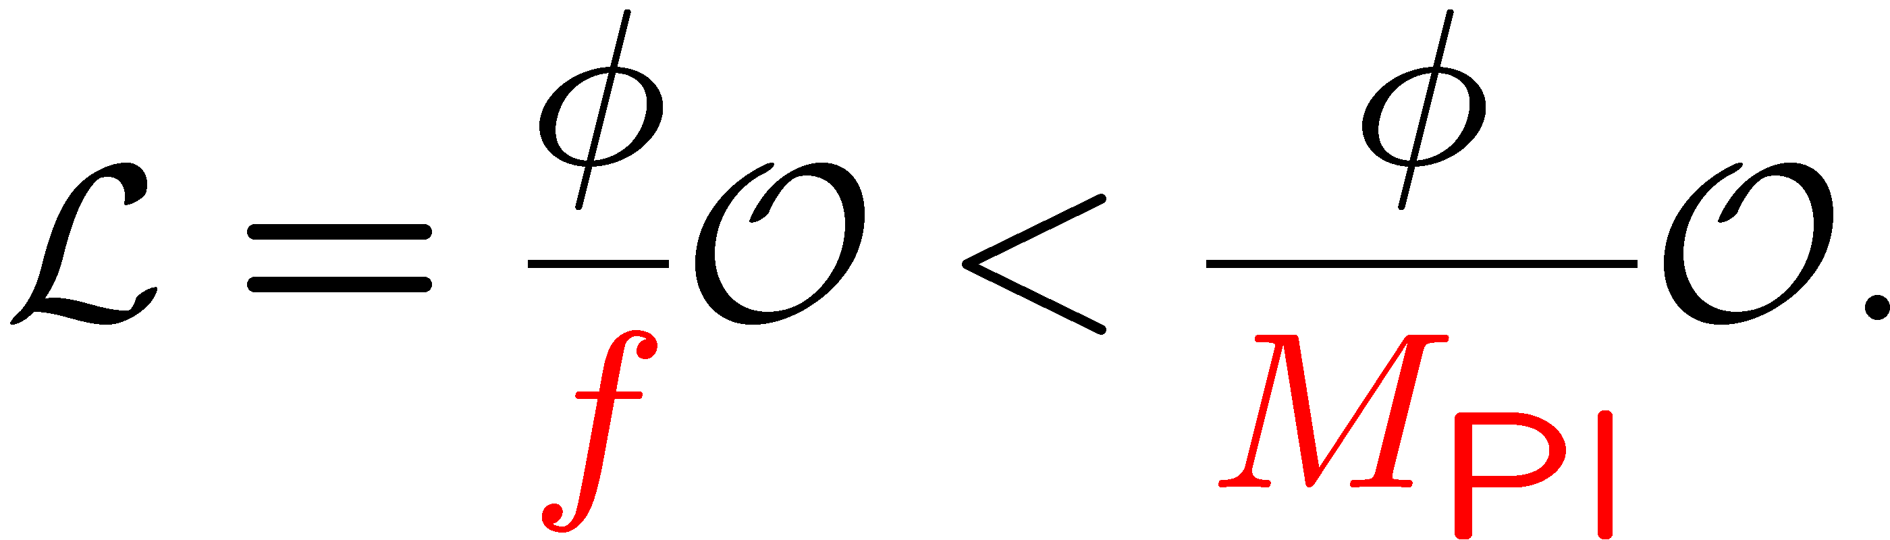
The weak gravity conjecture
[Arkani-hamed, Motl, Nicolis, Vafa]
The conjecture: “The gravity is the weakest force.”
But, one might have an axion interaction of M_{Pl} < f:
What if we have a weaker force than gravity?

Slide 51

[Slide from G. Shiu]
( via Bekenstein-Hawking formula)

Slide 52
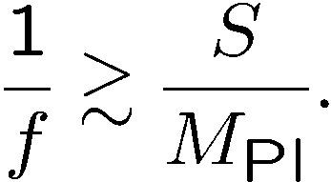
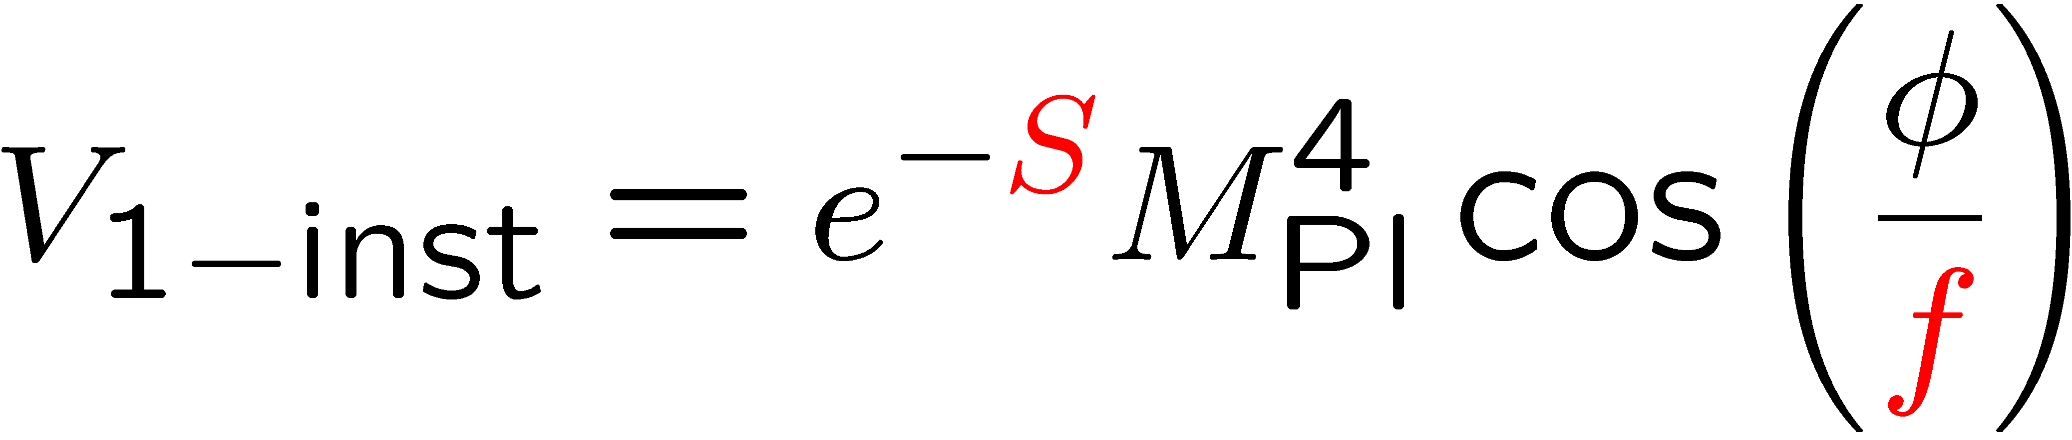
The weak gravity conjecture for axion
[Arkani-hamed, Motl, Nicolis, Vafa]
The conjecture for axion potential via one instanton effect:
Axion interaction for M_{Pl} < f:

Slide 53

[Slide from G. Shiu]
Multi-natural inflation!

Slide 54

Potential with modulations
Again, [Czerny, Takahashi]; [Czerny, TH, Takahashi]; [TH, Takahashi]; [Kobayashi, Takahashi];[Czerny, Kobayashi, Takahashi];
[TH, Kobayashi, Seto, Yamaguchi]
Potential studied independently regardless of WGC:
[Czerny, Kobayashi, Takahashi]
1403.4589
N=50 N=60
N=50 N=60

Slide 55
Recent studies of potentials with modulation
Potential via WGC = Multi-natural inflation!:
[Choi et al.]
1511.07201
[Kappl et al.]
1511.05560
N=50
N=60

Slide 56

Potential with modulations: running n_{s}
[Choi et al.]
1511.07201
N=60
[Kappl et al.]
1511.05560
N=50

Slide 57
4. Conclusion & discussion

Slide 58

Conclusion
Planck result can suggest a small r (< 0.11).
Discrete symmetries control an inflation model; ∃multi-instantons.
UV completion: compactification periodicity and brane configuration:
+ constraint on torus area ( ).
General message:
Compactification may help slow roll inflation due to discrete symmetries.
(preliminary result)

Slide 59
Discussion
Moduli stabilization during inflation required:
H_{inf} ～ gravitino mass < Heavy moduli.
Flux + racetrack (KL) model would help this issue.
Otherwise, slow roll inflation may be broken by a large inflaton mass via:
  Heavy moduli-inflaton mixing
  Quantum corrections from SUSY-breaking.

Slide 60
Appendix

Slide 61
[Slide from G. Shiu]

