Slide 1
Three-generation model and flavor symmetry in string theory
桑木野 省吾 (益川塾)
Based on arXiv: 1304.5621 [hep-th], 1311.4687 [hep-th],
1406.4660 [hep-th], 1502.00789 [hep-ph]
Collaborator : Florian Beye (Nagoya university)
Tatsuo Kobayashi (Hokkaido university)
益川塾セミナー 2015/4/23

Slide 2
Plan of Talk
Introduction
Heterotic string compactification
Three-generation models
Flavor symmetry at symmetry enhanced point
U(1) flavor model
Conclusion

Slide 3
Introduction
String → Standard Model
String theory
-- A candidate which describe quantum gravity and unify four forces
-- Is it possible to realize phenomenological properties of Standard Model ?
(Supersymmetric) Standard Model
-- We have to realize all properties of Standard model
Four-dimensions,
N=1 supersymmetry,
Standard model group( SU(3)*SU(2)*U(1) ),
Three generations,
Quarks, Leptons and Higgs,
No exotics,
Yukawa hierarchy,
Proton longevity,
R-parity,
Doublet-triplet splitting,
Moduli stabilization,
...
If we believe string theory as
the fundamental theory of our nature,
we have to realize standard model as
the effective theory of string theory !

Slide 4
Introduction
String → Standard Model ----- String compactification : 10-dim → 4-dim
Orbifold compactification, Calabi-Yau, Intersecting D-brane, Magnetized D-brane, F-theory, M-theory, …
(Symmetric) orbifold compactification
Dixon, Harvey, Vafa, Witten '85,'86
Ibanez, Kim, Nilles, Quevedo '87
SM or several GUT gauge symmetries
N=1 supersymmetry
Chiral matter spectrum
MSSM searches in symmetric orbifold vacua :
Embedding higher dimensional GUT into string
Kobayashi, Raby, Zhang '04
Buchmuller, Hamaguchi, Lebedev, Ratz '06
Lebedev, Nilles, Raby, Ramos-Sanchez, Ratz,
Vaudrevange, Wingerter '07
Kim, Kyae ’07
......
Three generations,
Quarks, Leptons and Higgs,
No exotics,
Top Yukawa,
Proton longevity,
R-parity,
Doublet-triplet splitting,
...

Slide 5





Introduction
Asymmetric orbifold compactification of heterotic string theory
Narain, Sarmadi, Vafa ‘87
Generalization of orbifold action (Non-geometric compactification)
SM or several GUT gauge symmetries
N=1 supersymmetry
Chiral matter spectrum
Increase the number of possible models (symmetric → asymmetric)
All Yukawa hierarchies ?
A few/no moduli fields (non-geometric)
Moduli stabilization ?
However, in asymmetric orbifold construction,
a systematic search for SUSY SM or other GUT extended models has not been investigated so far.
Goal : Search for SUSY SM in heterotic asymmetric orbifold vacua

Slide 6
Introduction
SUSY SM in asymmetric orbifold vacua
・ First step for model building: Gauge symmetry + Three generations
Four-dimensions,
N=1 supersymmetry,
Standard model group( SU(3)xSU(2)xU(1) ),
Three generations,
Quarks, Leptons and Higgs,
No exotics,
Yukawa hierarchy,
Proton stability,
R-parity,
Doublet-triplet splitting,
Moduli stabilization,
...
What types of gauge symmetries can be derived in these vacua ?
・SM group ?
・GUT group ?
・Flavor symmetry ?
・Hidden sector ?

Slide 7
Introduction
Flavor structure of quarks and leptons in standard model
・ Hierarchical masses and mixings
・ The key is flavor symmetry
・ Flavor model based on non-Abelian discrete flavor symmetry
・ Some discrete flavor symmetries have string origin
・ We consider orbifold string models at symmetry enhanced point in moduli space
Gauge origin of non-Abelian discrete symmetry
・ Applications to phenomenological models

Slide 8
Heterotic string compactification

Slide 9




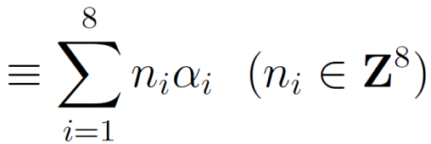



Heterotic String Theory
Heterotic string theory
Left
Right
Heterotic string for our starting point
Degrees of freedom
--- Left mover 26 dim. Bosons
--- Right mover 10 dim. Bosons and fermions
Extra 16 dim. have to be compactified
Consistency (Modular invariance) → If 10D N=1, E8 X E8 or SO(32)
Ex. ) E8 Root Lattice
: Simple roots of E8
Left-moving momentum
10dim
8dim
8dim
Left
Right

Slide 10



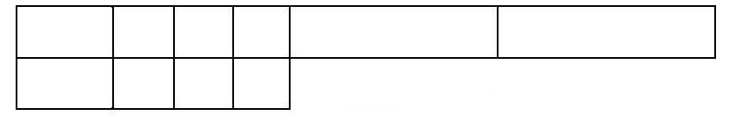

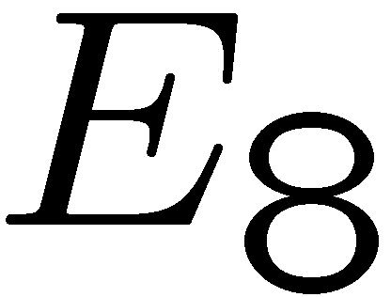

Heterotic Orbifold Compactification
heterotic orbifold compactification
Heterotic string theory
External 6 dim. → Assuming as Orbifold
Strings on orbifold
--- Untwisted sector
--- Twisted sector ( Fixed points )
Consistency condition (Modular invariance)
Shift orbifold for E8
Gauge symmetry is broken !
Project out suitable right-moving fermionic states
27 rep. chiral matters
Shift orbifold
4dim
6dim
8dim
8dim
Orbifold

Slide 11
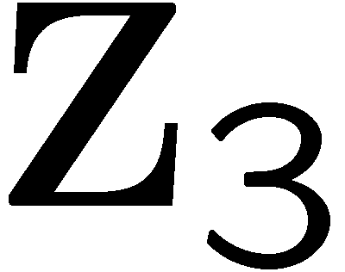


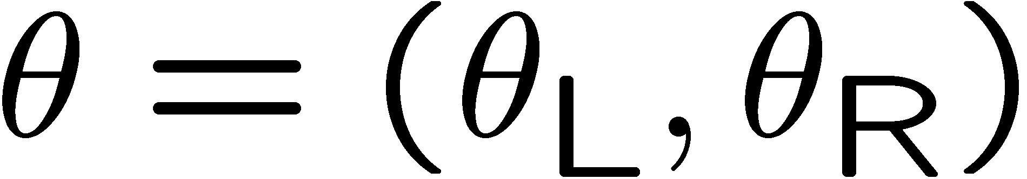
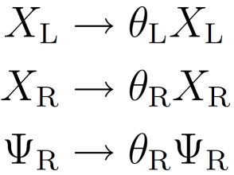


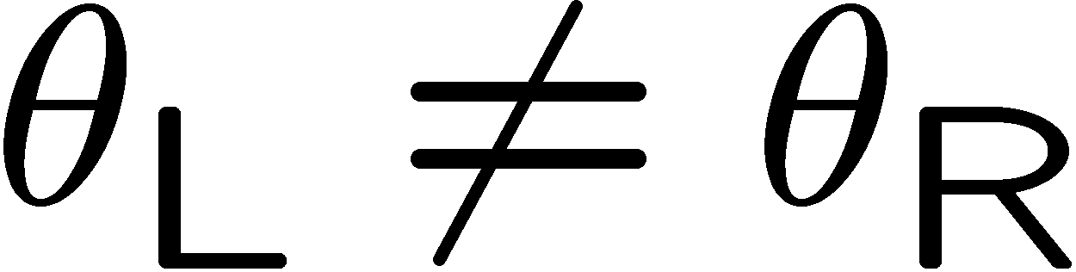

Asymmetric Orbifold Compactification
Asymmetric orbifold compactification
Ex.) action
Generalization of orbifold action
None
Orbifold action (Twist, Shift)
Left
Left mover :
Right
Right mover :
1/3 rotation
Orbifold actions for left and right movers can be chosen independently
Starting points should be suitable (22,6)-dimensional Narain lattices
Left-moving twists and shifts
Left
Right
Right-moving twist

Slide 12

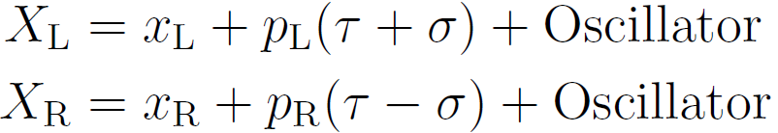
Asymmetric Orbifold Compactification
Narain lattices
(22,6)-dimensional Narain lattices
General flat compactification of heterotic string
--- Left : 22 dim
--- Right : 6 dim
4D N=4 SUSY
Left-right combined momentum are quantized on
some momentum lattices which are described in terms of group theory
(An, Dn, E6, E7, E8)
Mode expansion
4dim
22dim
Left
Right
4dim
6dim

Slide 13
Asymmetric Orbifold Compactification
Asymmetric orbifold compactification
Ex.) action
Generalization of orbifold action
None
Orbifold action (Twist, Shift)
Left
Left mover :
Right
Right mover :
1/3 rotation
Orbifold actions for left and right movers can be chosen independently
Starting points should be suitable (22,6)-dimensional Narain lattices
A few/no moduli fields because of asymmetric action
Rich source of hidden gauge symmetries
→ Moduli stabilization in heterotic string theory ?

Slide 14



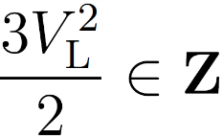
Z3 Asymmetric Orbifold Compactification
Asymmetric orbifold compactification = 4D Heterotic string theory on Narain lattice
+ Asymmetric orbifold action
We consider Z3 Abelian orbifold action
A Z3 asymmetric orbifold model is specified by
a (22,6)-dimensional Narain lattice which contains a right-moving or
lattice (compatible with Z3 automorphism)
a Z3 shift action
a Z3 twist action (N=4 SUSY → N=1 SUSY)
Consistency condition:
Left-moving Z3 shifts
Left
Right
Right-moving Z3 twist

Slide 15
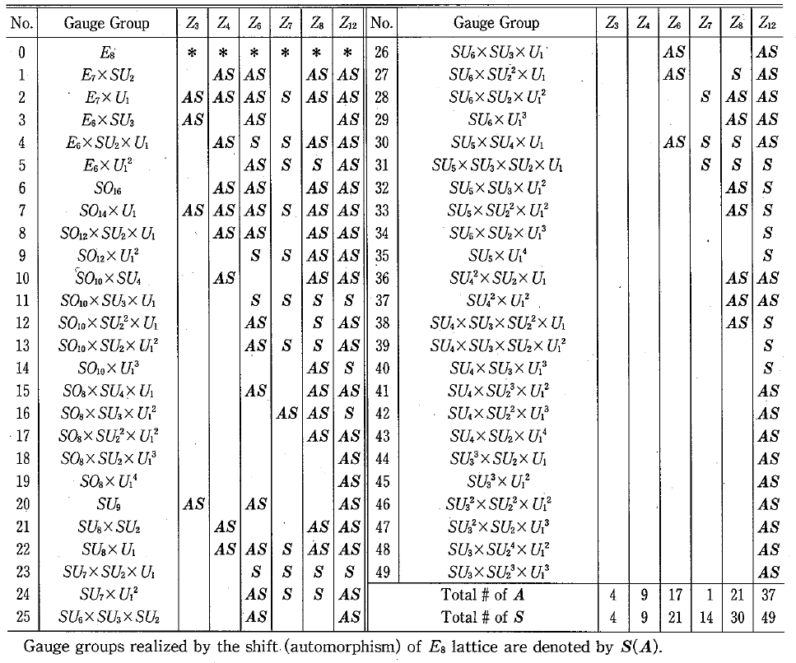
Lattice and gauge symmetry
Our starting point → Narain lattice
Symmetric orbifolds
Asymmetric orbifolds
Lattice
E8 x E8, SO(32)
What types of (22,6)-dimensional Narain lattices can be used for starting points ?
Gauge symmetry
breaking pattern
Classified
What types of gauge symmetries can be realized ?
10dim
8dim
8dim
4dim
22dim
Left
Left
Right
Right
4dim
6dim

Slide 16






(22,6)-dim lattices from 8, 16, 24-dim lattices
・ We construct (22,6)-dim Narain lattices from 8, 16, 24-dim lattices
by lattice engineering technique.
22dim
Left
Right
Reconstructing a lattice to new lattice with different dimensionality
6dim
8-dim lattice
16-dim lattice
24-dim lattice
Niemeier ‘73
8dim
16dim
24dim
Left
E8
Left
SO(32)
Left
Classified
24 types of lattices

Slide 17


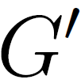

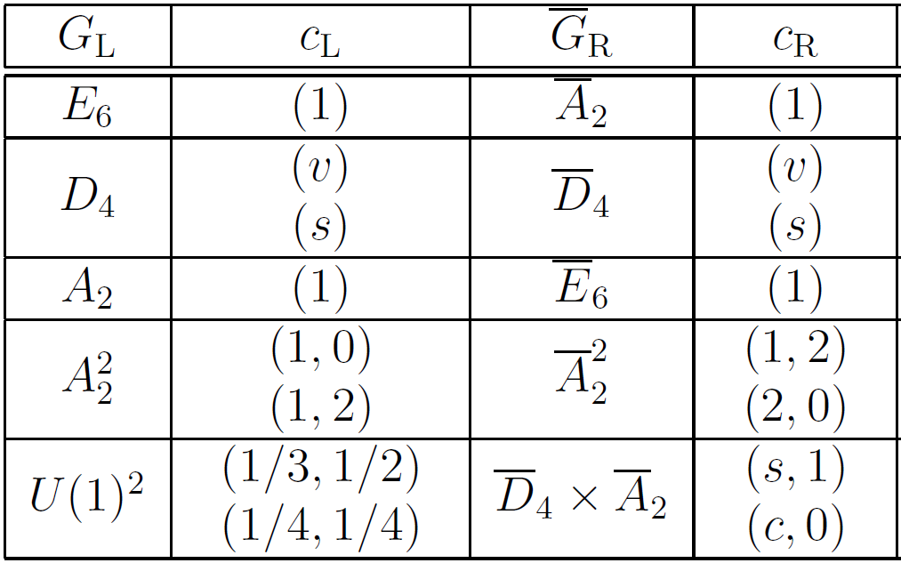


Lattice Engineering Technique
Lattice engineering technique
Lerche, Schellekens, Warner ‘88
We can construct new Narain lattice from known one.
We can replace one of the left-moving group factor with a suitable
right-moving group factor.
Replace
Extended Dynkin Diagram ( E8 )
Left-mover
Right-mover
Left
( Decomposition
)
Dual
Left
( Replace left
→ Right )
Left
The resulting lattice is also modular
invariant (modular transformation
properties of part and part
are similar)
Right

Slide 18

(22,6)-dim lattices from 8, 16, 24-dim lattices
Example :
24-dim lattice
Gauge symmetry : SU(12) x SO(14) x E6
24-dim
Left
A11
D7
E6
Left
A8
U1
A2
D7
E6
Left
A8
U1
D7
E6
(22,6)-dim
Right
E6
(22,6)-dim lattice
Gauge symmetry : SO(14) x E6 x SU(9) x U(1)
Notes:
name

Slide 19
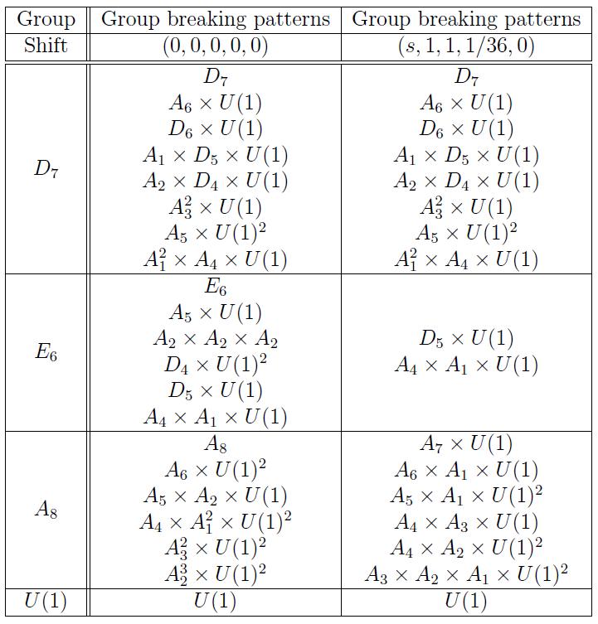

Gauge symmetry breaking by Z3 action
Z3 asymmetric orbifold compactification
Z3 action :
Right mover → twist action → N=1 SUSY
Left mover → shift action → Gauge symmetry breaking
・SO(14) x E6 x SU(9) x U(1) Gauge group
breaks to Several gauge symmetries.
・SM group, Flipped SO(10)xU(1),
Flipped SU(5)xU(1), Trinification SU(3)^3
group can be realized.
・Important data for model building.
Left
A8
U1
D7
E6
Right
E6

Slide 20
Result: Lattice and gauge symmetry
Our starting point → Narain lattice
Beye, Kobayashi, Kuwakino
arXiv:1304.5621 [hep-th]
Symmetric orbifolds
Asymmetric orbifolds
Lattice
E8 x E8, SO(32)
90 lattices
(with right-moving non-Abelian factor, from 24 dimensional lattices)
Gauge symmetry
breaking pattern
Classified
Classified
10dim
8dim
8dim
4dim
22dim
Left
Left
Right
Right
4dim
6dim

Slide 21
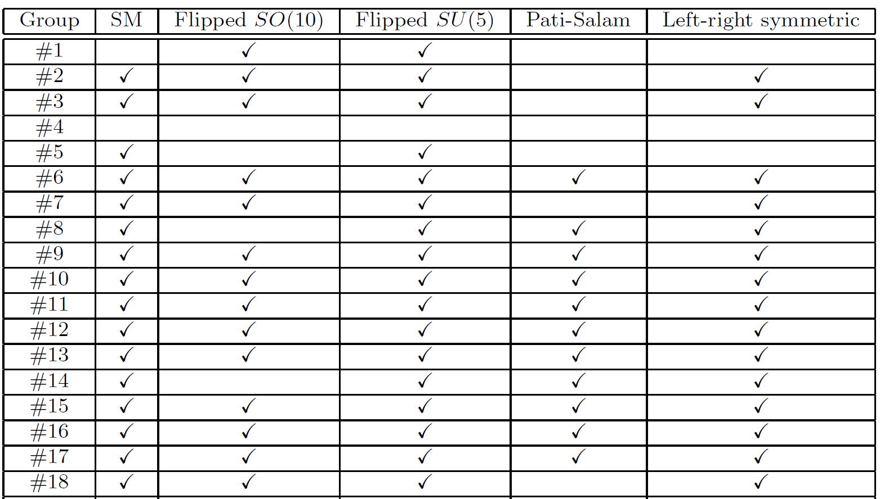
Gauge group patterns of models
SM or GUT group patterns of Z3 asymmetric orbifold models from 90 Narain lattices
+ also for the other lattices.

Slide 22
Three-generation models

Slide 23
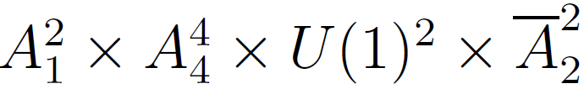

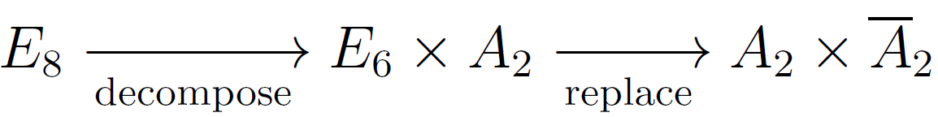
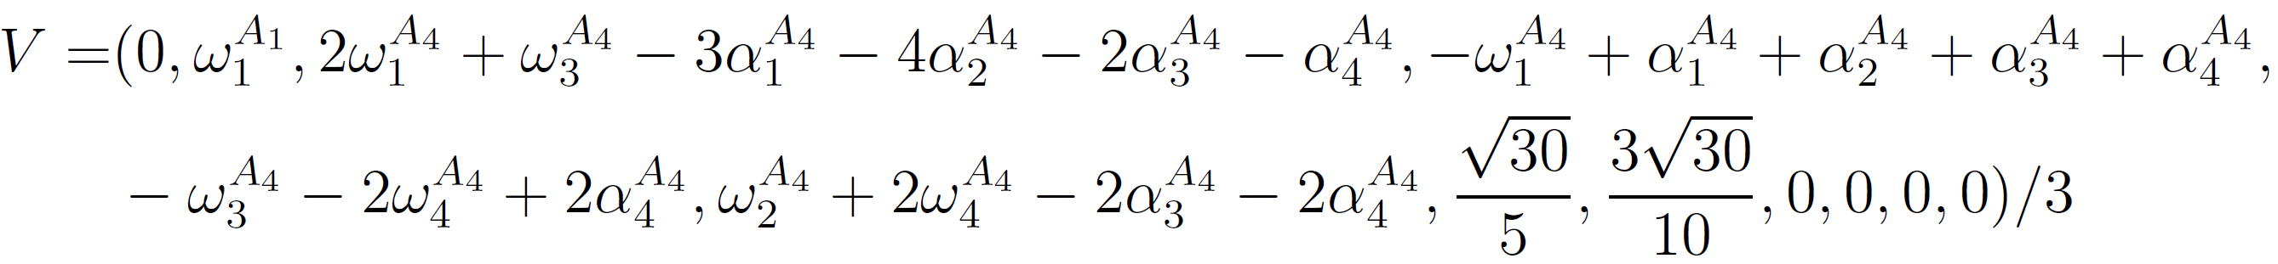

Z3 three generation left-right symmetric model
Z3 asymmetric orbifold compactification
Beye, Kobayashi, Kuwakino
arXiv: 1311.4687 [hep-th]
・ Narain lattice: lattice lattice
・ LET:
・ Z3 shift vector:
・ Group breaking:
shift action
Left
A2
A4
A4
A4
A4
U1
U1
Right
A2
A2
A2
twist action

Slide 24
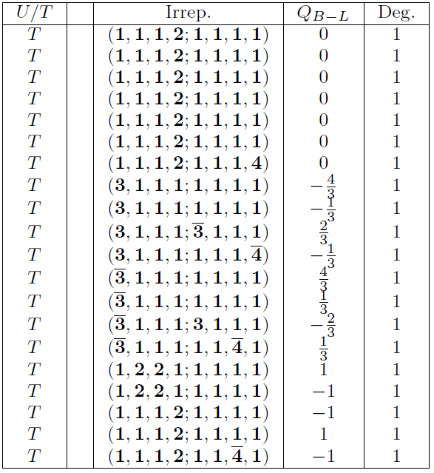
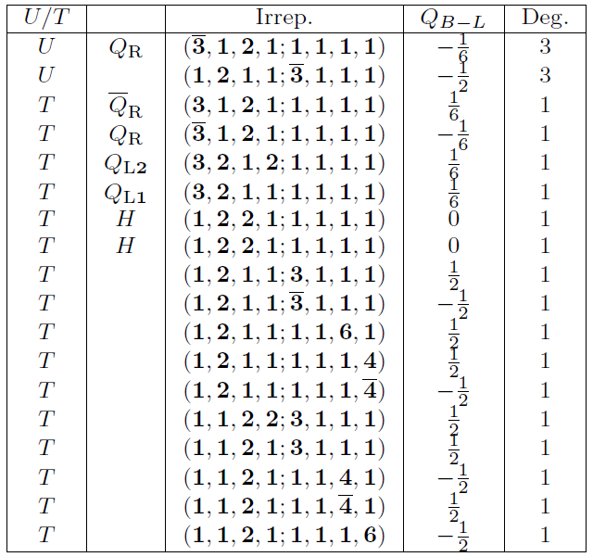
Z3 three generation left-right symmetric model
Massless spectrum ( )
+ other
fields
・ Three-generation model

Slide 25


Z3 three generation left-right symmetric model
Massless spectrum ( )
+ other
fields
Three-generation fields of
LR symmetric model
+
Vector-like fields
Higgs fields for →
・ Three-generation model
・ Additional fields are vector-like

Slide 26
Z3 three generation left-right symmetric model
Massless spectrum ( )
+ other
fields
Vector-like fields
・ Three-generation model
・ Additional fields are vector-like

Slide 27

Z3 three generation left-right symmetric model
Massless spectrum ( )
+ other
fields
SU(2)F
flavon
The first two-generation is unified into SU(2)F doublet.
・ Three-generation model
・ Additional fields are vector-like
・ Gauge flavor symmetry

Slide 28

Z3 three generation left-right symmetric model
Massless spectrum ( )
+ other
fields
・ Three-generation model
・ Additional fields are vector-like
・ Gauge flavor symmetry
・ No Top Yukawa by three point coupling( ) → higher dim. coupling

Slide 29
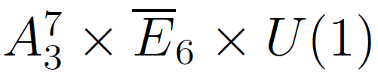
Z3 three generation SU(3)xSU(2)xU(1) model
Z3 asymmetric orbifold compactification
・ Narain lattice: lattice
・ LET:
・ Z3 shift vector:
・ Group breaking:
shift action
Left
A3
A3
A3
A3
A3
A3
A3
U1
Right
E6
twist action

Slide 30
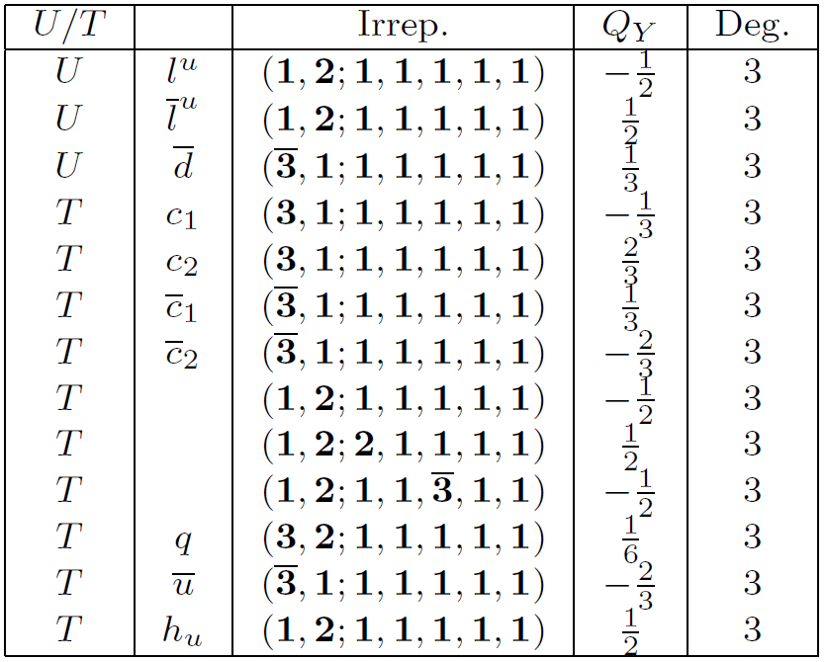

Z3 three generation SU(3)xSU(2)xU(1) model
Massless spectrum ( )
+ other fields
Three-generation fields of
SUSY SM model
+
Vector-like fields
・ Three-generation model
・ "3"-generation comes from a degeneracy "3“
・ Additional fields are vector-like
・ Top Yukawa from twisted sector

Slide 31
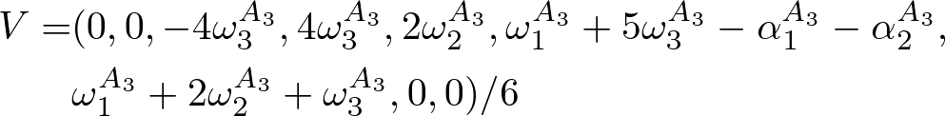

Z6 three generation SU(3)xSU(2)xU(1) model
Z6 asymmetric orbifold compactification
・ Narain lattice: lattice
・ LET:
・ Z6 shift vector:
・ Group breaking:
shift action
Left
A3
A3
A3
A3
A3
A3
A3
U1
Right
E6
twist action

Slide 32
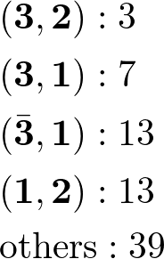
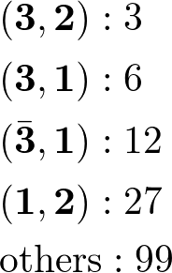
Z6 three generation SU(3)xSU(2)xU(1) model
Massless spectrum ( )
cf : Z3 model
・ Three-generation model
・ Number of massless states : fewer than Z3 cases

Slide 33
SUSY SM in asymmetric orbifold vacua
・ At this stage, we performed model buildings from several lattices of 90 lattices, and get models with
Four-dimensions,
N=1 supersymmetry,
Standard model group( SU(3)*SU(2)*U(1) ), LR symmetric group
Three generations,
Quarks, Leptons and Higgs,
No exotics (vector-like)
Top quark mass
Other quark masses (Charm quark mass)
Proton stability,
R-parity,
Doublet-triplet splitting,
Moduli stabilization,
...
Realized
Need further model building from other Narain lattices and effective theory analysis
( Z6, Z12, Z2xZ2, … )

Slide 34
SUSY SM in asymmetric orbifold vacua
Toward moduli stabilization in heterotic string theory
・In asymmetric orbifolds, number of geometrical moduli is small
・3-generation model with a dilaton field
・Strong dynamics in hidden sector (enhancement point)
→ Potential for a dilaton field

Slide 35
Flavor symmetry at symmetry enhanced point

Slide 36
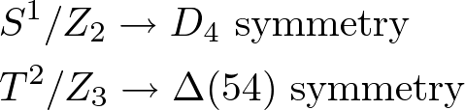


Discrete flavor symmetry in string model
・ In heterotic orbifold models, non-Abelian discrete symmetries arise from
extra-dimensional spaces.
Kobayashi, Nilles, Plöger, Raby, Ratz '07
・ Closed string on orbifold is specified by boundary condition
-- Untwisted string (Bulk modes)
-- Twisted string (localized modes on brane)
S1
S1/Z2

Slide 37
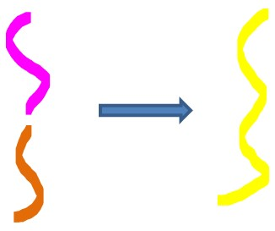
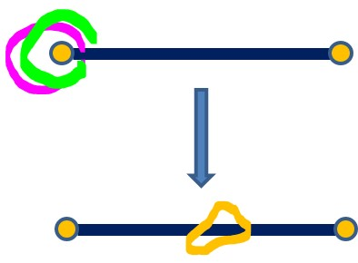
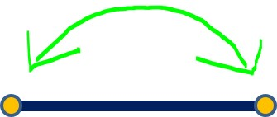

Discrete flavor symmetry in string model
・ Two strings are connected and become a string if boundary conditions fit each other.
・ String selection rule can be described by Z4 symmetry
・ Fixed points of S1/Z2 are equivalent. These is a permutation symmetry (Z2) of fixed points
・ String model has Z4 symmetry from interaction, and S1/Z2 orbifold has geometrical Z2 symmetry, which is a permutation symmetry of fixed points.
Non-Abelian discrete symmetry

Slide 38
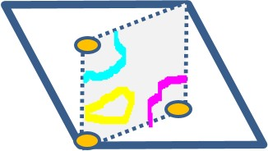
Discrete flavor symmetry in string model
1 dimensional orbifold : S1/Z2
2 dimensional orbifold : T2/Z3
・ Non-Abelian discrete symmetries have a stringy origin, which are determined by
the geometrical structure of the extra dimension space

Slide 39
Gauge origin of discrete flavor symmetry
symmetry enhance point in moduli space
Beye, Kobayashi, Kuwakino
arXiv:1406.4660 [hep-th]
S1
enhance
U(1) gauge symmetry
SU(2) gauge symmetry
orbifold
orbifold
S1/Z2
enhance
D4 discrete symmetry
U(1) gauge symmetry
・ D4 non-Abelian discrete symmetry is enhanced to U(1) continuous gauge symmetry

Slide 40
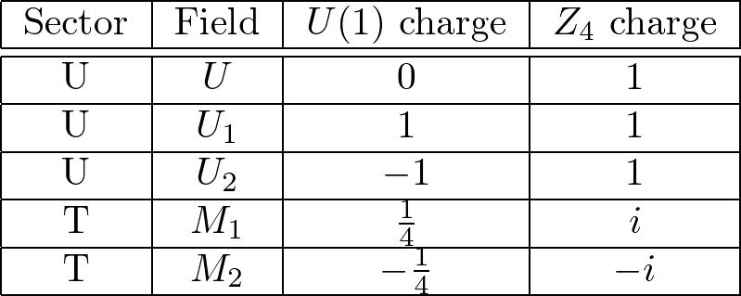

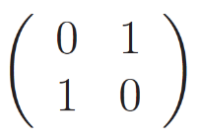
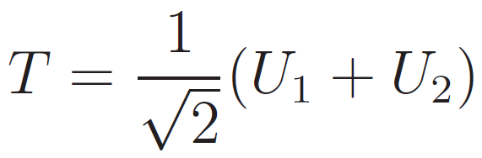


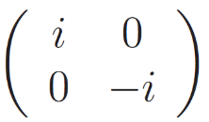
Gauge origin of discrete flavor symmetry
1-dimensional orbifold model at symmetry enhance point
-- Massless spectrum of U(1) orbifold theory
-- This model has symmetry :
Z2 symmetry can be described by or
-- Non zero VEV of Kahler moduli field (radion) T breaks the U(1) symmetry to
Z4 Abelian discrete symmetry
Z4 symmetry can be described by

Slide 41
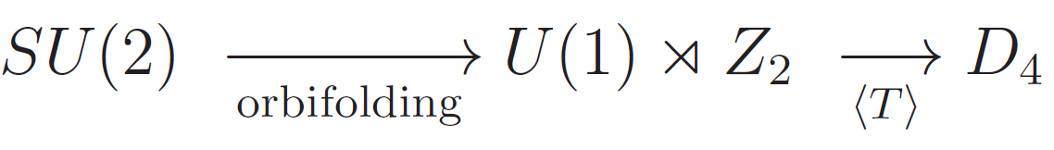

Gauge origin of discrete flavor symmetry
symmetry enhance point in moduli space
S1
U(1) gauge symmetry
SU(2) gauge symmetry
move away from enhance point
orbifold
S1/Z2
D4 discrete symmetry
U(1) gauge symmetry
-- Symmetry breaking patterns are summarized as

Slide 42
Gauge origin of discrete flavor symmetry
symmetry enhance point in moduli space (2-dim)
T2
enhance
U(1)^2 gauge symmetry
SU(3) gauge symmetry
orbifold
orbifold
T2/Z3
enhance
Δ(54) discrete symmetry
U(1)^2 gauge symmetry
・ Δ(54) non-Abelian discrete symmetry is enhanced to U(1)^2 continuous gauge symmetry

Slide 43
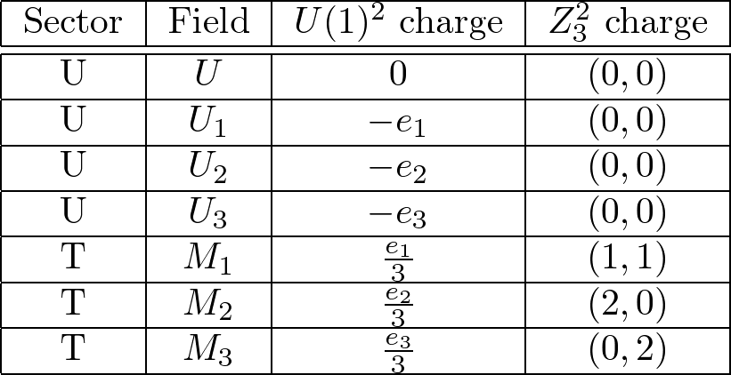

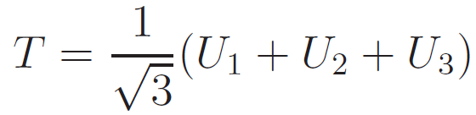

Gauge origin of discrete flavor symmetry
2-dimensional orbifold model at symmetry enhance point
-- Massless spectrum of U(1)^2 orbifold theory
: Simple roots of SU(3)
-- This model has symmetry :
-- Non zero VEV of Kahler moduli field (radion) T breaks the U(1)^2 symmetry to
Z3 x Z3 Abelian discrete symmetry

Slide 44
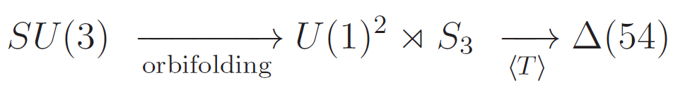

Gauge origin of discrete flavor symmetry
symmetry enhance point in moduli space
T2
U(1)^2 gauge symmetry
SU(3) gauge symmetry
T2/Z3
orbifold
move away from enhance point
Δ(54) discrete symmetry
U(1)^2 gauge symmetry
-- Symmetry breaking patterns are summarized as

Slide 45



Field-theoretical application
The previous result in string models
Beye, Kobayashi, Kuwakino
arXiv: 1502.00789 [hep-ph]
suggests that theory or theory can be an origin of non-Abelian discrete symmetries
-- Generalization of denominator of U(1) charge to N
Gauge extensions of phenomenologically interesting non-Abelian discrete symmetries

Slide 46

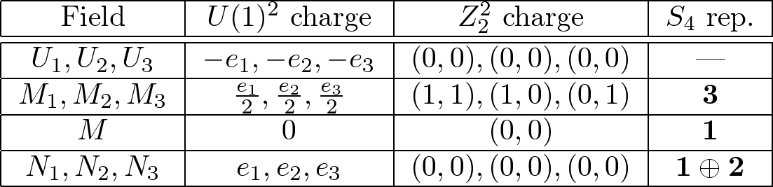
non-Abelian discrete symmetry
model ( )
: Simple roots
of SU(3)
・ VEV relation maintains S3, but breaks U(1)^2 → Z2^2.
・ Resulting symmetry is

Slide 47


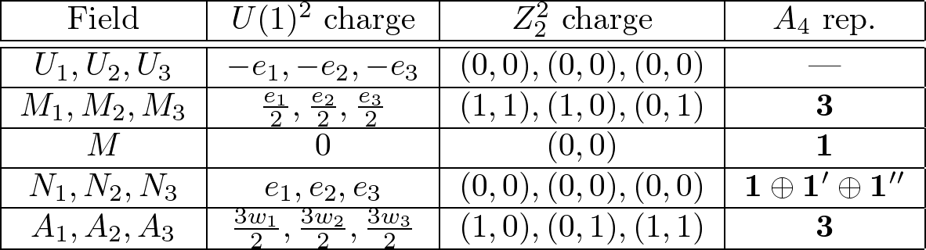

non-Abelian discrete symmetry
model ( )
: Simple roots
of SU(3)
: Fundamental weights
of SU(3)
・ Field A_i breaks
・ VEV relation maintains Z3, but breaks U(1)^2 → Z2^2.
・ Resulting symmetry is

Slide 48
U(1) flavor model

Slide 49

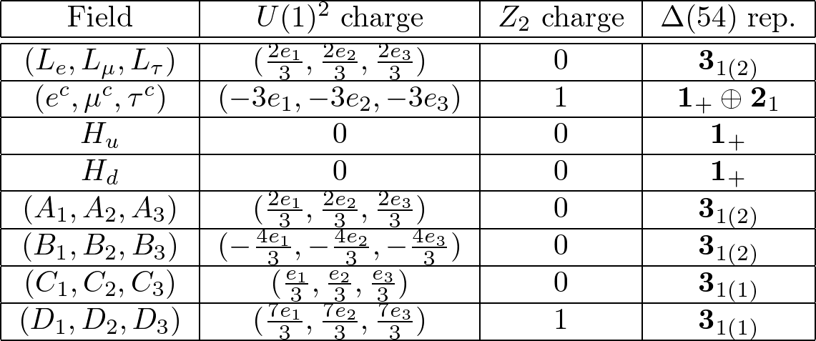
lepton flavor model
model
・ Gauge extension of Δ(54) discrete lepton flavor model
: Simple roots
of SU(3)

Slide 50
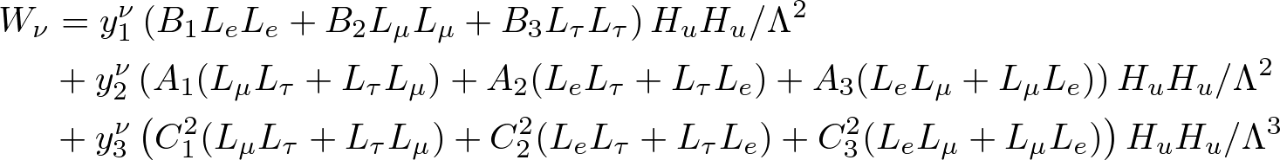
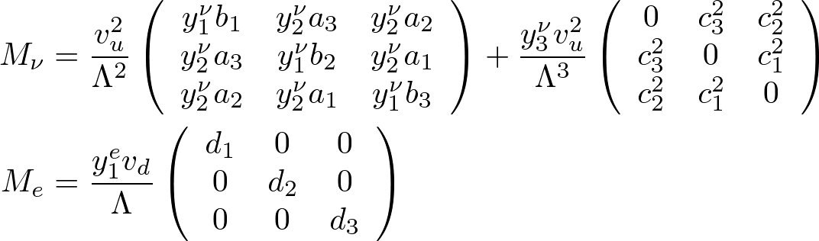
lepton flavor model
・ Superpotential for neutrinos and charged leptons ( invariance )
・ Mass matrices
・ Flavon superpotential

Slide 51
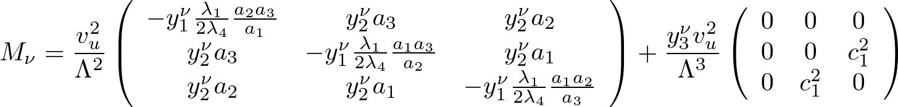
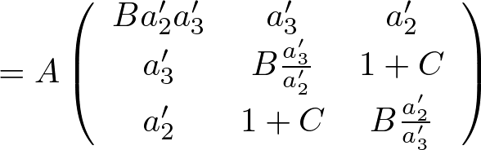
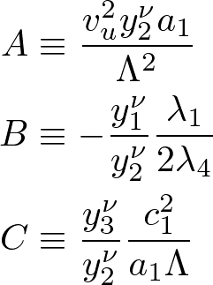
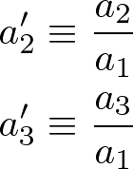



lepton flavor model
・ By solving vacuum structure, neutrino mass matrix becomes
・ We consider the case of real mass matrix and inverted hierarchy for simplicity.
5 real parameters
Oscillation parameters
fitting
for simplicity
prediction

Slide 52
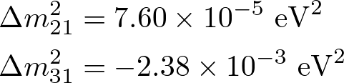



lepton flavor model
・ Choosing suitable parameters, we can fix experimental values
Several values for angles and
・ Prediction of our model : against angles and
・This solution is consistent with 2σ range of recent fits from neutrinoless double beta decay

Slide 53
Summary
Z3 asymmetric orbifold compactification of heterotic string
Our starting point : Narain lattice
90 lattices with right-moving non-Abelian factor can be constructed from 24 dimensional lattices
We calculate group breaking patterns of Z3 models
Three generation SUSY SM / left-right symmetric model
Z6 three-generation model
Outlook: Search for a realistic model
-- Search for Z3 models from other lattices
-- Other orbifolds Z6, Z12, Z3xZ3…
-- Yukawa hierarchy
-- (Gauge or discrete) Flavor symmetry,
-- Moduli stabilization, etc.

Slide 54
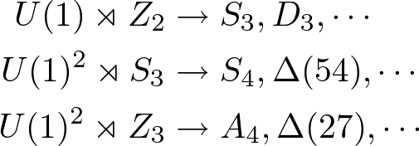
Summary
(Non-)Abelian gauge origin of non-Abelian discrete flavor symmetry
This can be understood naturally in orbifold string models
Phenomenologically interesting non-Abelian discrete symmetries can be realized from U(1) theories with a permutation (rotation) symmetry
We apply this mechanism to lepton flavor model
Outlook : Realization in string theory
Higher dimensional gauge theory
Z’ boson(s) from U(1) breaking may relate to origin of Yukawa hierarchy
U(1) theory
Flavor structure
(discrete flavor symmetry)
Z’ boson
Z' bosons as a probe of flavor structure ?

