Slide 1
新しいラージN極限と インスタントン
柴 正太郎
2014/04/30 @ 益川塾
畔柳さん、花田さん、本多さん、松尾さんとの共同研究に基づく。arXiv:1307.0809 [hep-th] (accepted by JHEP)

Slide 2
From Strings to M !!
D-branes
M-branes
BLG theory & ABJM theory for M2-branes (2007, 2008)
5d/6d equivalence for M5-branes (2010)

Slide 3
Large-N limit?
4d SU(N) super Yang-Mills theory
In usual, it means ‘t Hooft limit:
1/N expansion = genus expansion
The perturbative series (of λ) may have a finite radius of convergence at large-N.
→ Analytic continuation to strong ‘t Hooft coupling?
(cf. AdS/CFT correspondence in string theory. M-theory?)
Various nice properties (factorization, integrability, etc…)
(related to string theory!)

Slide 4
Super Yang-Mills theory
SU(N)
Action
N-dependence of amplitudes
Planar diagram (genus 0)
N⁻³ × N² × N³ = N²
(propagators) (vertices) (index loops)
Non-planar diagram (genus 1)
N⁻³ × N² × N¹ = N⁰
(propagators) (vertices) (index loops)
This is why the large-N limit is called “the planar limit”.
dominant!

Slide 5
Topology
More generally, － (# propagators) + (# vertices) + (# index loops) = 2-2(# genus) : It is known as Euler number.
sphere
(genus 0)
torus
(genus 1)

Slide 6
Relation to string theory
We consider the diagrams which can be drawn on genus-g surface, called “genus-g diagrams”.
They correspond to diagrams with g closed string loops. The amplitudes: (with λ fixed)
For example, in AdS/CFT correspondence, 4d N=4 SYM is equivalent to IIB string on AdS₅×S⁵ (by considering the bunch of D3-branes and ).
# genus = g
genus-g surface
= g closed string loops
…

Slide 7
String to M?
In string theory (in AdS/CFT correspondence),
classical gravity = planar limit (g_{s}→0, α’→0) (Only genus-0 diagrams dominate.)
g_{s} correction = 1/N correction (string coupling)
α’ correction = 1/λ correction ( ~ string length²)
But what about M-theory?
We need to consider the region of
Is there any large-N limit??

Slide 8
Another large-N limit
p=0 case
It is nothing but the ‘t Hooft limit.
p>0 case
We call it “very strongly coupled large-N limit”.
1/N expansion is different from genus expansion.
Application for M-theory? (p=1): (In ‘t Hooft limit, g_{YM} and g_{s} must become zero. )
Instanton effect becomes finite: (In ‘t Hooft limit, it is exponentially suppressed.)

Slide 9
Conjecture
The very strongly coupled large-N limit is well-defined and essentially the same as the ‘t Hooft limit.
More precisely: large-N limit and strong ‘t Hooft coupling limit commute.
When there is no “phase transition” (or as long as one considers the same point in the moduli space), the analytic continuation from the planar limit gives the right answer.
[Azeyanagi-Fujita-Hanada ’12]
[Azeyanagi-Hanada-Honda-Matsuo-SS ’13]

Slide 10
[Azeyanagi-Fujita-Hanada ’12]
[Azeyanagi-Hanada-Honda-Matsuo-SS ’13]
(string)
IIA SUGRA
(M)
11d SUGRA
strong coupling limit
(analytic continuation, if no transitions)
planar limit
essentially
planar limit!
p=0
‘t Hooft limit
p=1
very strongly coupled
large-N limit

Slide 11
Observation: Analytic continuation to M-theory

Slide 12
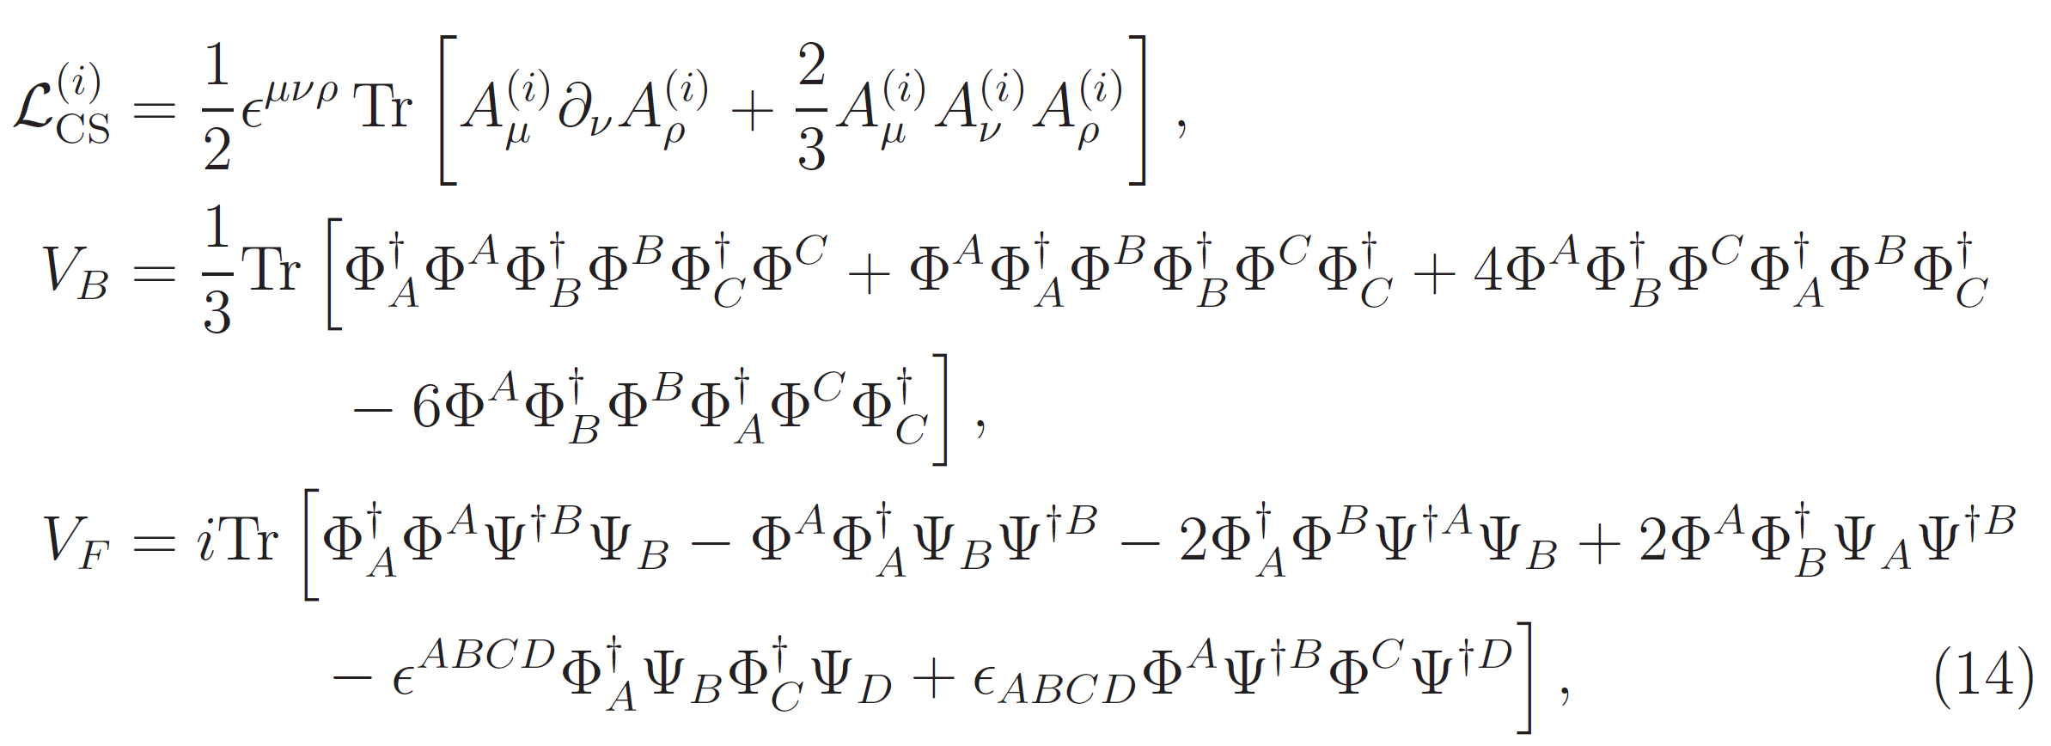
Effective theory on M2-branes
ABJM theory (dual to M-theory on AdS₄ x S⁷/ Z_{k} )
where
Chern-Simons level
U(N)×U(N) gauge group

Slide 13
(D2-branes)
IIA string
(M2-branes)
M-theory
strong coupling limit
(analytic continuation)
‘t Hooft limit
very strongly coupled
large-N limit
Tree-level string (α’ correction)
Perturbative
gauge theory

Slide 14
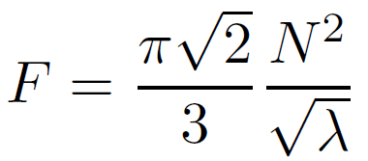
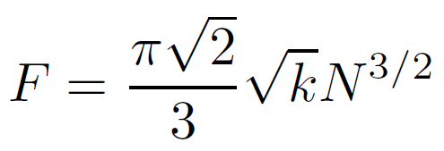
Free energy
We can calculate it by using ABJM matrix model (which is derived by using localization technique).
It agrees with SUGRA predictions. (We checked it smoothly connects them and perturbative ones.)
In IIA string region:
In M-theory region:
Analytic continuation from to
[Kapustin-Willett-Yaakov ’09]
[Drukker-Marino-Putrov ’10]
[Hanada-Honda-Honma-Nishimura-SS-Yoshida ’12]
the same
expression!

Slide 15
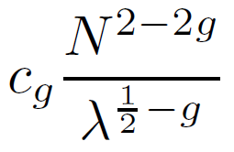
Planar part is dominant!
even in M-theory region!
N-dependent in M-theory region
AdS/CFT tells us that, at strong coupling, α’-expansion (1/λ-expansion) is good, at least in IIA string region.
Then, only the leading term in each F_{g} is important.
For F₀ (g=0) : , For F_{g} (g>0) :
The planar part (g=0) dominates even outside the planar limit :

Slide 16
What about M5-branes?
Effective field theory is not known yet.
Recently, however, the special class (called “class S”) of 4d N=2 theories has been widely studied as the theory of M5-brane on 2d punctured Riemann surface.
special (simple) examples
4d N=2* SYM :
mass deformation
4d N=4 SYM (maximal SUSY) : Effective theory on D3-branes (IIB string on AdS₅×S⁵)
[Gaiotto ’09]
main topic of this seminar

Slide 17
Example 1: 4d N=4 SYM

Slide 18
AdS₅/CFT₄ correspondence
[Maldacena ’97]
4d N=4 SYM is equivalent to IIB string on AdS₅×S⁵ :
Perturbative string picture is valid when
In usual, one takes the ‘t Hooft limit first and then consider strong ‘t Hooft coupling. (tree-level string)
Or one consider large-but-finite-N with λ=O(1), so that 1/N expansion and string loop expansion coincide.
However, such limit is not required for the validity of the weakly coupled gravity description.

Slide 19
Very strongly coupled large-N
[Azeyanagi-Fujita-Hanada ’12]
When there is gravity dual:
f_{0,0} dominates as long as
At , it is simply the same expression as the planar limit. So the very strongly coupled limit exists!!
In addition, the analytic continuation to can be confirmed by using S-duality.
=
SUGRA

Slide 20
Example 2 (main topic): 4d N=2* SYM
[Azeyanagi-Hanada-Honda-Matsuo-SS ‘13]

Slide 21
Free energy
4d N=2* SYM can be obtained by mass deformation of N=4 SYM. Here we consider N=2* U(kN) SYM.
Free energy is calculated by using Nekrasov’s formula.
g_{p} is YM coupling and a_{i} are Coulomb parameters (moduli).
Classical part : almost the same as N=4 case
Perturbative part : 1-loop quantum effect
Instanton part : non-perturbative contribution
perturbative
instanton
classical

Slide 22
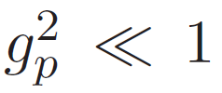
Perturbative part
This sector takes the same expression in the ’t Hooft limit and the very strongly coupled large-N limit. That is, they are related by “analytic continuation”.
The conditions in this expression are as follows:
We need to use the saddle point method for the integral of a, so we assume , or equivalently,
We use the spectral density of a for which obeys the semi-circle law.
[Douglas-Shenker ’95]
[Russo-Zarembo ’12]

Slide 23
One-instanton part
for the Young tableau
Compared to the perturbative part, it is subdominant in the both limits. But a different point is:
In the ‘t Hooft limit, it is exponentially suppressed as ~ e^{-N}.
In the very strongly coupled large-N limit (g_{p}~1), it may give comparable contribution O(N⁰) as the genus-one diagrams in the perturbative sector.
b
a
: interactions between instantons

Slide 24
(Whole of) free energy
By summing up all the parts and by taking into account the multi-instanton configurations, one obtains
Note that the interaction between instantons is negligible.
Then the free energy for generic tableaux decomposes to a sum of contribution from each eigenvalue a as
In both limits the planar part (~ N²) is dominant and they are related by “analytic continuation”.
perturbative part
instanton with only

Slide 25
Further evidence: Orbifold equivalence
[Azeyanagi-Hanada-Honda-Matsuo-SS ‘13]

Slide 26
4d N=4 SYM
[Kachru-Silverstein ’98]
AdS/CFT
In this discussion, the planar limit is not really necessary: classical gravity discussion is the key.
From the gauge theory viewpoint, the equivalence is gone as soon as the nonplanar diagrams are taken into account.
4d N=4 U(kN) SYM
IIB string on AdS₅×S⁵
orbifold equivalence
orbifold equivalence
4d N=4 [U(N)]^{k} SYM
IIB string on AdS₅×S⁵/Z_{k}
AdS/CFT
In the gauge side, correlation func. of Z_{k}-invariant operators coincide with that in the orbifolded theory.
In the gravity side, Z_{k}-invariant modes do not distinguish these two theories.

Slide 27
4d N=2* SYM
[Azeyanagi-Hanada-Honda-Matsuo-SS ’13]
When the daughter theory keeps N=2 SUSY, one can easily confirm the orbifold equivalence by using the Nekrasov’s formula. In both large-N limits,
The equivalence holds at each instanton sector. (The sector with the same total number of instantons.)
“parent”: N=2* U(kN) gauge theory
kN
Z_{k} orbifolding
N
“daughter”: N=2 [U(N)]^{k} necklace quiver
N
N

Slide 28
Towards SYM with less SUSY
The orbifold equivalence requires that the vacuum structures of the parent and daughter theories be properly related.
When the number of instantons and anti-instantons is O(1), the vacuum structures don’t change, so the equivalence holds.
However, when it becomes O(N), the vacuum structures in the very strongly coupled large-N limit are modified and hence careful identification of the right vacua is required.
“parent”
4d N=2 SYM
“daughter”
YM with less SUSY
Z_{k} orbifolding
You can use Nekrasov’s formula.
You can take it to be non-SUSY!

Slide 29
Conclusion and Discussion
Both in the very strongly coupled large-N limit and in the ‘t Hooft limit, the planar sector is dominant.
In addition, the two large-N limits are smoothly related by analytic continuation. (No transitions in our cases.)
Application for 4d N=2 theories in “class S”
Gauge/gravity correspondence in M-theory?
11d SUGRA, corresponding to “planar” in gauge theory side, may know the instantons in the large-N limit with fixed g_{YM}!
On-shell action of 11d SUGRA
(Gaiotto-Maldacena geometry)
??
Free energy of
4d N=2 gauge theory
=
[Azeyanagi-Hanada-Honda-Matsuo-SS, in progress]

