Slide 1
26 Jan 2013@京産大
Implication of 126 GeV Higgs
for Planck scale physics
Satoshi Iso (KEK, Sokendai)
with Y.Orikasa (Osaka) 1210.2848 to appear in PTEP
Higgs was discovered at
M_{H} =126 GeV
No evidence
of “new” physics
@ ATLAS,CMS & LHCb
What is the implication of these two?
together with some phenomena beyond SM
(ν oscillation, Baryon asymmetry, Dark matter)

Slide 2
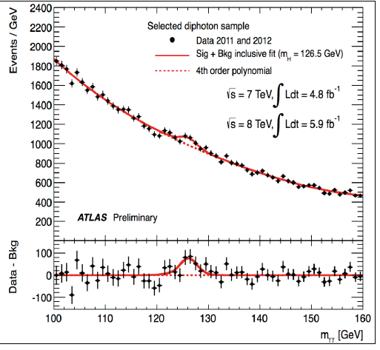
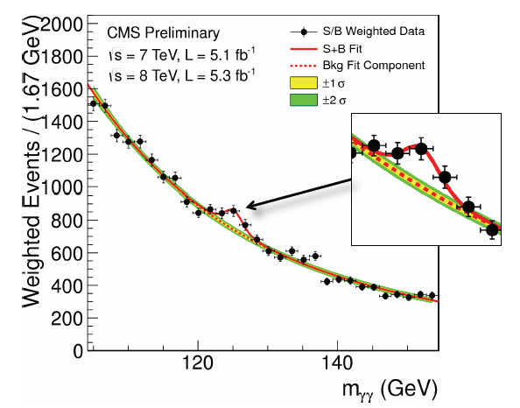
Brief summary of July 4th 2012
Discovery of Higgs(-like particle) was reported by CMS and ATLAS groups:
7 TeV L= 5.2 /fb (2011) + 8 TeV with L= 5.1 /fb for 3 months in 2012
Mh = 125.8 ± 0.4 GeV (stat)± 0.4 GeV (sys) CMS
126.0 ± 0.4 GeV (stat)± 0.4 GeV (sys) ATLAS
→ Now 12.2 /fb
ATLAS H → 2 gamma
CMS H → 2 gamma

Slide 3
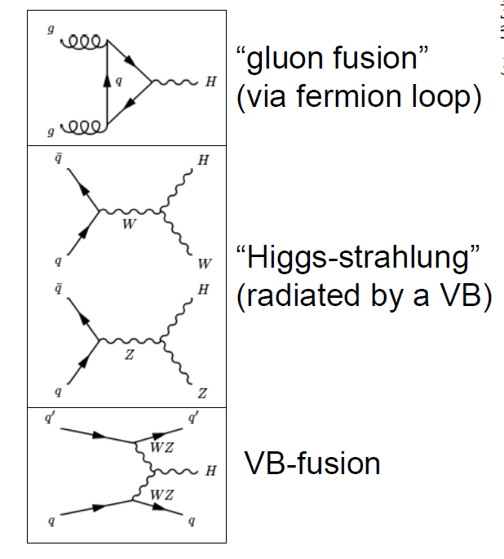
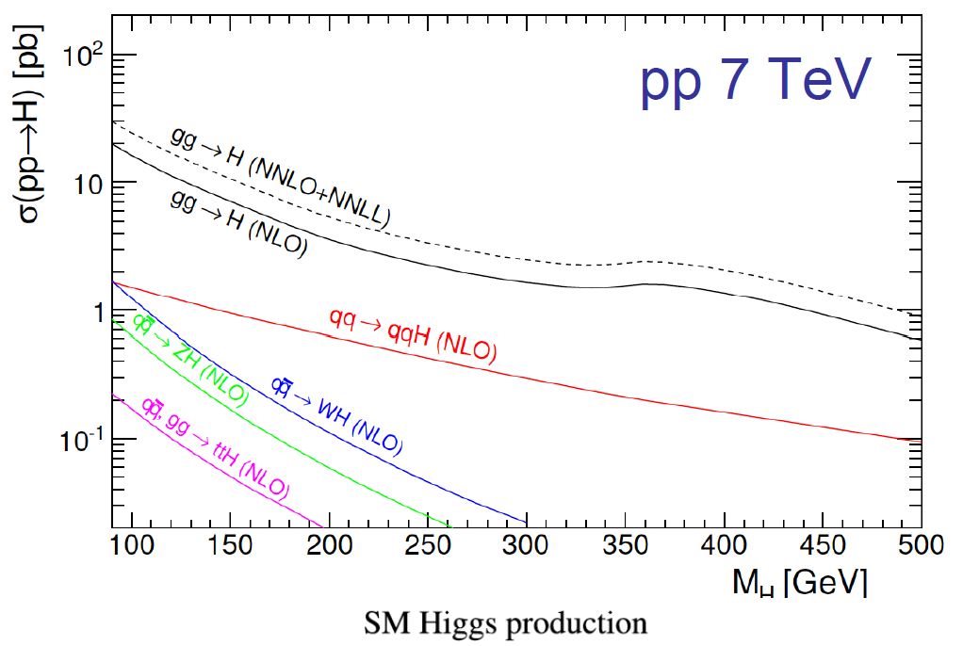
Production of SM Higgs

Slide 4
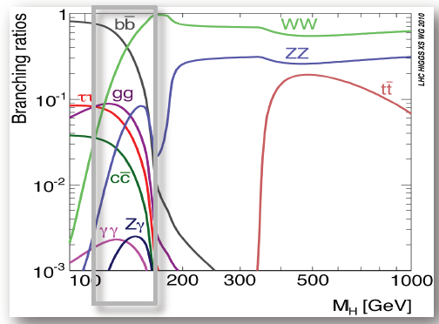
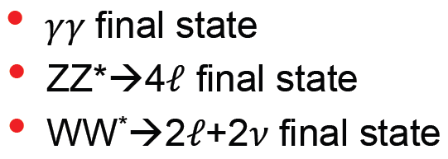


Decay modes of SM Higgs
3 major channels for low mass Higgs
1% mass
resolution
Another useful decay modes

Slide 5

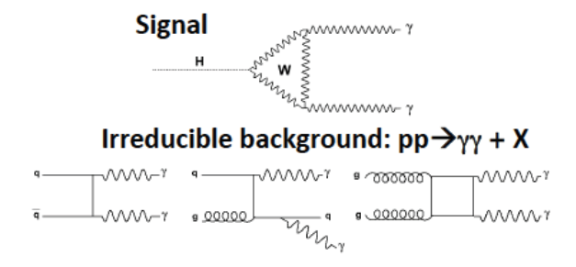
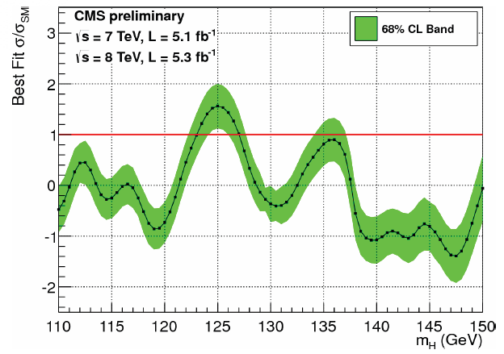
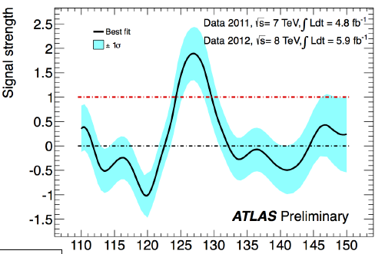


CS is low (50 fb), but relatively clean bkg
→ around 250 events are expected @ 5 /fb
→ 170 events @ efficiency 40 % (ATLAS) in 6340 backgrounds
Both of CMS and ATLAS reported
slightly larger events than SM expected
but not inconsistent with SM result.
New particles may contribute to the loop.
CMS
ATLAS
SM
SM

Slide 6

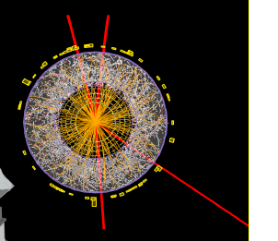

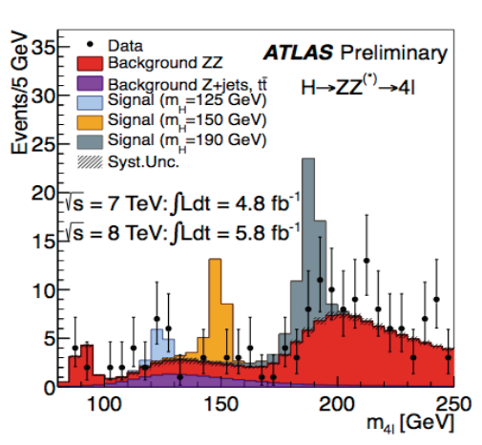
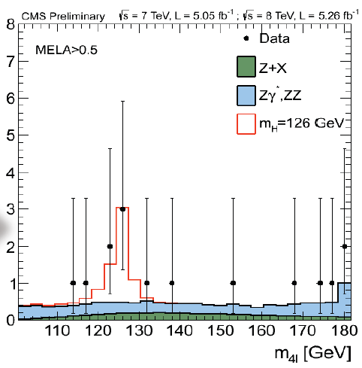
Gold plated mode
CMS

Slide 7


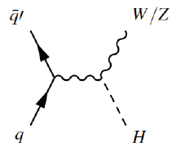

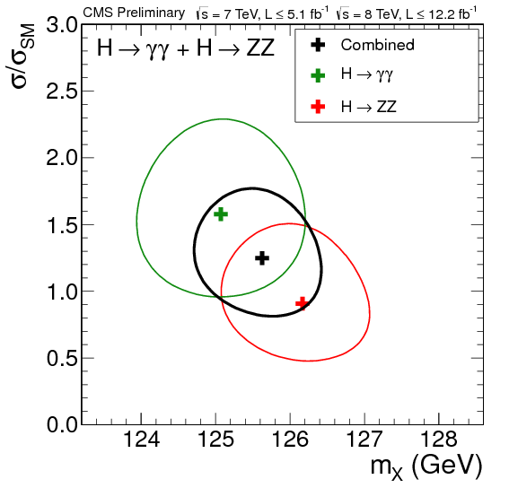
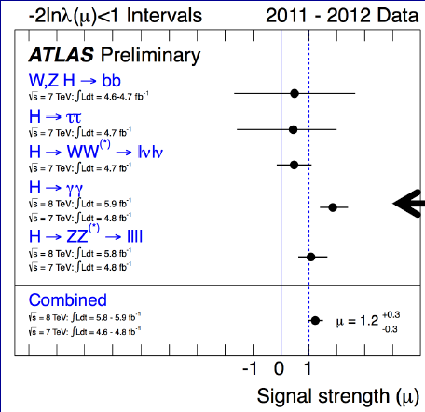
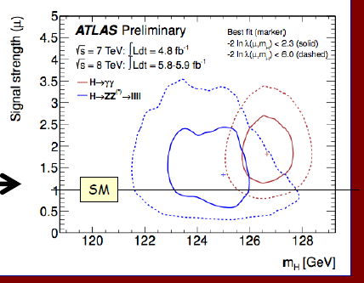
CMS
combining all decay modes
Mh = 125.8 ± 0.4 ± 0.4 GeV (CMS)
126.0 ± 0.4 ± 0.4 GeV (ATLAS)
SM
ATLAS
SM

Slide 8
125-6 GeV Higgs
Almost consistent with Standard Model Higgs
But slightly larger events of H → 2 photon than SM prediction
LHC will run until this winter before upgrade to 13-14 TeV
3 times data will be collected
new physics search
They will give new data analysis at Moriond
Stay tuned.

Slide 9
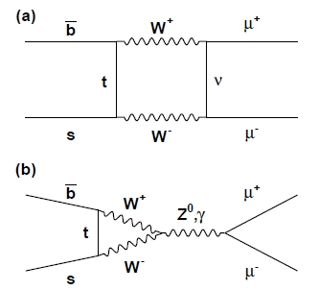
What can we learn from the current data?
Higgs mass 126 GeV
No evidence beyond SM
Higgs decay
Flavor physics: LHCb, B-factory, MEG
(e.g. Br(Bs → μμ) = 3.2 ^{+1.5} _{-1.2}×10⁻⁹ )
consistent with SM (3.2±0.2)×10⁻⁹.
It is a good time to reconsider
“the central dogma” of particle physics
GUT → hierarchy problem → TeV SUSY

Slide 10
Hierarchy problem

Slide 11




Naturalness (Hierarchy problem)
Quadratic divergence
Quadratic divergence in Higgs mass term
Cancellation of Quadratic divergence
(supersymmetry etc.)

Slide 12





Bardeen (1995 @ Ontake summer school)
Standard model is classically scale invariant if Higgs mass term is absent.
Quantum anomaly breaks the invariance (if not conformal )
The common wisdom is that the breaking is not soft and we have
Bardeen argued that it should be

Slide 13
Hierarchy problem
Is quadratic divergence the issue of hierarchy problem?
NO
Bardeen(1995)
H Aoki, SI PRD(2012)
There are 3 different types of divergences
Quadratic divergences Λ²
Logarithmic divergences m² log Λ
Logarithmic but looks like quadratic M² log Λ

Slide 14
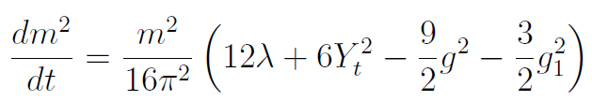

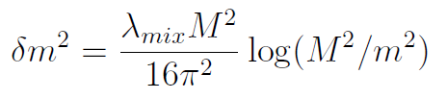
Quadratic divergence can be simply subtracted,
so it gives a boundary condition at UV cut off Λ.
→ If massless at Λ, it continues to be so in the IR theory.
(2) No Higgs mass term is generated in SM through RGE
(multiplicatively renormalized)
(3) If SM is coupled with a massive particle with mass M,
logarithmic divergences give a correction to m as

Slide 15
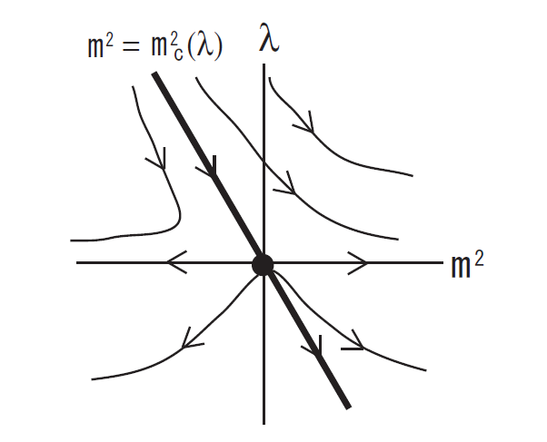


Hierarchy problem in Wilsonian RG
H Aoki, SI PRD(2012)]
Critical line
*
*
FP
FP
With quadratic div.
No quadratic div.
Fine - tuning of the distance from the critical line = Low energy mass scale
The difference is the choice of the coordinates of the parameter space.

Slide 16
In order to solve the “hierarchy problem” without a special
cancellation like supersymmetry, we need to control
(a) “quadratic divergence” → correct boundary condition at Planck
The most natural b.c. is NO MASS TERMS at Planck
( = classical conformal invariance)
(b) “radiative corrections” by mixing with other relevant operators
No intermediate scales between EW (or TeV) and Planck
“Classical conformal theory with no intermediate scale”
can be an alternative solution to hierarchy problem.
Bardeen (95)
Shaposhnikov (07)
Meissner Nicolai (07)
SI, Okada,Orikasa (09)

Slide 17
Stability of Vacuum

Slide 18

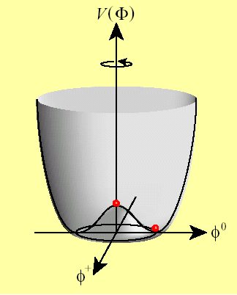

Another Hint of 126 GeV Higgs mass is
Stability bound of the Higgs quartic coupling

Slide 19
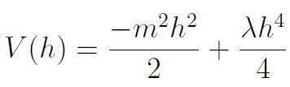



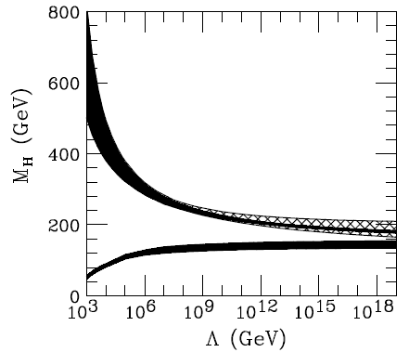
Higgs potential
RGE improved effective potential for large field (h >> v)
RGE @1-loop
Already known
It is related to Higgs mass as
Higgs mass controls the behavior of Higgs potential at large values of h.
This gives two bounds for Higgs mass
(1) The quartic coupling does not blow up until UV cut-off.
M < 180 GeV (triviality bound)
(2) The quartic coupling does not become negative
until UV cut-off. (Stability bound)
M = 125 GeV Higgs is very close to the stability bound.
125

Slide 20
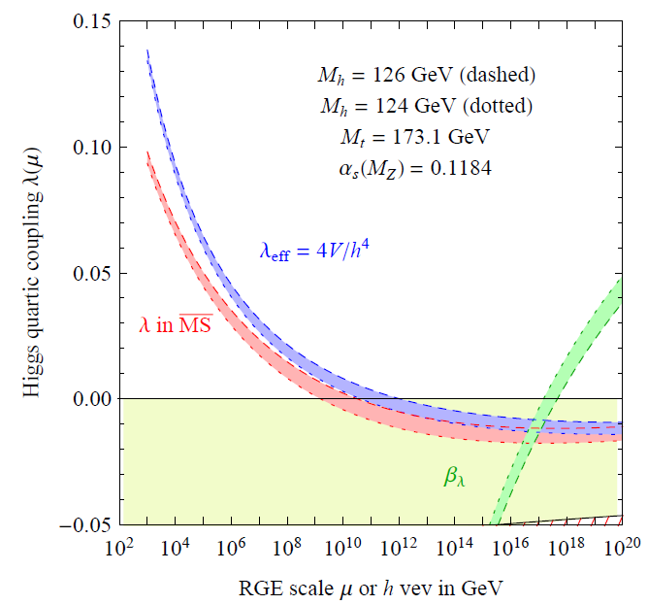
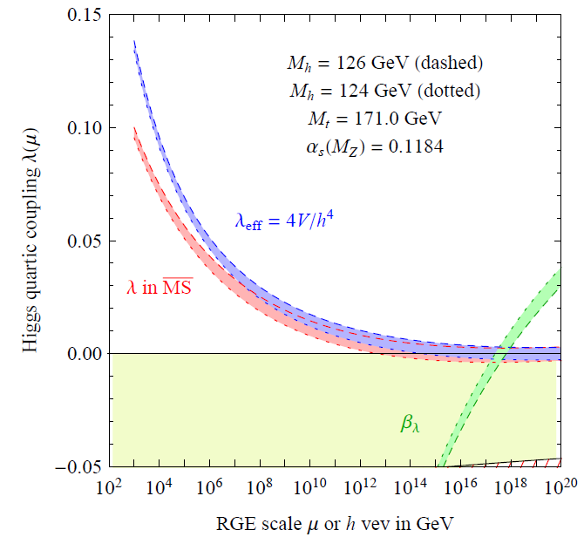
Why stability bound is important for Planck scale physics?
New physics at 10¹² GeV
is necessary to stabilize the vacuum
Flat Higgs potential
at Planck scale
very sensitive to top quark mass
Elias-Miro et.al.(12)
Shaposhnikov et.al. (12)

Slide 21

If this is the case ?
Direct window to Planck scale
M.Shaposhnikov (07)

Slide 22
Emergence of
Higgs potential

Slide 23

Indication of LHC on Higgs potential
Hierarchy
(classical conformality)
Stability
Vanishing at Planck
LHC experiment implies that
Higgs has a flat potential V(H)=0 at Planck.

Slide 24

Higgs potential
Potential minimum
Spontaneous Symmetry
Breaking
Higgs particle

Slide 25
How can we realize EW symmetry breaking
from V(H)=0 potential at Planck?
Everything should be
radiatively generated.

Slide 26

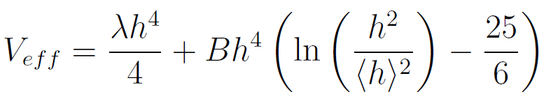
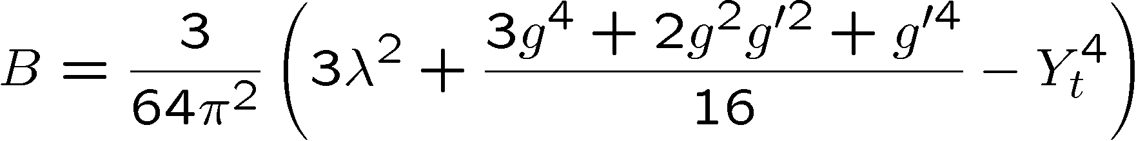
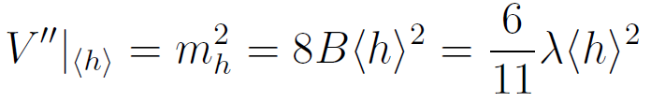
Two mechanisms of symmetry breaking
（１）SSB by negative mass term
（２）Coleman-Weinberg mechanism (radiative breaking)
tree
1-loop
Higgs mass is given by

Slide 27

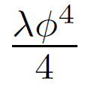
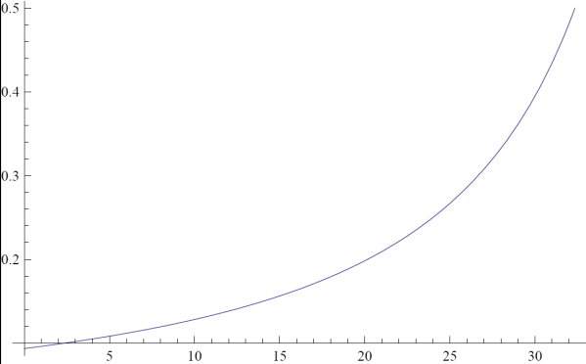

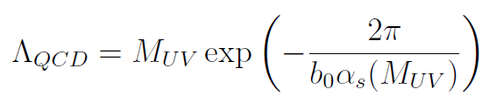
（2’） RG improved CW mechanisms
Coleman-Weinberg radiative breaking
Symmetry is broken near
the scale where the
coupling crosses zero.
Dimensional transmutation
cf. Dimensional transmutation in QCD

Slide 28
But CW does not work in SM.
the large top Yukawa coupling invalidates the CW mechanism
Extension of SM is necessary !
Meissner Nicolai (07)
(B-L) extension of SM with flat Higgs potential at Planck
B-L sector
・U(1)B-L gauge
・SM singlet scalar φ
・Right-handed ν
SM
N Okada, Y Orikasa,
& SI
0902.4050 (PLB)
0909.0128 (PRD)
1011.4769 (PRD)
1210.2848(PTEP)
“Occam’s razor” scenario
that can explain ・ 126 GeV Higgs
・ hierarchy problem
・ ν oscillation, baryon asymmetry

Slide 29
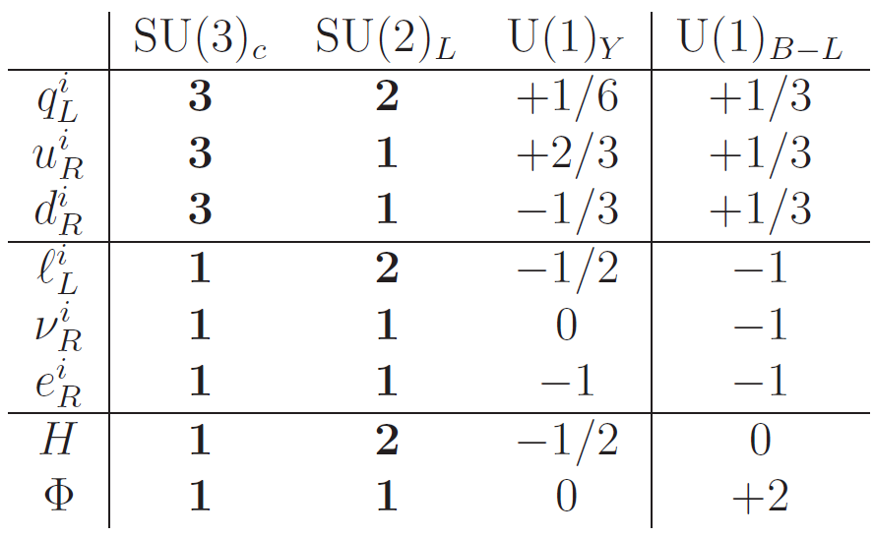

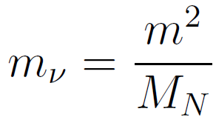
Model: (B-L) extension of SM with Right Handed Neutrinos
N Okada, Y Orikasa, SI
PLB676(09)81,
PRD80(09)115007
PRD83(11)093011
H Higgs doublet
B-L sector scalar field
・B-L is the only anomaly free global symmetry in SM.
・[U(1)_{B-L}]³ is anomaly free if we have right handed fermion.
・B-L gauge symmetry is broken by vev of an additional scalar.
See-saw mechanism

Slide 30

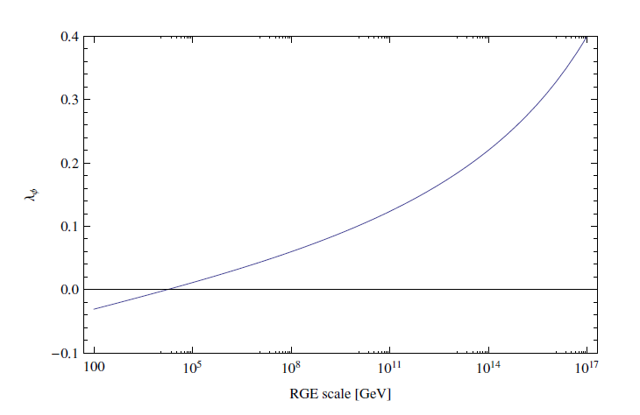



Flat Higgs potential at Planck scale
classically
conformal
126 GeV
key to relate EW and TeV
CW mechanism
in B-L sector
TeV
Planck
B-L can be broken by CW mechanism at TeV.

Slide 31

How about EWSB ?
Can the small scalar mixing be realized naturally?
YES
Radiatively generated scalar mixing λ_{mix} in V(H)
triggers EWSB

Slide 32
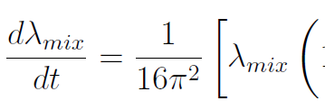








Why is small negative λ_{mix} generated?
********
********
U(1)_(B-L)
U(1)_Y

Slide 33
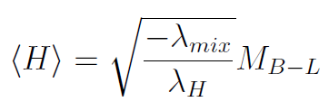
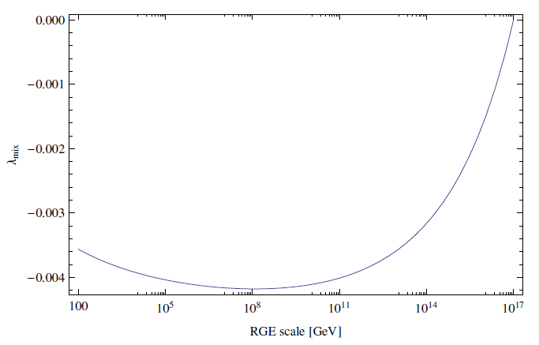
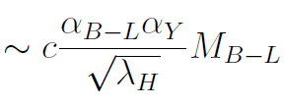


Running of Scalar mixing
small negative

Slide 34

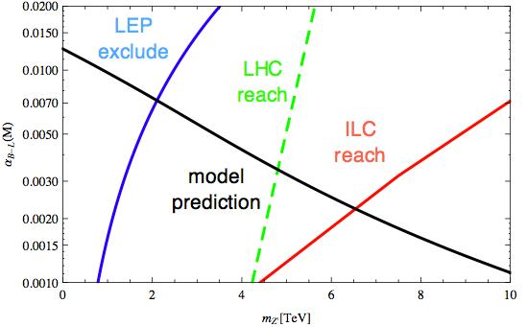



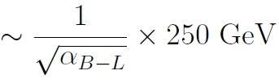



Prediction of the model
In order to realize EWSB at 246 GeV,
B-L scale must be around TeV (for a typical value of α_{B-L} ).
LHC reach
14 TeV 100 fb ⁻¹
ILC

Slide 35
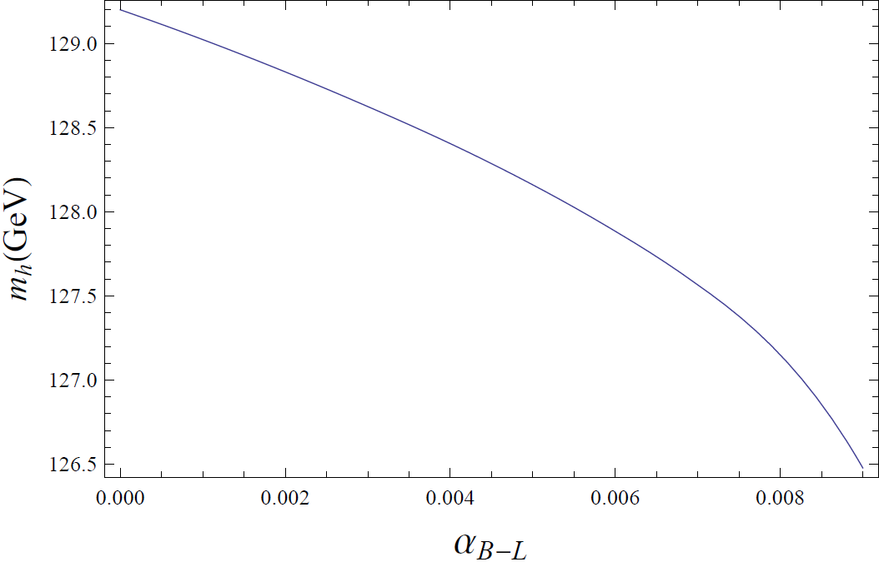
Stability bound in TeV scale B-L model
An extra positive term is added
Lower the
stability bound
Stability bound
In SM

Slide 36
Summary
・126 GeV Higgs = border of the stability bound of SM vacuum.
→ Direct window to Planck scale → Flat Higgs potential @Planck
Hint for the origin of Higgs in string theory
・Occam’s razor scenario beyond SM
“Classically conformal B-L model” is proposed
(1) it can solve hierarchy problem
(2) it can explain why B-L breaking scale is around TeV.
(3) Stability bound can be lowered about 1 GeV
M_{H} ~ 128 GeV
(4) phenomenologically viable
Neutrino oscillation, resonant leptogenesis
(5) Highly predictive (or excludable)
Prediction
Z’ around a few TeV, M_{φ} < M_{Z’} , Leptogenesis at TeV

Slide 37
Future perspectives
・ Origin of flat Higgs potential at Planck
Hierarchy problem & M_{H} =126 GeV
→ PNGB ? Moduli ? Gauge/Higgs ? …..
Non-susy vacua of superstring with flat V(H)
・ Resonant leptogenesis
Kadanoff-Baym equation (quantum Boltzman)
・ Non-susy GUT at Planck SO(10) or E6 type
Gravity or string threshold correction to RGE
Garny, Kartavsev, Hohenegger (11)

