Slide 1

クォーク・グルーオン・プラズマにおける「力」の量子論的記述
赤松 幸尚
(名古屋大学素粒子宇宙起源研究機構)
Y.Akamatsu, A.Rothkopf, PRD85(2012),105011 (arXiv:1110.1203[hep-ph] )
Y.Akamatsu, arXiv:1209.5068[hep-ph]

Slide 2
Contents
Introduction
In-Medium QCD Forces
Influence Functional of QCD
Dynamical Equations (I)
Dynamical Equations (II)
Summary & Outlook

Slide 3
1. Introduction

Slide 4
Confinement & Deconfinement
Vacuum Potential
Singlet channel
V(R)
T=0
R
String tension K ~ 0.9GeVfm⁻¹
Coulomb + Linear
The Schrödinger equation
Mass spectra (cc, bb)
_
_

Slide 5
Confinement & Deconfinement
In-Medium Potential
Debye screened potential
V(R)
T>TC
R
Debye mass ω_{D} ~ gT (HTL)
Debye Screened
Higher T
The Schrödinger equation
Existence of bound states (cc, bb)
→ J/Ψ suppression in heavy-ion collisions
_
_
Matsui & Satz (86)
What is the in-medium potential?

Slide 6
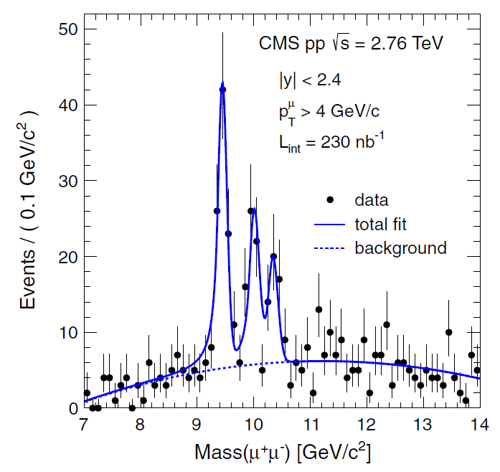
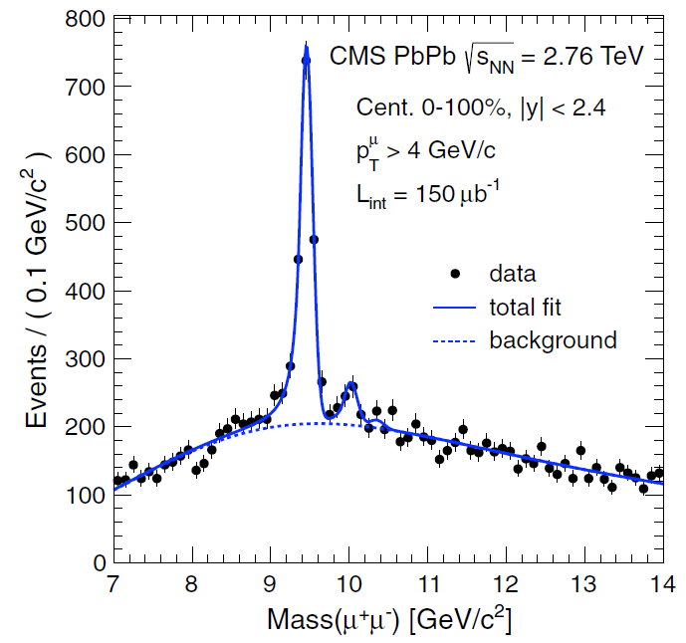
Quarkonium Suppression at LHC
CMS
Sequential melting of bottomonia
p+p
A+A

Slide 7
2. In-medium QCD forces
What is the in-medium potential?

Slide 8
In-Medium Potential
Definition
r
T=0, M=∞
R
Long time dynamics
t
σ(ω;R)
V(R) from large τ behavior
V(R)
ω

Slide 9
In-Medium Potential
Definition
T>0, M=∞
r
R
Long time dynamics
Lorentzian fit of σ(ω;R,T)
t
σ(ω;R,T)
i=0 i=1 …
(0<τ<β)
Γ(R,T)
V(R,T)
ω
Spectral decomposition

Slide 10
In-Medium Potential
Complex Potential
Laine et al (07), Beraudo et al (08),
Bramilla et al (10), Rothkopf et al (12).
Long time dynamics
Lorentzian fit of σ(ω;R,T)
Suggests stochastic & unitary description

Slide 11
In-Medium Potential
Stochastic Potential
Akamatsu & Rothkopf (‘12)
(T omitted)
Introduce noise field Θ(t,R)
Density matrix: Non-local correlation relevant
Imaginary potential
= Local correlation

Slide 12
In-Medium Forces
M<∞
Debye screened force
+
Fluctuating force
M=∞
(Stochastic) Potential force
→Hamiltonian dynamics
M<∞
Drag force
Non-potential force
Langevin dynamics
→Not Hamiltonian dynamics
How to describe in-medium QCD forces?

Slide 13
3. Influence functional of QCD
How to describe in-medium QCD forces?

Slide 14
Open Quantum System
sys = heavy quarks
env = gluon, light quarks
Basics
Hilbert space
von Neumann equation
Trace out the environment
Reduced density matrix
Master equation
(Markovian limit)

Slide 15
Closed-Time Path
1
Basics
2
Partition function

Slide 16
Closed-Time Path
Apply to QCD
Factorized initial density matrix
Influence functional
Feynman & Vernon (63)

Slide 17
Influence Functional
Open Quantum System
1
2
s
Path integrate until s, with boundary condition

Slide 18
Influence Functional
Functional Master Equation
Effective initial wave function
Effective action S1+2
→Single time integral
Long-time behavior (Markovian limit)
Analogy to the Schrödinger wave equation
Functional differential equation
How does this formalism work in perturbation theory?

Slide 19
4. Dynamical equations (I)
How does this formalism work in perturbation theory?

Slide 20
Approximations
Leading-Order Perturbation
Influence Functional
Expansion up to 4-Fermi interactions
Leading-order result by HTL resummed perturbation theory

Slide 21
Approximations
Heavy Mass Limit
Non-relativistic kinetic term
Expansion up to
Non-relativistic 4-current (density, current)
(quenched)

Slide 22
Approximations
Long-Time Behavior
Time-retardation in interaction
Low frequency expansion
Using free equation of motion

Slide 23
Effective Action
LO pQCD, NR Limit, Slow Dynamics
Stochastic potential
(finite in M→∞)
Drag force
(vanishes in M→∞)

Slide 24
Hamiltonian Formalism (technical)
Order of Operators = Time Ordered
Change of Variables (canonical transformation)
Kinetic term
Instantaneous interaction
or
Remember the original order
Make 1 & 2 symmetric
Determines without ambiguity

Slide 25
Hamiltonian Formalism (technical)
Variables of Reduced Density Matrix
Renormalization
Latter is better (explained later)
Convenient to move all the functional differential operators to the right in
In this procedure, divergent contribution from Coulomb potential at the origin appears → needs to be renormalized

Slide 26
Functional Master Equation
Renormalized Effective Hamiltonian

Slide 27
Functional Master Equation
Schrödinger wave equation
Anti-commutator in functional space
So what?

Slide 28
5. Dynamical equations (II)
So what?

Slide 29
Density Matrix
Coherent State
Source for HQs

Slide 30
Density Matrix
A few HQs
One HQ
Similar for two HQs, …

Slide 31
Master Equation
Functional Master Equation
Functional differentiation
Color traced
Master equation

Slide 32
Master Equation
HQ Number Conservation
Ehrenfest Equation
Moore et al (05,08,09)

Slide 33
Other Results
Complex Potential
Time-evolution equation + Project on singlet state
Laine et al (07), Beraudo et al (08), Brambilla et al (10)

Slide 34
Other Results
Stochastic Dynamics
M=∞ : Stochastic potential
Debye screened potential
Fluctuation
D(x-y): Negative definite
M<∞ : Drag force
Two complex noises c1,c2
→ Non-hermitian evolution

Slide 35
6. Summary & OUTLOOK

Slide 36
Quantum Dynamics of HQs in Medium
  Stochastic potential, drag force
Non-Equilibrium Quantum Field Theory
  Open quantum system, closed-time path, influence functional
  Functional master equation, master equation, etc.
Non-Perturbative Region
  Model the renormalized effective Hamiltonian
  Higher-order perturbative analyses (process involving real gluons)
  Application to phenomenology

